Slide 1
Week00
Hans the Announcement Parrot
🦜
introduce class
introduce self
take roll
syllabus
type
whitespace
scope
success tips
fix Eclipse installs
NOTE: lecture is recorded and posted ~noon same day
NOTE: Homework00 is due on Monday
NOTE: Help Hours start on Monday

Slide 2
record lecture!

Slide 3
introduce class

Slide 4
what is CS 136?
a computer science major requirement 🎉
a bridge between coding and theory
about how you store data (HINT: in an array)
harder problems
bigger problems
good prep for coding interviews 💸
going beyond "it works" to different measures of "good"
speed 🦔
space 🐘
elegance? ✨

Slide 5
introduce self

Slide 6
[other slide deck]

Slide 7
take roll

Slide 8
take roll
this is the only time i will ever take roll
this is also the only time i will wear a coat 😢
please correct me if i mispronounce your name
if you are not yet enrolled, please fill out the other sheet now

Slide 9
syllabus

Slide 10
syllabus

Slide 11
syllabus
🚌

Slide 12
syllabus
🚌
🪟

Slide 13
the syllabus is online https://github.com/james-bern/CS136/wiki

Slide 14
grading

Slide 15
final grade
final grade is 1/3 homework, 1/3 midterm exam, 1/3 final exam
homework is on an A- (90), A (95), A+ (100) scale
A- is meant to be doable
A is meant to be challenging
A+ is meant to be a growth opportunity 🪴
i will go over some of your homework with you during lab and ask you questions about it 🙂👍
exams are in-person, on-paper, no-notes
questions are either similar to homework, or similar to PracticeExam
"if you understand the (A- and A) homework, the exam should be unsurprising and approachable"

Slide 16
😈 ChatGPT

Slide 17
ChatGPT can do every homework in this class up to an A level 😈 it is impossible for me to prove whether or not you used ChatGPT (people who say otherwise are wronggg)

Slide 18
so, ChatGPT, etc. are "allowed," but...
you are not allowed copy and paste code from anywhere
bad bad very bad don't do it
(unless i gave you the code then it's fine 🙂👍)
you can't use ChatGPT, etc. on exams
😈 "if your coding job can be done by an AI, then it will be done by an AI"

Slide 19
collaboration

Slide 20
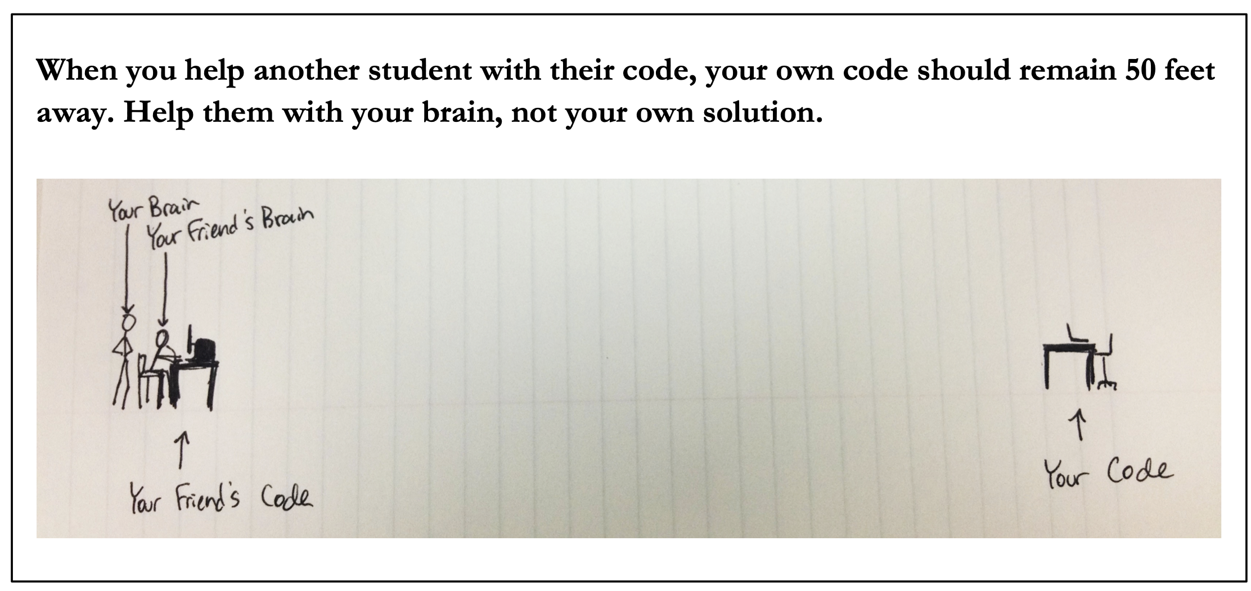
😈

Slide 22
Java

Slide 23
Java

Slide 24
☕️

Slide 25
this class is in Java

Slide 26
this class is in Cow.Java

Slide 27
which is basically C

Slide 28
by which I mean Java

Slide 29
type

Slide 30
type

Slide 31
a variable in Java has a type
# okay in Python
foo = 7 # foo is an int
foo = False # now, foo is a boolean
// NOT okay in Java
int foo = 7; // foo is an int
foo = false; // Error: incompatible types:
// boolean cannot be converted to int

Slide 32
declaring and initializing are separate things
// Option A: one line int foo = 7; // declare int foo and initialize it to 7
// Option B: two lines int foo; // declare a variable foo of type int foo = 7; // initialize foo to 7

Slide 33
primitive types

Slide 34
primitive types
in this class, "a variable being a primitive" means that the variable is a boolean, char, double, or int
primitive types are simple
primitive types are small
primitive types are NOT Objects
we will talk about Objects later
examples of Objects: String, MyCoolClass, int[] (array of ints)

Slide 35
boolean, char, double, int
a boolean stores a truth value
true, false
a char stores a character
'\0', 'a', 'Z', '!', '\n'
a double stores a real number
0.0, -0.5, 3.1415926, Double.NEGATIVE_INFINITY
an int stores an integer
0, -1, 4

Slide 36
primitive type Venn diagram
integers
numbers
char
double
boolean
int

Slide 37
char is an integer type
a char is an integer type
each char has a corresponding integer, for example ('a' == 97)
the letters are in order ('a' == 97), ('b' == 98), ('c' == 99)...
the numbers are also in order ('0' == 48), ('1' == 49)...
you can do math with char's
char foo = 'a' + 2; // foo is 'c'
char bar = '0' + 7; // bar is '7'
int baz = '6' - '0'; // baz is 6

Slide 38
zero
each primitive data type has its own notion of what it means to "be zero"
int zero = 0;
double zero = 0.0;
boolean zero = false;
char zero = '\0'; // the "null character"

Slide 39
whitespace

Slide 40
whitespace

Slide 41
whitespace
whitespace includes spaces, tabs, and newlines
🐍 Python does care about whitespace (indentation changes what code does)
☕️ Java does NOT care about whitespace (it cares about curly braces)
🗣️ do you care about whitespace?
some guidelines:
be consistent
make sure your curly braces line up
✨ use Eclipse's auto-indentation feature (see Tut00)! no excuses!
sparks joy | NOT equivalent -- doesn’t spark joy
for (int i = 0; i < 10; ++i) { if (i % 3 == 0) { System.out.println("fizz"); } } | for (int i = 0; i < 10; ++i) { if (i % 3 == 0) { } System.out.println("fizz"); }

Slide 42
scope

Slide 43
scope

Slide 44
scope
a scope is a region of code in which variables live
in Java, a scope is (usually) defined by a pair of curly braces
OUTER_SCOPE { INNER_SCOPE } OUTER_SCOPE
{
int i;
{
int j;
// you CAN use i here 🙆‍♂️
// you CAN use j here 🙆‍♂️
}
// you CAN use i here 🙆‍♂️
// you CANNOT use j here 🙅
}

Slide 45
common scope-related errors

Slide 46
cannot be resolved to a variable
Compile Error: foo cannot be resolved to a variable
class Main extends Cow {
public static void main(String[] arguments) {
if (...) {
int foo = 0;
} else {
int foo = 1;
}
PRINT(foo);
}
}

Slide 47
cannot be resolved to a variable
class Main extends Cow {
public static void main(String[] arguments) {
int foo;
if (...) {
foo = 0;
} else {
foo = 1;
}
PRINT(foo);
}
}

Slide 48
duplicate local variable
Compile Error: duplicate local variable foo
class Main extends Cow {
public static void main(String[] arguments) {
int foo;
if (...) {
int foo = 0;
} else {
foo = 1;
}
PRINT(foo);
}
}

Slide 49
duplicate local variable
class Main extends Cow {
public static void main(String[] arguments) {
int foo;
if (...) {
foo = 0;
} else {
foo = 1;
}
PRINT(foo);
}
}

Slide 51
success tips

Slide 52
success tips (1/3)
establish basic study habits (this might not have been necessary in highschool; it most likely is now)
start homework early! (very hard to code well while stressed)
don't work in a vaccuum
collaborate with your friends / acquaintences / enemies
come to help hours (they are there for you!)
code a lot (ideally, 5+ days per week)
if the homeworks are feeling too hard, talk to me; we have resources!
if the homeworks are too easy, do the A+ / A++; do side projects; just keep coding; code code code code code; COOOOOOOOODE

Slide 53
success tips (2/3)
try to find your own bugs
this is a huge skill; it takes time (and pain) to build
try to answer your own questions (using Google!) ("what does IDE stand for?"; "what does this error message mean?")
this is also a huge skill; it also takes time (and pain) to build
however, if you are stuck (>= 10+ minutes of pain), ASK FOR HELP
there is literally no judgement here; we all have different starting points; my only goal is for all students to get stronger and have fun 🙂👍
and, for what it's worth, i was a mechanical engineering undergrad and my first comp sci course was *terrifying* (though, eventually, fun)

Slide 54
most importantly though

Slide 55

you gotta push the button

Slide 58
come see me if you had trouble with Tut00 otherwise, see you in class on Monday 🌞

Slide 59
Week01
🦜
tips and tricks
operators
control flow
Cow.Java
WARMUP
foo = (2 * 5.0) - 1.0;
what type is foo?
what value is foo?
bar = (3 > foo);
what type is bar?
what value is bar?
char baz = 'A' + ('7' - '5');
what value is baz?

Slide 60
tips and tricks

Slide 61
"hot code replace failed" Eclipse message

Slide 62
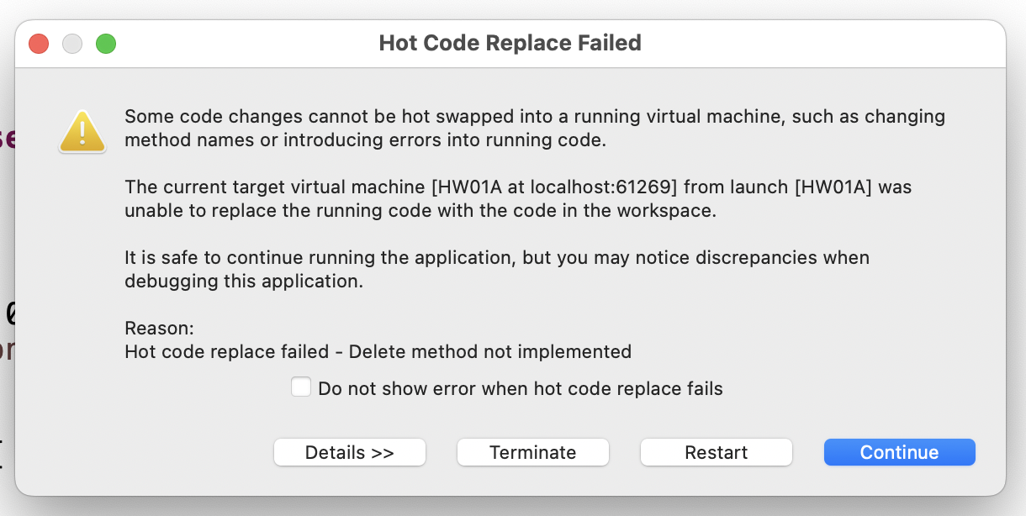
if you've been getting this error a bunch...

Slide 63
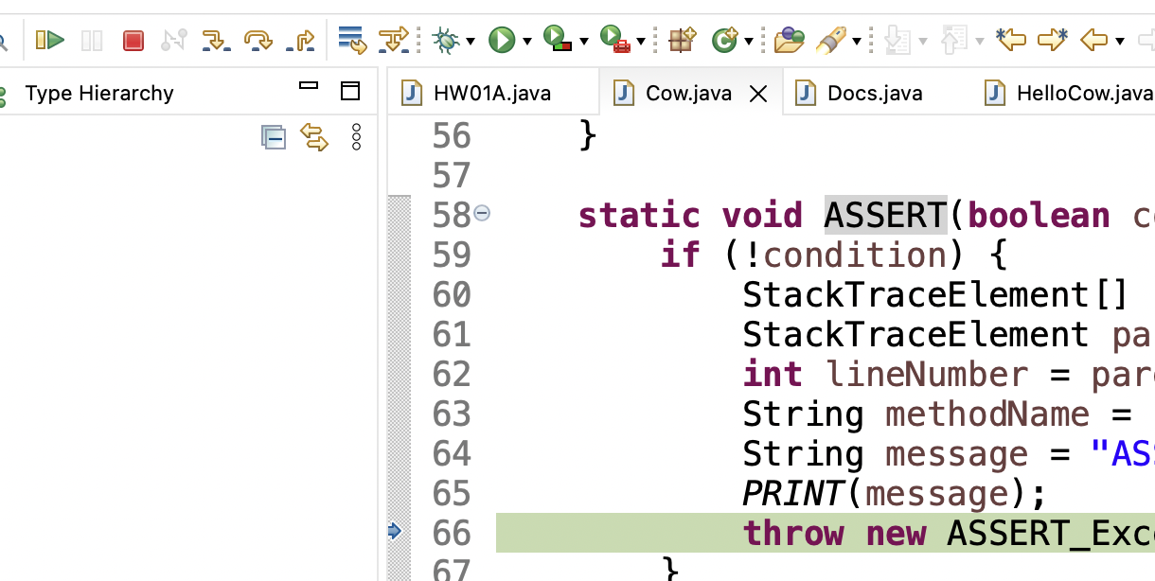
make sure you are pressing this button after every crash / failed assert (otherwise Eclipse keeps your program running, and will try to "hot swap" your changes into it)

Slide 64
you can also press this button (which, for us, does basically the same thing)

Slide 65
you can also just close Eclipse and reopen it if anything really weird happens 🤷

Slide 66
how to email jim

Slide 67
first, how to email not-jim
Subject Line: Question Regarding The Reading
Email Body:
Dear Prof. Dr. Professorson Ph.D Exquire,
I hope you are having a wonderful afternoon; that the morning sun is shining upon you this fine evening, and that you do not feel the quiet whisper of the all-consuming Void chilling you to your very core.
I am writing because I am unclear on the assigned reading for tomorrow. Your very, very helpful syllabus says to read pages 300 – 500 of Beowulf, however the book is, it seems, much fewer than 500 pages long.
Thank you so much for your help with this matter. I appreciate the time you take in supporting me in my studies—I could not do this without you.
Sincerely,
James Bern
Caltech '15

Slide 68
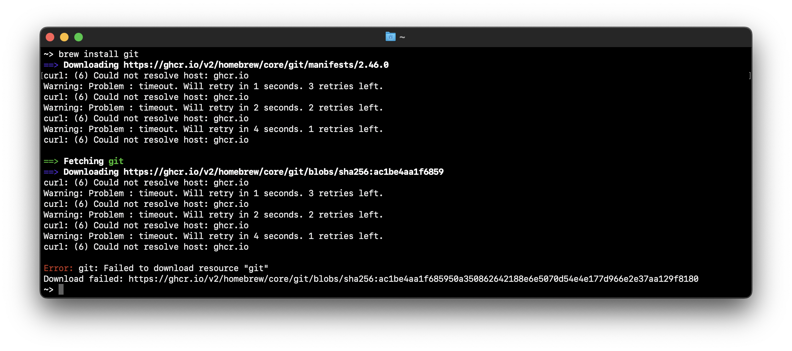
how to email jim
Reply to Q + A Thread
Email Body: brew won't install 😡

Slide 69
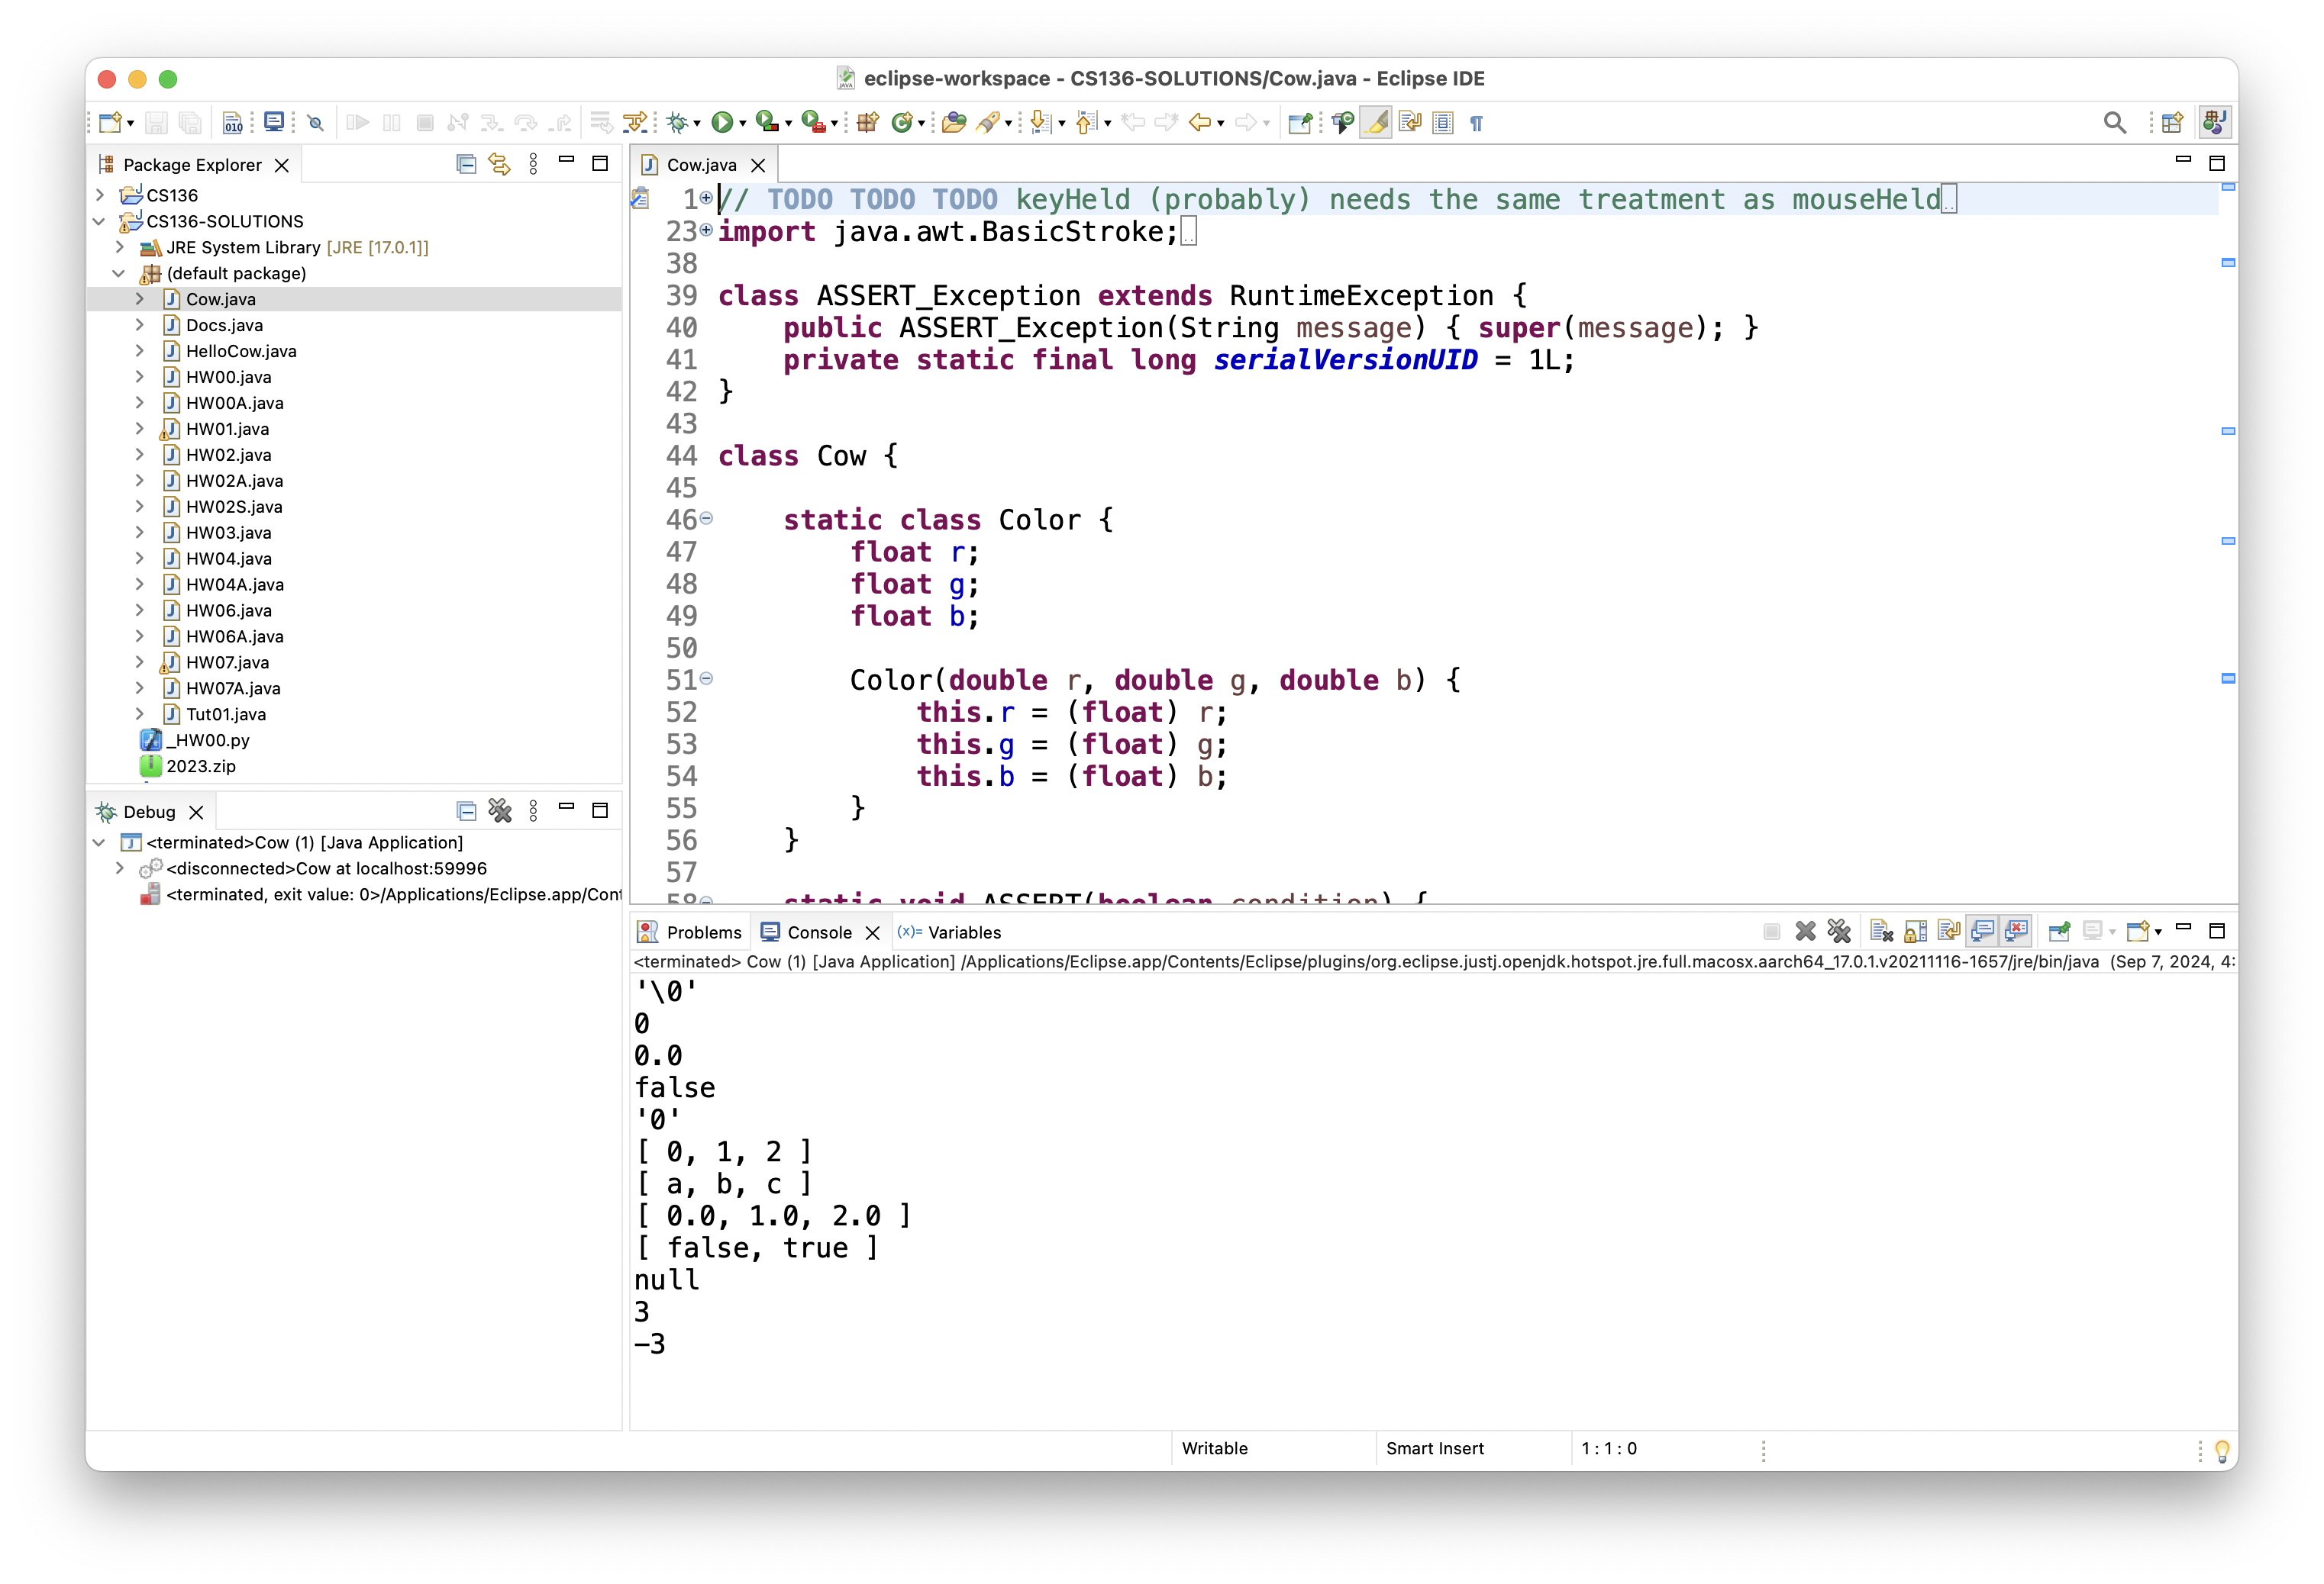
how to email jim
Reply to Q + A Thread
Email Body: can't run tic tac toe 😢

Slide 70
this is the fastest way to get your question answered i will not be offended i promise

Slide 71
how to do HW

Slide 72
implement one thing at a time get it working perfectly then, try the next thing

Slide 73
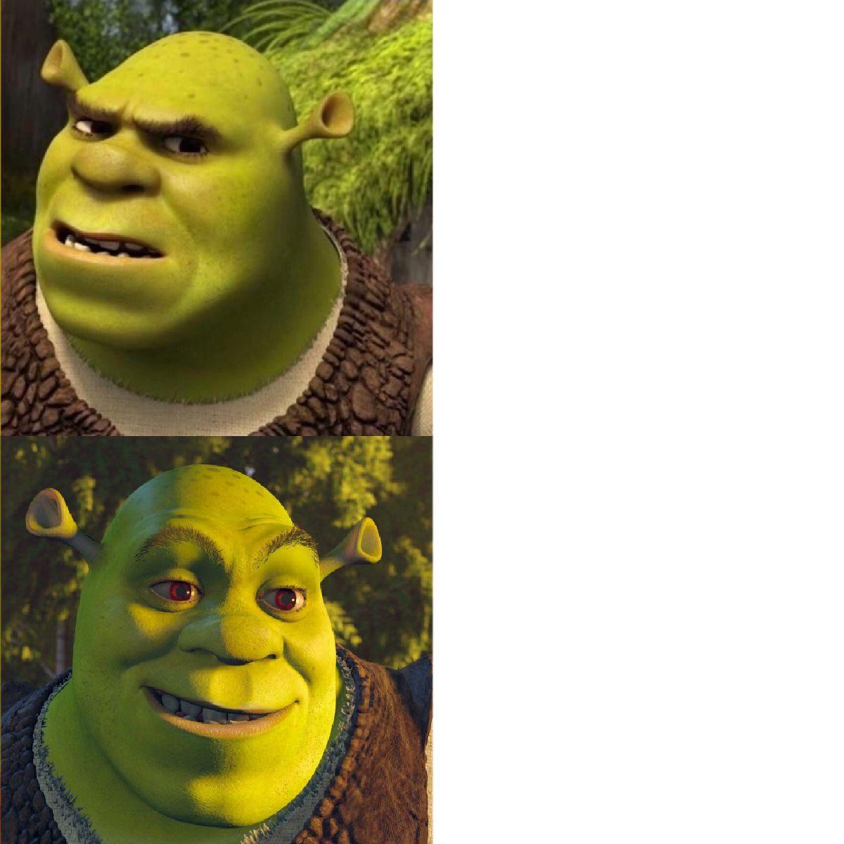
code up the entire homework without ever trying to run it
compile early; compile often

Slide 74

compilers

Slide 75
operators (except for bitwise operators, which we'll do later maybe)

Slide 76
assignment operator

Slide 77
assignment operator
= assigns the value on the right-hand side to the variable on the left-hand side
int i = 0; // 0 ("int i now has the value 0")
double foo = coolFunction();
☠ the assignment operator returns the value it assigned this is usually pretty confusing
boolean b = false;
boolean c = (b = foo());

Slide 78
arithmetic operators

Slide 79
basic arithmetic (number) operators
+ adds two numbers
- subtracts two numbers
* multiplies two numbers
/ divides two numbers
☠ an int divided by an int is an int
int foo = 8 / 2; // 4
int bar = 7 / 2; // 3
Java "throws away the remainder"
- returns the negative of a number
int bar = -7; // -7 ("negative 7" or "minus 7")
int baz = -bar; // 7

Slide 80
modulo
x % y returns the remainder of (x / y) and is read "x modulo y"
int foo = 17 % 5; // 2 ("17 divided by 5 is 3 remainder 2")
☠ % probably doesn't do what you expect for negative numbers; if x can be negative, use MODULO(x, y) instead
5 % 3 // 2
4 % 3 // 1
3 % 3 // 0
2 % 3 // 2
1 % 3 // 1
0 % 3 // 0
-1 % 3 // -1 🤔
MODULO(-1, 3) // 2 🙂👍

Slide 81
modulo

Slide 82
7 % 3
2
R1
3
7
-
6
1

Slide 83
🐍 -7 % 3
☕️ MODULO(-7, 3)
☕️ -7 % 3
-2
R-1
3
-7
-7 - (-6)
= -7 + 6
= -1
+ 3 = 2
-
-6
-1
-1

Slide 84
%
x % y returns the remainder of (x / y) and is read "x modulo y"
int foo = 17 % 5; // 2 ("17 divided by 5 is 3 remainder 2")
☠ % probably doesn't do what you expect for negative numbers; if x can be negative, use Math.floorMod(x, y) instead
5 % 3 // 2
4 % 3 // 1
3 % 3 // 0
2 % 3 // 2
1 % 3 // 1
0 % 3 // 0
-1 % 3 // -1 WAIT WHAT 🤔
MODULO(-1, 3) // 2 🙂👍

Slide 85
MODULO(x, y)
MODULO( 5, 3) // 2
MODULO( 4, 3) // 1
MODULO( 3, 3) // 0
MODULO( 2, 3) // 2
MODULO( 1, 3) // 1
MODULO( 0, 3) // 0
MODULO(-1, 3) // 2
MODULO(-2, 3) // 1
MODULO(-3, 3) // 0
MODULO(-4, 3) // 2
MODULO(-5, 3) // 1
MODULO(-6, 3) // 0
MODULO(-7, 3) // 2

Slide 86
logical operators

Slide 87
logical operators (1/2)
|| returns whether the left-hand side or the right-hand side is true
(true || true) // true
(true || false) // true
(false || true) // true
(false || false) // false
&& returns whether the left-hand side and the right-hand side are true
(true && true) // true
(true && false) // false
(false && true) // false
(false && false) // false
! returns the opposite of a boolean, and is read as "not"
(!true) // false ("not true")
(!false) // true

Slide 88
logical operators (2/2)
// example, step by step
boolean a = (2 + 2 == 5); // false
boolean b = true; // true
boolean c = (a || b); // true
boolean d = !c; // false
// same thing all on one line
boolean d = !((2 + 2 == 5) || true); // false
// equivalent code
boolean d = false;

Slide 89
☠ logical operator short-circuiting
(false && foo()) "lazily" evaluates to false without evaluating foo()
(true || foo()) "lazily" evaluates to true without evaluating foo()

Slide 90
comparison operators

Slide 91
☠ equality (is equal to)
== returns whether the left-hand side is equal to the right-hand side
boolean b = (foo == bar);
if (foo == bar) { ... }
☠ this does NOT work for String's
instead, use (stringA.equals(stringB))
☠ this (usually) does NOT work for double's
instead, use ARE_EQUAL(double1, double2)

Slide 92
is greater than, is less than
> returns whether the left-hand side is greater than the right-hand side
< returns whether the left-hand side is less than the right-hand side

Slide 93
convenient operators (feel free to ignore these for now)

Slide 94
inequality
!= returns whether the left-hand side is not equal to the right-hand side
(left != right) is exactly the same as (!(left == right))

Slide 95
greater than or equal to, less than or equal to
>= returns whether the left-hand side is greater than or equal to the right-hand side
(left >= right) is basically the same as ((left > right) || (left == right)) greater-than or equal
<= returns whether the left-hand side is less than or equal to the right-hand side

Slide 96
arithmetic assignment operators
a += b; // a = a + b;
a -= b; // a = a - b;
a *= b; // a = a * b;
a /= b; // a = a / b;

Slide 97
String concatenation
+ concatenates two String's
// String foo = "Hello".concat("World"); String foo = "Hello" + "World"; // "HelloWorld"
it also does some conversions for you (very convenient, kind of confusing)
// String foo = "Hello".concat(Integer.toString(2)); String foo = "Hello" + 2; // "Hello2"

Slide 98
increment operator
to "increment" means to increase the value of a number by one
i = i + 1;
i += 1;
the pre-increment ++i increments i and returns the new value of i
j = ++i; // i = i + 1;
// j = i;
the post-increment i++ increments i and returns the old value of i
j = i++; // j = i;
// i = i + 1;

Slide 99
decrement operator
to "decrement" means to decrease the value of a number by one
i = i - 1;
i -= 1;
the pre-decrement --i decrements i and returns the new value of i
j = --i; // i = i - 1;
// j = i;
the post-decrement i-- decrements i and returns the old value of i
j = i--; // j = i;
// i = i - 1;

Slide 100
Week01b
🦜
🐝
record lecture
tips and tricks
operators
control flow
Cow.Java
REVIEW
foo = true;
bar = false;
baz = (!(!foo || !bar) && !!foo);
what value is baz?
WARMUP
A) imagine if code didn't have for, while, or functions...
B) imagine if it didn't have if...
could it get the job done?
could it ✨spark joy✨?

Slide 101
control flow

Slide 102
the execution of a Java program starts at the top of main(...) and flows down down down

Slide 103
let's step through this program in our minds, and then in a debugger
class Main extends Cow {
public static void main(String[] arguments) {
double a = 3.0;
double b = 4.0;
double result = SQRT(a * a + b * b);
PRINT(result);
}
}

Slide 104
[visualizing the flow of HW00A in a debugger] 💻👥

Slide 105
functions (preview)

Slide 106
functions (preview)
when a function is called, control flow jumps to the top of the function, flows down through it, and then jumps back to right after the function call
class Main {
static double pythagoreanTheorem(double a, double b) {
return Math.sqrt(a * a + b * b);
}
public static void main(String[] arguments) {
double hypotenuse = pythagoreanTheorem(3.0, 4.0);
System.out.println(hypotenuse);
}
}

Slide 107
ASSERT

Slide 108
ASSERT(condition);
an assert statement crashes the program if its condition is false
ASSERT(false); crashes the program no matter what
class Main {
static double pythagoreanTheorem(double a, double b) {
ASSERT(a > 0.0);
ASSERT(b > 0.0);
return Math.sqrt(a * a + b * b);
}
public static void main(String[] arguments) {
double hypotenuse = pythagoreanTheorem(3.0, 4.0);
PRINT(hypotenuse);
}
}

Slide 109
assert condition; (Java Java)
☠ Java's asserts are actually disabled by default (wat)
you can enable them in Eclipse, but it's easy to forget to do

Slide 110
if and else

Slide 111
if (condition) { body }
an if statement lets a program make a decision (instead of just stepping down down down forever down)
int choice = getIntFromUser();
if (choice == 0) {
System.out.println("The user chose 0. What a fine choice");
}

Slide 112
if (...) { if-body } else { else-body }
the body of an else statement is executed if its corresponding if statement's condition is false
int choice = getIntFromUser();
if (choice == 0) {
System.out.println("The user chose 0. What a fine choice");
} else {
System.out.println("The user did not choose 0.");
System.out.println("How avant-garde!");
}

Slide 113
if (...) { ... } else if (...) { ... } ... else { ... }
if and else statements can be chained together
this is great for decisions with many options
int choice = getIntFromUser();
if (choice == 0) {
...
} else if (choice == 1) {
...
} else if (choice == 2) {
...
} else {
ASSERT(false);
}

Slide 114
while and do...while

Slide 115
while (condition) { body }
a while loop repeats a block of code as long as the condition holds (if the condition is false the first time we see it, we never execute the body)
while (true) { ... } is an infinite loop
while (!gameOver) {
...
if (player.health <= 0) {
gameOver = true;
}
}

Slide 116
do { ... } while (...);
a do...while loop is (sometimes) useful when you know you need to do something at least once (and then potentially a bunch more times)
int choice;
do {
choice = getIntFromUser();
} while (!(0 <= choice && choice <= 2));
int choice = getIntFromUser();
while (!(0 <= choice && choice <= 2)) {
choice = getIntFromUser();
}

Slide 117
for

Slide 118
for (...; condition; ...) { ... } (1/2)
a for loop can be a convenient alternative to a while loop
for (int i = 0; i < n; ++i) {
...
}
{
int i = 0;
while (i < n) {
...
++i;
}
}

Slide 119
for (...; condition; ...) { ... } (2/2)
for loops can be kind of wild (probably stick with simple ones for now)
for (double a = 10.0; (a > 1.01); a = SQRT(a)) {
...
}
for (int j = n - 1, i = 0; (i < n); j = i++) {
...
}
for (;;) {
...
}

Slide 120
break and continue

Slide 121
break
break breaks out of a loop
while (true) {
...
if (player.health <= 0) {
break;
}
}

Slide 122
continue
continue continues to the next iteration of a loop
for (int i = 0; i < chairs.length; ++i) {
if (chairs[i].hasStudentSittingInIt) {
continue;
}
...PRINT student's name...
}

Slide 123
exceptions to the rule that "scope is the same as curly braces"

Slide 124
for (...; ...; ...) { ... }
variables declared inside the parentheses of a for loop are not available outside of the for loop (this is probably the behavior you already expected)
Compile Error: cannot find symbol i
class Main {
public static void main(String[] arguments) {
for (int i = 0; i < 10; ++i) {
...
}
PRINT(i);
}
}

Slide 125
☠ if, else, for, while without braces (1/2)
☠ if you (intentionally or unintentionally) forget your curly braces, then Java will assume you wanted them go around the first statement after the if (...), else, for (...), or while (...)
in this class, i highly recommend always using curly braces
if (choice == 0)
System.out.println("The user chose 0. What a fine choice");
if (choice == 0) {
System.out.println("The user chose 0. What a fine choice");
}

Slide 126
☠ if, for, while without braces (2/2)
if (choice == 0)
PRINT("The user chose 0. What a fine choice");
else
PRINT("The user did not choose 0.");
PRINT("How avant-garde!");
if (choice == 0) {
PRINT("The user chose 0. What a fine choice");
} else {
PRINT("The user did not choose 0.");
} // whoops!
PRINT("How avant-garde!");

Slide 127
Week01c
🦜
🐝
record lecture
tips and tricks
operators
control flow
Cow.Java
story tiiiime ☕️
NOTE: if lab too loud can use other room
REVIEW / WARMUP
1) what is 1234 % 10?
2) what is 1234 / 10?
3) what is 1 / 10?
4) implement int digitSum(int n) { ... }
using a while loop
BONUS: what does this print?
double a = -42.0;
double b = 0 * a;
PRINT(b);
PRINT(b == 0.0);

Slide 128
Java doesn't have a goto
NOTE: gray sections are just for fun; not on the HW; not on the tests

Slide 129
goto

Slide 130
goto label;
a goto "goes to" some label
it turns out loops are just convenient alternatives to goto's
goto's are considered *spooky*👻
while (condition) {
...
}
label BEGINNING_OF_WHILE:
if (!condition) {
goto END_OF_WHILE;
}
...
goto BEGINNING_OF_WHILE;
label END_OF_WHILE:

Slide 131
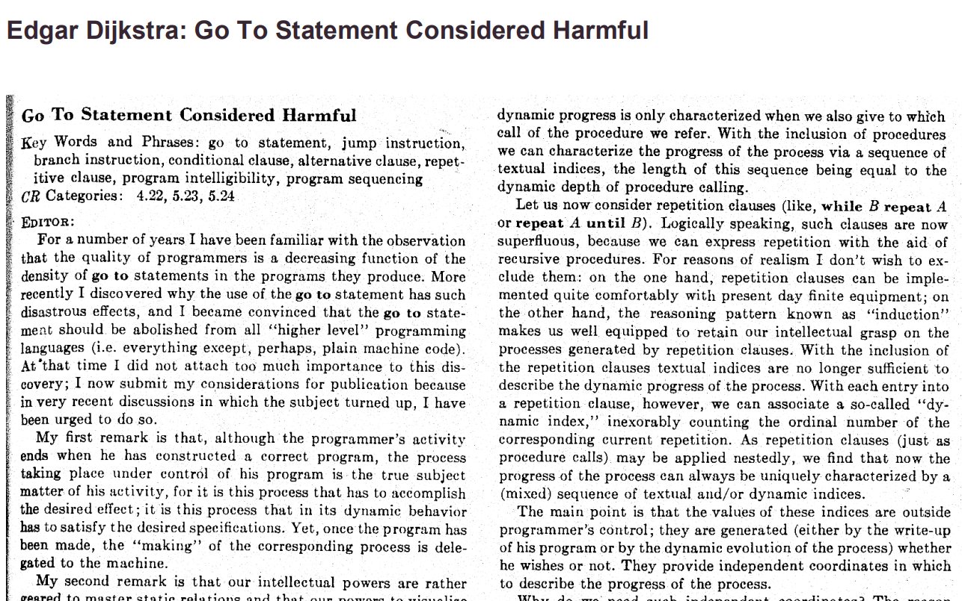

Slide 132
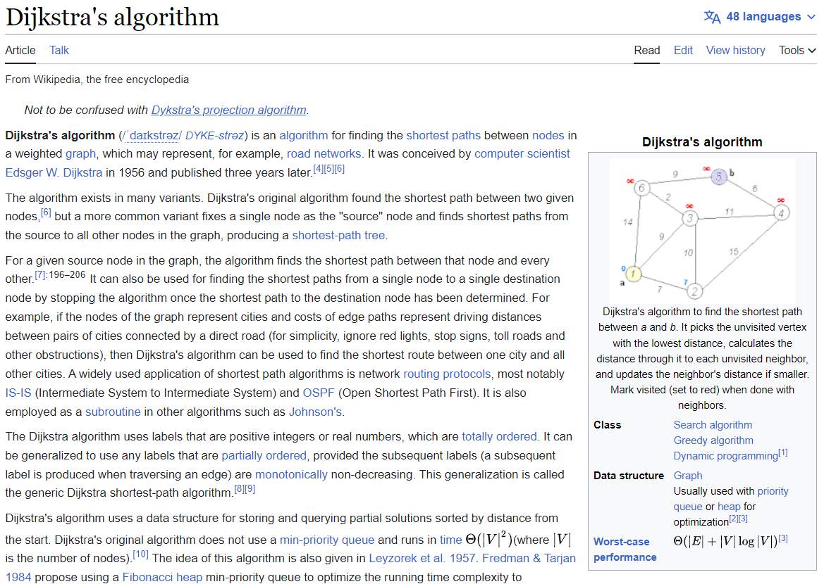

Slide 133
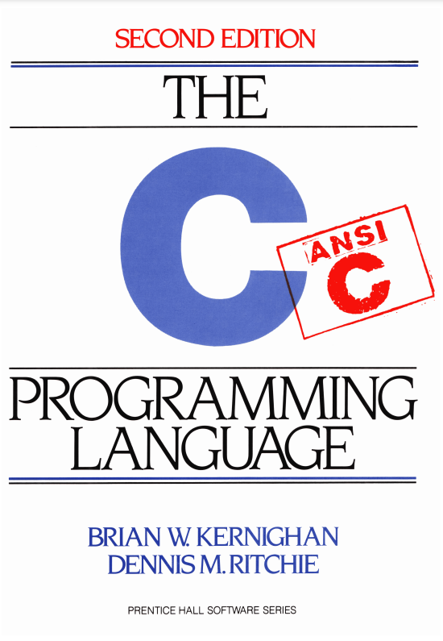

Slide 134
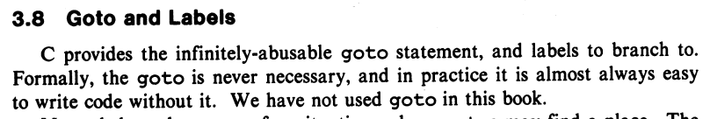
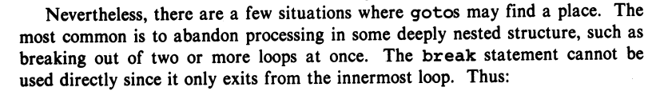
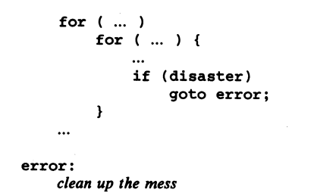

Slide 135
story time ☕️

Slide 136
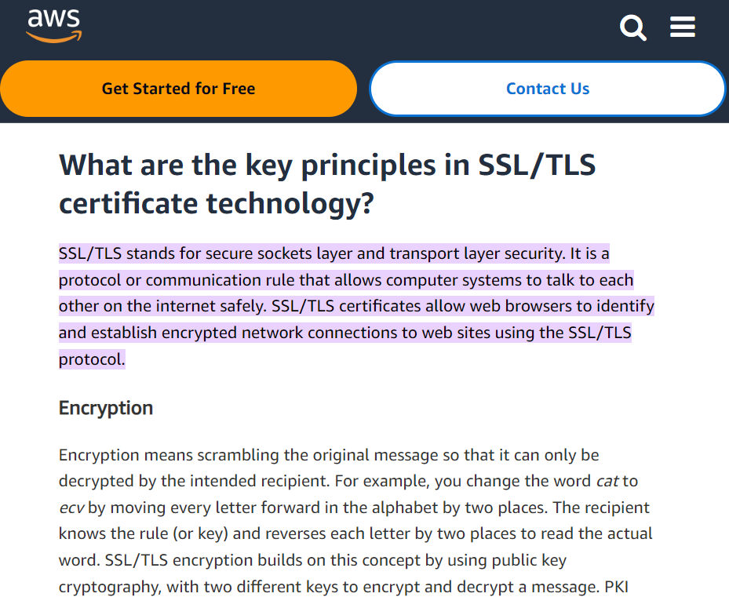

Slide 137
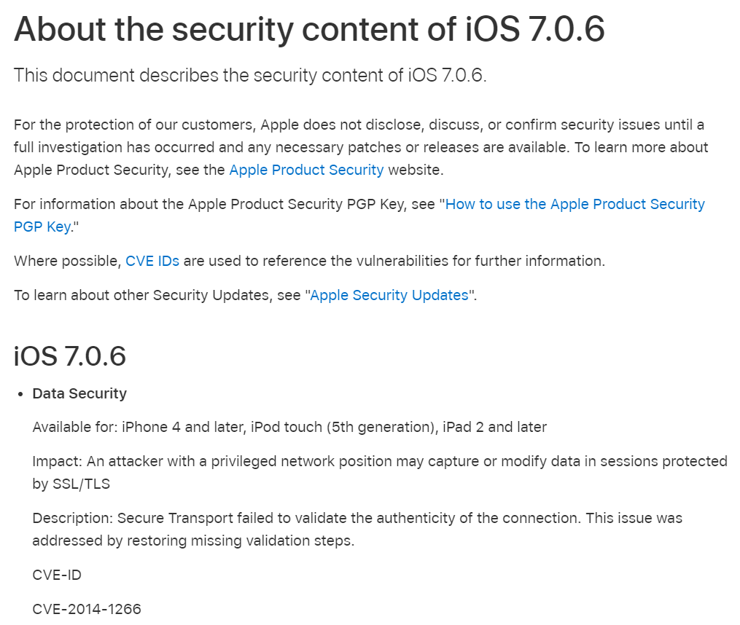

Slide 138
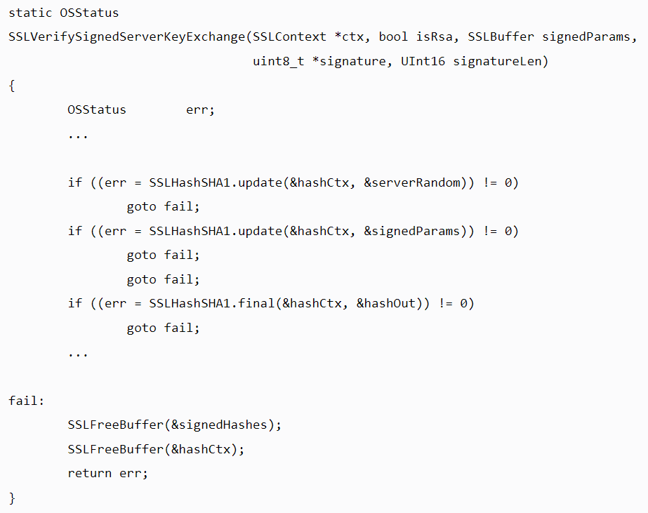

Slide 139
{
}
goto fail;

Slide 140
did the bug really happen because they left out the curly braces?

Slide 141
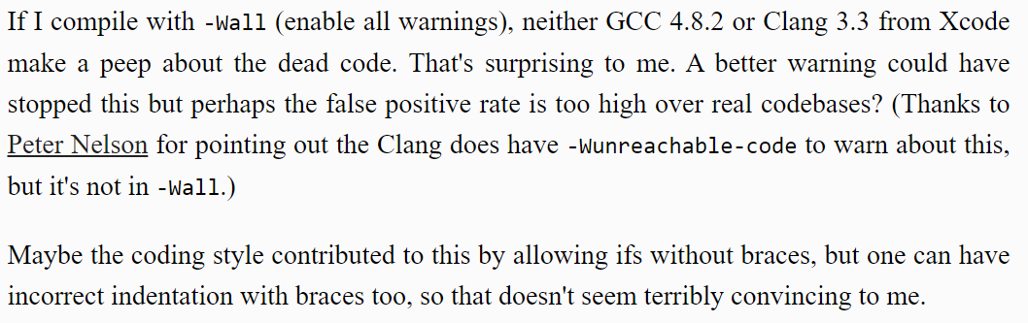

Slide 143
press CTRL+A and then press CTRL+I

Slide 144
🙂👍

Slide 145
Cow.Java

Slide 146
overview during a frame (like a frame of a movie) we update and draw the world

Slide 147

beginFrame()
beginFrame()
beginFrame()
beginFrame()
beginFrame()
beginFrame()

Slide 148
[discussion of update-draw loop]

Slide 149
your best friend

Slide 150

DOCUMENTATION

Slide 151
[examples]

Slide 152
Cow.java examples
rainbow circle example
grid
checkerboard
paint

Slide 153
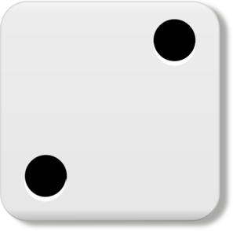
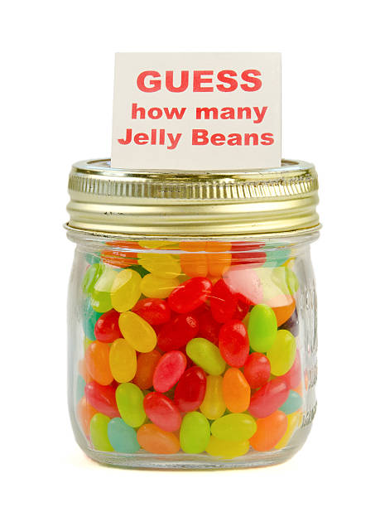
Week02
TODO: record lecture
🦜
NOTE: Jim has jury duty on thu 🎉
🦜
arrays
array examples
swap
array examples that use swaps
WARMUP
Guess how many arrays we used to make this:
https://youtu.be/dadIdXQMBi4
NOTE: an array is a fixed-length sequence of elements, all the same type

Slide 154
how many arrays?
ARRAYS (not counting tiny arrays of 3 double's, which i use to represent points)
NOTE: Counts are very approximate
==========
strings for loading files >5
huge arrays for drawing random stuff (the floor, etc) 2
random stuff in my cow.cpp library (keyboard state, OpenGL objects, etc.) >20
random global variables 1
building the simulation >6
simulation state 3
simulation itself >20
dragon head mesh 7
dragon body mesh 7
dragon mesh 7
sphere mesh 3
cylinder mesh 3
motor configuration 3
arrays that just move data back and forth between C++ <-> unity 8
inverse kinematics >15
physics >10
----------
definitely at least 100; probably less than 1000

Slide 155
arrays

Slide 156
metaphor

Slide 157
an array is like a very organized person's flower planter - one flower per square - the planter can't change size (it is made of artisinal woods or something)

Slide 158
🌻
🌺
🥀
🌹

Slide 159
mental model of an array

Slide 160
mental model of an array
a fixed number of equally-sized boxes, all right next to each other
the array itself lives "in memory"
1 | 5 | 3 | 2 | 7
int[] foo = new int[5];
foo[0] = 1;
foo[1] = 5;
foo[2] = 3;
foo[3] = 2;
foo[4] = 7;

Slide 161
the array itself lives "in memory"
1 | 5 | 3 | 2 | 7

Slide 162

1 | 5 | 3 | 2 | 7

Slide 163
learn about memory and become a real CS pro a couple important questions to ask yourself: https://www.youtube.com/watch?v=BNtcWpY4YLY

Slide 164
arrays

Slide 165
arrays (1/2)
an array is a fixed-length sequence of elements, all of the same type
"an array of 4372 double's"
"an array of 1 int's"
"an array of 64 Student's"

Slide 166
arrays (2/2)
we will often write an array using curly braces
{ 7, 7, 9 } is an array containing 7, 7, and 9
optionally, you can include a comma after the last element
{ 7, 7, 9, }
☠ even though sets from math also use curly braces, Java arrays have nothing to do with sets; in a set, all elements must be unique; in an array, elements do NOT have to be unique

Slide 167
array operations

Slide 168
array operations

Slide 169
creating an array (1/2)
you can create an array by specifying its length (the number of elements); if you do, the array is zero-initialized (all elements are initially set to zero)
int[] A = new int[8]; // { 0, 0, 0, 0, 0, 0, 0, 0 }
double[] B = new double[1]; // { 0.0 }
boolean[] C = new boolean[2]; // { false, false }
char[] D = new char[4]; // { '\0', '\0', '\0', '\0' }
String[] E = new String[3]; // { null, null, null }
[visualize in Eclipse]

Slide 170
creating an array (2/2)
you can also create an array by specifying its elements; if you do, the array's length is the number of elements you specified
int[] array = { 7, 7, 9 }; // new int[3] is implied
NOTE: this syntax can only be used for creation
🙅 NOT okay to do later: array = { 4, 5, 6 };
🙆 OKAY to do later:
array[0] = 4;
array[1] = 5;
array[2] = 6;
boolean[] array = { true };
String[] array = { "hello", "world" };

Slide 171
getting an array's length
after creating an array, you can get (but not set) its length
int[] array = { 7, 7, 9 };
PRINT(array.length); // 3
int[] array = new int[8];
PRINT(array.length); // 8
Error: cannot assign a value to final variable length
array.length = 42;

Slide 172
getting the value of an element of an array
you can get the value of an element of an array using the square brackets and the index of the element
this is also called "accessing the array"
int[] array = { 3, 4, 5 };
int foo = array[0]; // 3
int[] array = { 3, 4, 5 };
int foo = array[42];
java.lang.ArrayIndexOutOfBoundsException: 42

Slide 173
setting the value of an element of an array
you can set the value of an element of an array using the square brackets and the index of the element
int[] array = { 7, 7, 9 };
array[1] = 8;
// { 7, 8, 9 }
int[] array = { 7, 7, 9 };
array[-1] = 1000;
java.lang.ArrayIndexOutOfBoundsException: -1

Slide 174
☠ printing the elements of an array
☠ in Java, you don't simply call System.out.println(array)
instead, you call System.out.println(Arrays.toString(array));
note: this prints with square brackets instead of curly brackets
🤷‍♂️
or just call PRINT(array);
🐄💖✨
(note: also uses square brackets)

Slide 175
iterating over an array

Slide 176
iterating over an array
a for loop can be used to iterate over an array
for (int i = 0; i < array.length; ++i) {
array[i] = ...;
}

Slide 177
[example in Eclipse]

Slide 178
Week02b
🛌
zzz...
arrays
array examples
swap
array examples that use swaps
WARMUP:
On your computer, write an array deep copy from scratch, including test code.
TODO: record lecture

Slide 179
array examples

Slide 180
example: creating an array of the first 100 non-negative integers

Slide 181
example: creating an array of the first 100 non-negative integers [ 0, 1, ..., 99 ]
class Main extends Cow {
public static void main(String[] arguments) {
int[] array = new int[100];
for (int i = 0; i < array.length; ++i) {
array[i] = i;
}
PRINT(array);
}
}

Slide 182
example: (deep) array copy

Slide 183
example: array copy
class Main extends Cow {
public static void main(String[] arguments) {
int[] source = { 3, 4, 5 };
int[] destination = new int[source.length];
for (int i = 0; i < source.length; ++i) {
destination[i] = source[i];
}
PRINT(source);
PRINT(destination);
}
}

Slide 184
☠ example: bad very bad broken array copy

Slide 185
☠ example: bad very bad broken array copy
class Main extends Cow {
public static void main(String[] arguments) {
int[] source = { 3, 4, 5 };
int[] destination = source;
source[0] = 7;
PRINT(source);
PRINT(destination);
}
}

Slide 186
example: circular array
3, 4, 5, 6, 7, 8, 9, 10, 11,

Slide 187
class Main extends Cow {
public static void main(String[] arguments) {
int nextIndex = 0;
int[] circularArray = new int[5];
for (int dataPoint = 1; dataPoint < 100; ++dataPoint) {
// push dataPoint into the circularArray
circularArray[nextIndex] = dataPoint;
// update nextIndex
nextIndex = (nextIndex + 1) % circularArray.length;
}
}
}

Slide 188
example: finding the index (and value) of an array's maximum element

Slide 189
example: finding the index (and value) of an array's maximum element
import java.util.*;
class Main {
public static void main(String[] arguments) {
double[] array = { 1.0, 3.0, -42.0, 1000.0, 99.0 };
int indexOfMaximumElement = -1;
double valueOfMaximumElement = Double.NEGATIVE_INFINITY;
for (int i = 0; i < array.length; ++i) {
if (array[i] > valueOfMaximumElement) {
indexOfMaximumElement = i;
valueOfMaximumElement = array[i];
}
}
System.out.println("array[" + indexOfMaximumElement + "] = " + valueOfMaximumElement);
}
}

Slide 190
multi-dimensional arrays

Slide 191
multi-dimensional arrays

Slide 192
multi-dimensional arrays (arrays of arrays of ...)
multi-dimensional arrays are sometimes really handy
int[][] array = { { 3, 4 }, { 5, 6 }, { 7, 8 } };
PRINT(array);
// [[3, 4], [5, 6], [7, 8]]
PRINT(array[0][1]); // 4
int[][][] array = new int[2][3][4];
array[0][0][0] = 42;
System.out.println(Arrays.toString(array));
// [[[42, 0, 0, 0], [0, 0, 0, 0], [0, 0, 0, 0]], [[0, 0, 0, 0], [0, 0, 0, 0], [0, 0, 0, 0]]]

Slide 193
Week02c
!
juggling club after colloquium today 🤹
🛌
HW01 is being graded
so far only 1 person followed the TODO's... 🥲
(fix for full points back)
Pre-Lab
Post-Lab
arrays
array examples
swap
array examples that use swaps
big O
WARMUP:
How do we swap two numbers...
...in Java?
...in Python?
...in C using XOR and no temporary?
BONUS:
What is the big O runtime of pressing backspace in your text box (n is buffer.length)
TODO: record lecture

Slide 194
swap

Slide 195
🐍 Python swap

Slide 196
🐍 Python swap
a = 0
b = 1
a, b = b, a # Python swap
# a is now 1
# b is now 0

Slide 197
☠️ BAD VERY BAD BROKEN swap

Slide 198
☠️ BAD VERY BAD BROKEN swap
int a = 0;
int b = 1;
{ // BAD VERY BAD BROKEN swap
a = b; // a <- 1
b = a; // b <- 1
}

Slide 199
swap

Slide 200
swap
int a = 0;
int b = 1;
{ // swap
int tmp = a; // tmp <- 0
a = b; // a <- 1
b = tmp; // b <- 0
}

Slide 201
array algorithms that use swaps

Slide 202
reversing an array

Slide 203
out-of-place reverse
we can reverse an array out-of-place using an additional array
static int[] outOfPlaceReverse(int[] array) {
int[] result = new int[array.length];
for (int i = 0; i < array.length; ++i) {
int j = (array.length - 1) - i;
result[i] = array[j];
}
return result;
}

Slide 204
in-place reverse
we can reverse an array in-place using "swaps" (no additional array)
static void inPlaceReverse(int[] array) {
for (int i = 0; i < array.length / 2; ++i) {
int j = (array.length - 1) - i; // "mirror index"
// swap array[i] <-> array[j]
int tmp = array[i];
array[i] = array[j];
array[j] = tmp;
}
}

Slide 205
bubble sort

Slide 206
bubble sort
bubble sort is a simple in-place sorting algorithm that uses swaps
class Main {
public static void main(String[] arguments) {
int[] array = { 2, 4, 1, 6, 0, 3, 5 };
boolean arrayIsSorted;
do {
arrayIsSorted = true;
for (int i = 0; i < array.length - 1; ++i) {
if (array[i] > array[i + 1]) {
arrayIsSorted = false;
// swap
int tmp = array[i];
array[i] = array[i + 1];
array[i + 1] = tmp;
}
}
} while (!arrayIsSorted);
PRINT(array);
}
}

Slide 207
bubble sort
bubble sort is a simple in-place sorting algorithm that uses swaps
boolean arrayIsSorted;
do {
arrayIsSorted = true;
for (int i = 0; i < array.length - 1; ++i) {
if (array[i] > array[i + 1]) {
arrayIsSorted = false;
// swap
int tmp = array[i];
array[i] = array[i + 1];
array[i + 1] = tmp;
}
}
} while (!arrayIsSorted);

Slide 208
big O

Slide 209
big O (math)

Slide 210
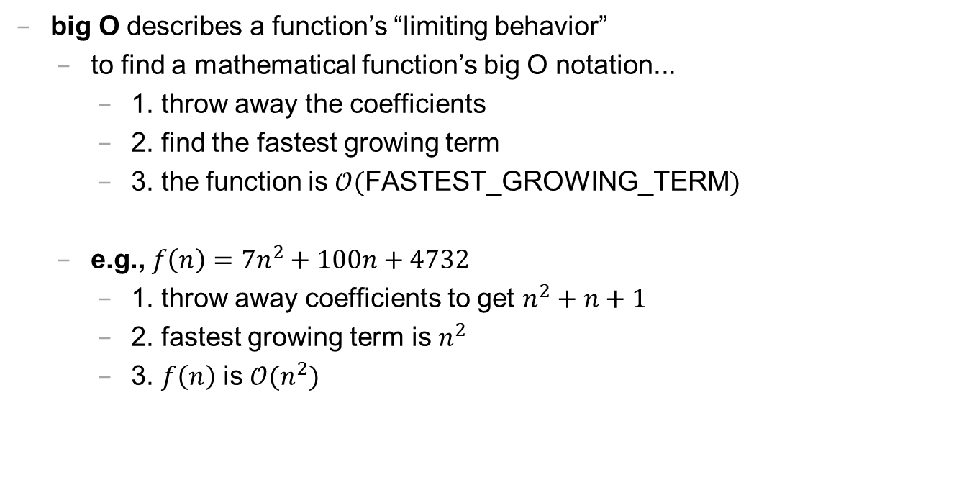
big O (1/2)
big O describes a function’s “limiting behavior”
to find a mathematical function’s big O notation...
1. throw away the coefficients
2. find the fastest growing term
3. the function is $𝒪($FASTEST_GROWING_TERM$)$
e.g., $f\left(n\right)=7n^{2}+100n+4732$
1. throw away coefficients to get $n^{2}+n+1$
2. fastest growing term is $n^{2}$
3. $f\left(n\right)$ is $𝒪(n^{2})$

Slide 211
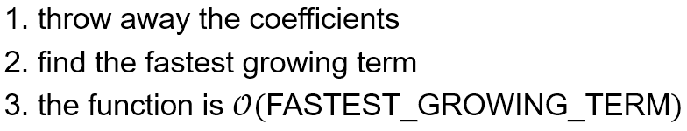
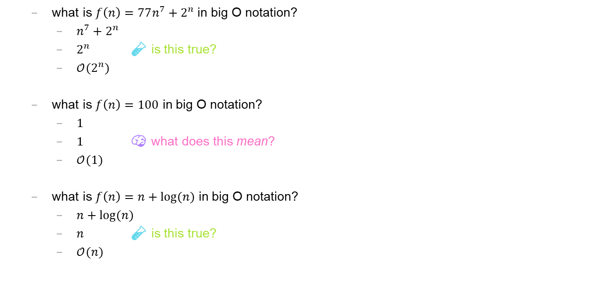
big O (2/2)
what is $f\left(n\right)=77n^{7}+2^{n}$ in big O notation?
$n^{7}+2^{n}$
$2^{n}$ 🧪 is this true?
$𝒪(2^{n})$
what is $f\left(n\right)=100$ in big O notation?
$1$
$1$ 🧠 what does this mean?
$𝒪(1)$
what is $f\left(n\right)=n+log⁡(n)$ in big O notation?
$n+log⁡(n)$
$n$ 🧪 is this true?
$𝒪(n)$

Slide 212
logarithmic growth is the inverse of exponential growth

Slide 213
y = 2^{x}
🧠 solve for x.

Slide 214
y = 2^{x} x = log₂ y

Slide 215
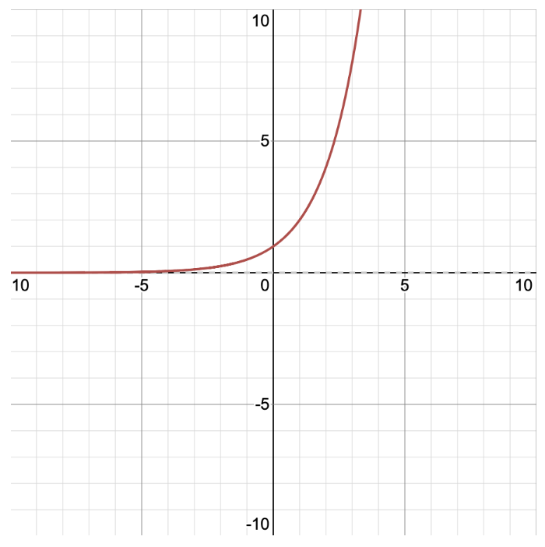
y = 2^{x} x = log₂ y
y
x

Slide 216
y = 2^{x} x = log₂ y
y
x

Slide 217
big O runtime (arrays)

Slide 218
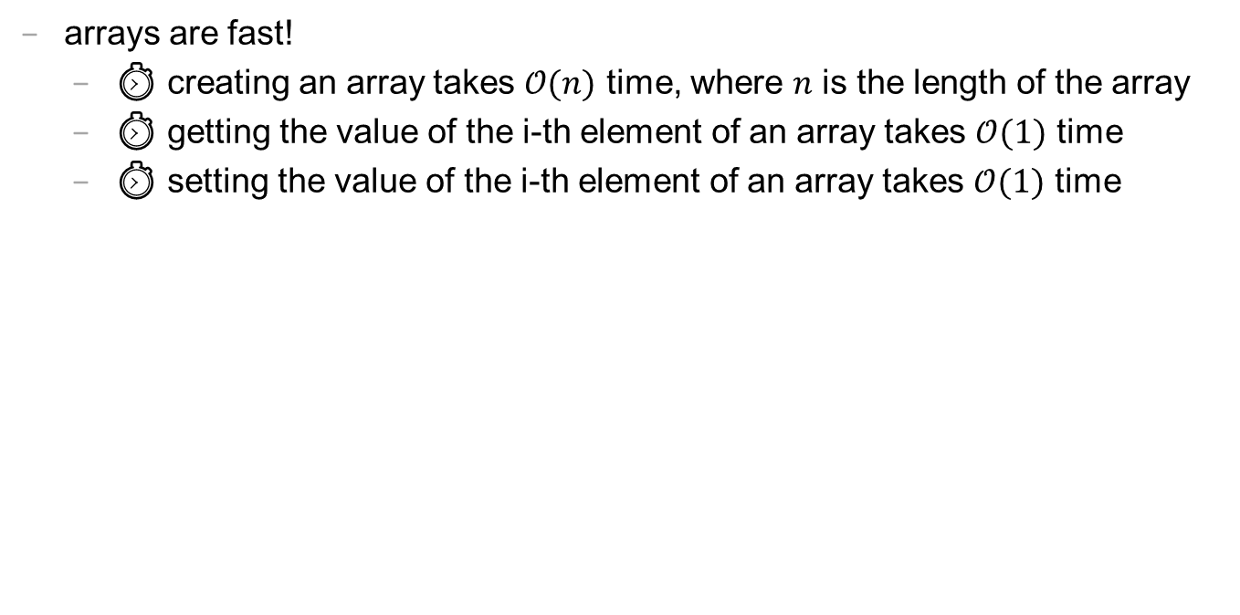
runtime of array operations
arrays are fast!
⏱️ creating an array takes $𝒪(n)$ time, where $n$ is the length of the array
⏱️ getting the value of the i-th element of an array takes $𝒪(1)$ time
⏱️ setting the value of the i-th element of an array takes $𝒪(1)$ time

Slide 219
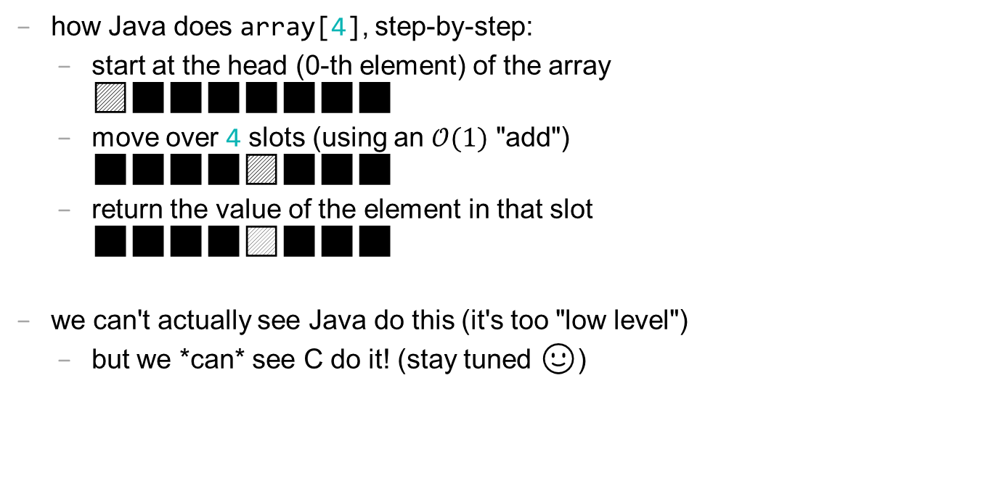
accessing an array "under the hood"
how Java does array[4], step-by-step:
start at the head (0-th element) of the array 🟦⬛⬛⬛⬛⬛⬛⬛
move over 4 slots (using an $𝒪(1)$ "add") ⬛⬛⬛⬛🟦⬛⬛⬛
return the value of the element in that slot ⬛⬛⬛⬛🟨⬛⬛⬛
we can't actually see Java do this (it's too "low level")
but we *can* see C do it! (stay tuned 🙂)

Slide 220
big O runtime (code)

Slide 221
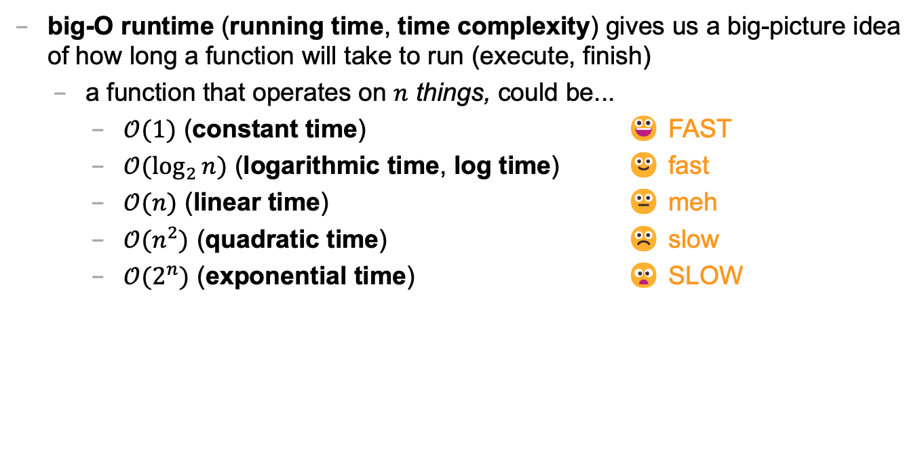
big-O runtime (1/3)
big-O runtime (running time, time complexity) gives us a big-picture idea of how long a function will take to run (execute, finish)
a function that operates on $n$ things, could be...
$𝒪(1)$ (constant time) 😀 FAST
$𝒪(\log_{2}{n})$ (logarithmic time, log time) 🙂 fast
$𝒪(n)$ (linear time) 😐 meh
$𝒪(n^{2})$ (quadratic time) ☹️ slow
$𝒪(2^{n})$ (exponential time) 😦 SLOW

Slide 222
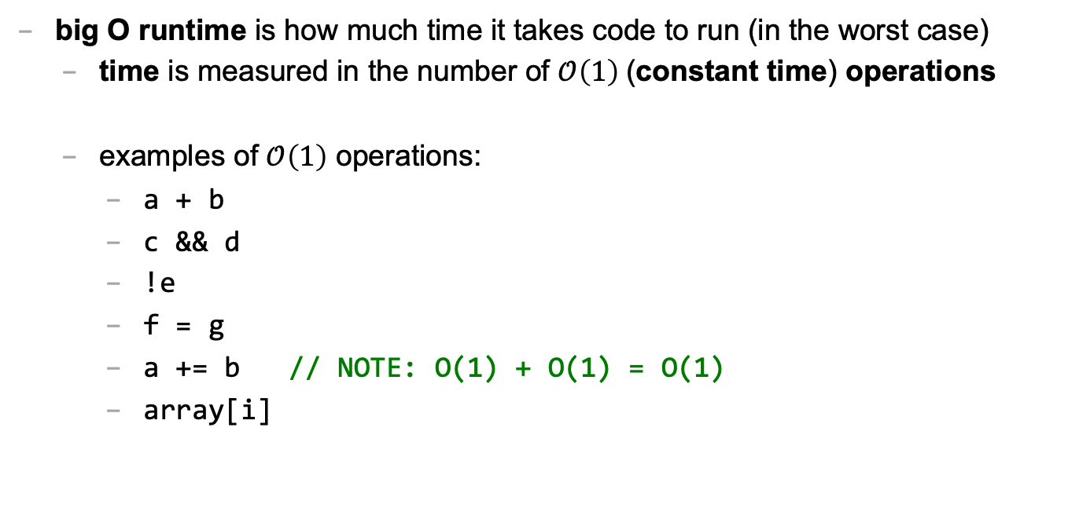
big O runtime (2/3)
big O runtime is how much time it takes code to run (in the worst case)
time is measured in the number of $𝒪\left(1\right)$(constant time) operations
examples of $𝒪\left(1\right)$ operations:
a + b
c && d
!e
f = g
a += b // NOTE: O(1) + O(1) = O(1)
array[i]

Slide 223
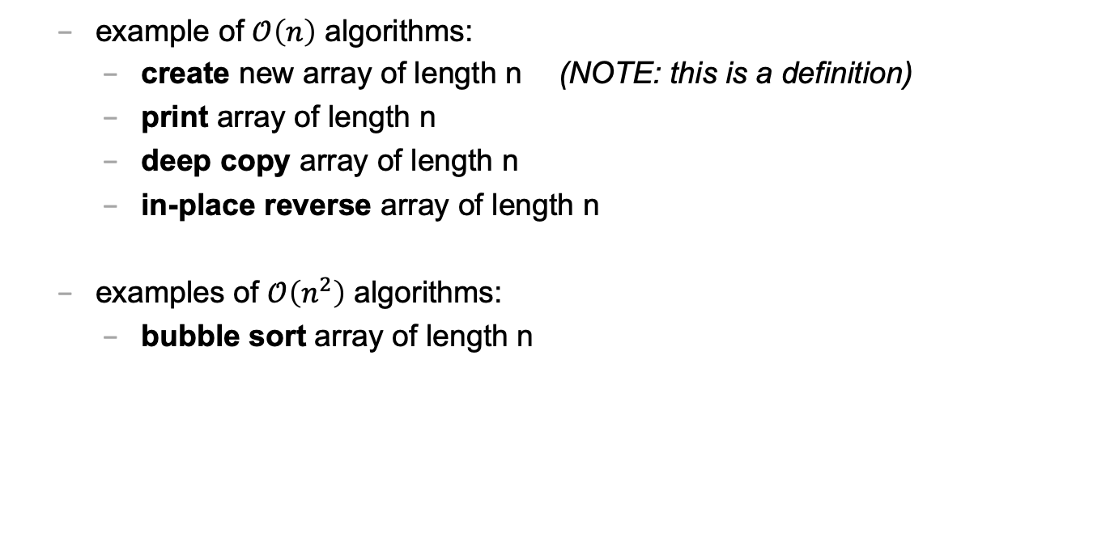
big O runtime (3/3)
example of $𝒪\left(n\right)$ algorithms:
create new array of length n (NOTE: this is a definition)
print array of length n
deep copy array of length n
in-place reverse array of length n
examples of $𝒪\left(n^{2}\right)$ algorithms:
bubble sort array of length n

Slide 224
fun examples

Slide 225
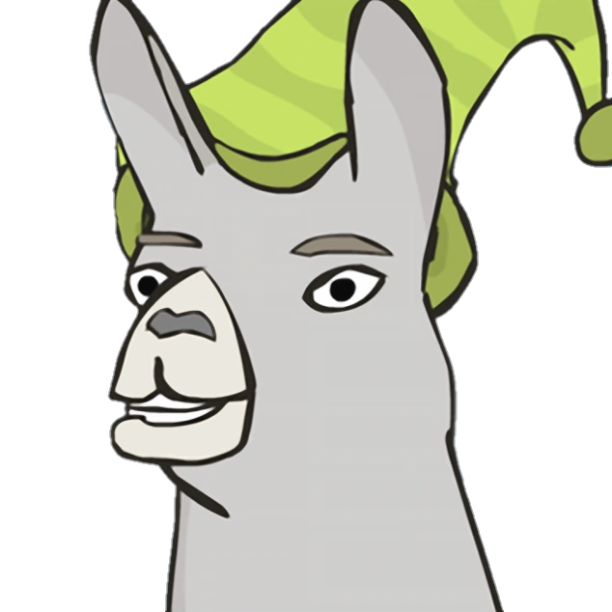
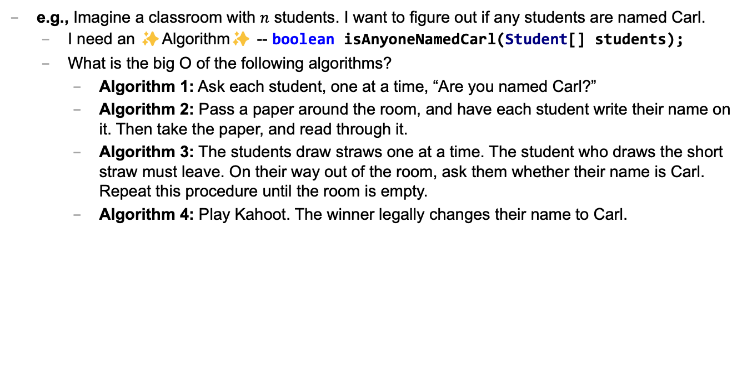
Caaaaaaaaaaaarl
e.g., Imagine a classroom with $n$ students. I want to figure out if any students are named Carl.
I need an ✨Algorithm✨ -- boolean isAnyoneNamedCarl(Student[] students);
What is the big O of the following algorithms?
Algorithm 1: Ask each student, one at a time, “Are you named Carl?”
Algorithm 2: Pass a paper around the room, and have each student write their name on it. Then take the paper, and read through it.
Algorithm 3: The students draw straws one at a time. The student who draws the short straw must leave. On their way out of the room, ask them whether their name is Carl. Repeat this procedure until the room is empty.
Algorithm 4: Play Kahoot. The winner legally changes their name to Carl.

Slide 226
textbox examples

Slide 227
let's say n equals buffer.length

Slide 228
what's the big O of pressing →?

Slide 229
what's the big O of pressing A?

Slide 230
💻 array tutorial

Slide 231
💻 array tutorial

Slide 232
💻 array tutorial
// 🟢 ([5, 4, 7, 0, 7], 7) -> 2
// 🟢 ([5, 4, 7, 0, 7], 3) -> -1
static int findFirstIndexOf(int[] array, int value);
// 🟦 ([1, 3, 3, 2, 3, 4], 3) -> [1, 2, 4]
static int[] removeAllOccurences(int[] array, int value);
// ♦️ [[1, 3], [2, 4, 5], [0, 5]] -> [0, 1, 2, 3, 4, 5, 5]
static int[] mergeArrayOfSortedArrays(int[][] arrays);

Slide 233
colloquium

Slide 234
where is everyone?

Slide 235


San Diego 🌞🏝️🏄‍♀️🌮

Slide 236
we have snacks!

Slide 237
wait till the end 🍪

Slide 238
wait till the end 🥲

Slide 239
🥲

Slide 240
🍪

Slide 241
odd.

Slide 242
announcements

Slide 243
juggling club is after colloquium 🤹‍♀️

Slide 244
juggging club after colloquium 🤹‍♀️
juggling
is
colloquium
club
after

Slide 245
note: alumnus Rich Ward '89 sent us juggling clubs! they are fun and purple and gold

Slide 246


Slide 247
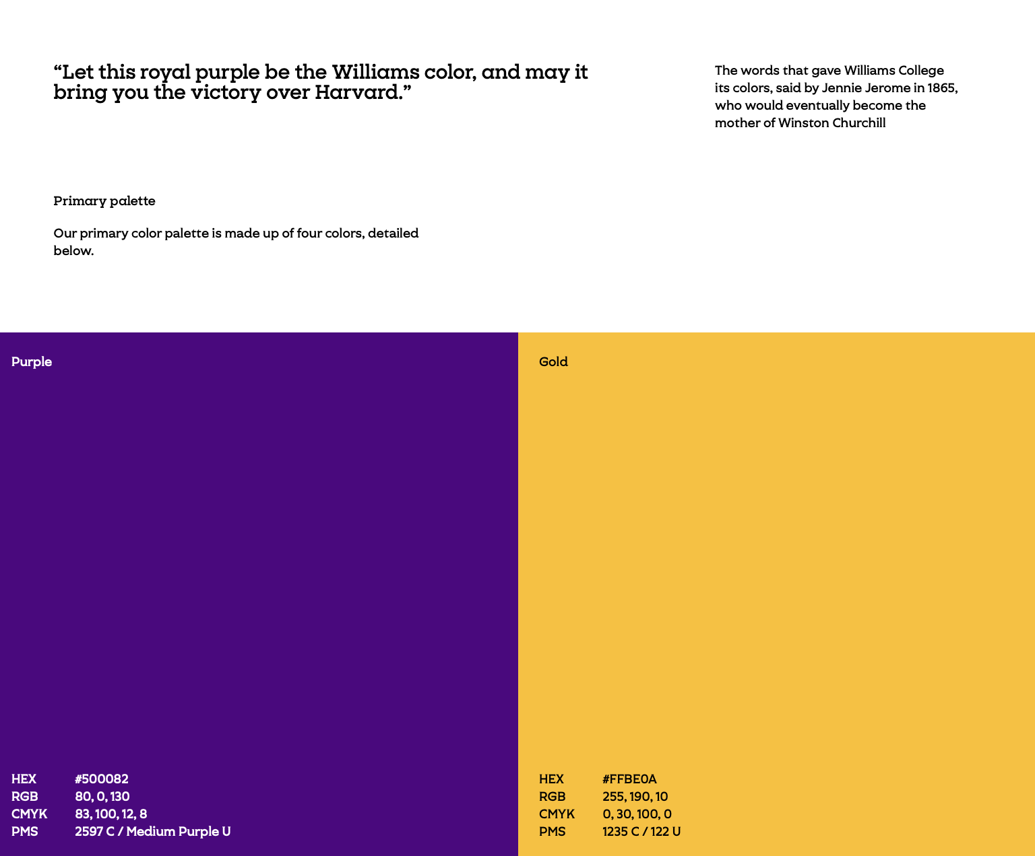

Slide 248
note: alumnus Rich Ward '89 sent us juggling clubs! they are fun and purple and gold

Slide 249
note: in unrelated news, the Registered Student Organization known as the Williams Juggling Club is now the Ward Juggling Club ✨

Slide 250
:D

Slide 251
any other announcements?

Slide 252
speaker

Slide 253
Hannah Gommerstadt
🥾
🥾
Position: Assistant Professor of Computer Science at Vassar
Research: Programming Languages; Concurrent Data Structures
Teaching: Compilers, Functional Programming, Discrete Math
Hobbies: Hiking

Slide 254
Week03
TODO: record lecture
Today is...
✨No-Laptop Monday! ✨
🦜🦜🦜
WARMUP
What is a bullet hell?
HW03 preview
functions
classes
HW03 behind the scenes
references
BONUS
Who wrote the game Everyday Shooter?
What is she working on now?
BONUS
What does Touhou 7: Perfect Cherry Blossom's Extra Stage look like? Who wrote this?

Slide 255
but first, something nice

Slide 256
🦉 secret agent owl

Slide 257
🦉 secret agent owl

Slide 258
🦉 secret agent owl

Slide 259
🦉 secret agent owl

Slide 260
HW03 preview 👻

Slide 261
functions

Slide 262
anatomy of a function

Slide 263
anatomy of a function (1/2)
a function is a lil chunk of code you can call from elsewhere
a function takes any number of arguments
... foo(int arg) { ... } // function foo takes an int
a function with a non-void return type must return a value of that type
int bar(...) { ... } // bar returns an int
void baz(...) { ... } // baz doesn't return anything
ReturnType functionName(ArgumentOneType argumentOne, ...) {
...
}

Slide 264
anatomy of a function (2/2)
void drawLine(
double a_x,
double a_y,
double b_x,
double b_y,
Color color) {
...
}

Slide 265
return

Slide 266
return (1/2)
a return statement stops execution of a function and returns the program to where the function was called
some return statements return a value
return 123;
others do not
return;
✨ this can be used to stop running a void-returning function in the middle

Slide 267
return (2/2)
a function with a non-void return type must return a value of that type, regardless of the path taken through the function
Error: missing return statement
static boolean isEven(int n) {
if (n % 2 == 0) {
return true;
}
}

Slide 268
return (2/2)
a function with a non-void return type must return a value of that type, regardless of the path taken through the function
static boolean isEven(int n) {
if (n % 2 == 0) {
return true;
} return false;
}

Slide 269
return (3/2)
a function with a non-void return type must return a value of that type, regardless of the path taken through the function
static boolean isEven(int n) {
return (n % 2 == 0);
}

Slide 270
return (3/2)
a function with a non-void return type must return a value of that type, regardless of the path taken through the function

Slide 271
return (2/2)
a function with a non-void return type must return a value of that type, regardless of the path taken through the function
Error: missing return statement
static boolean isPrime(int n) {
if (n <= 1) { return false; }
for (int i = 2; i <= SQRT(n); ++i) {
if (n % i == 0) { return false; }
}
}

Slide 272
return (2/2)
a function with a non-void return type must return a value of that type, regardless of the path taken through the function
static boolean isPrime(int n) {
if (n <= 1) { return false; }
for (int i = 2; i <= SQRT(n); ++i) {
if (n % i == 0) { return false; }
}
return true;
}

Slide 273
void

Slide 274
void
void is a special return type meaning a function does not return a value
void functions often modify (the objects referenced by) their arguments
static void inPlaceReverse(int[] array) { ... }
// no need to return a reference to array // (user of the function already has one)
in Java, the main method is a void function (it doesn't return anything)
public static void main(String[] arguments) { ... }

Slide 275
the call stack

Slide 276
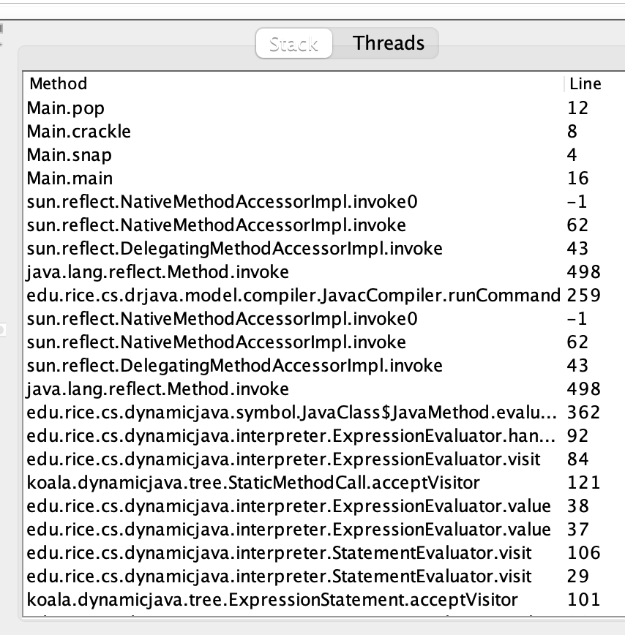
the call stack
functions can call other functions
the resulting "stack" of function calls is called the call stack
class Main {
static void snap() {
crackle();
}
static void crackle() {
pop();
}
static void pop() {
return;
}
public static void main(String[] arguments) {
snap();
}
}

Slide 277
🤔

Slide 278
[let's see what Eclipse does]

Slide 279
recursion

Slide 280
recursion (1/2)
a recursive function is a function that calls itself
each call must make progress towards a base case (when the function finally returns without calling itself)
✨ when in doubt, try something like zero for your base case
class Main extends Cow {
static int digitSum(int n) {
if (n == 0) {
return 0;
}
return digitSum(n / 10) + (n % 10);
}
public static void main(String[] arguments) {
PRINT(digitSum(256)); // 13
}
}

Slide 281
static int digitSum(int n) {
if (n == 0) {
return 0;
}
return digitSum(n / 10) + (n % 10);
}
return 0;
return digitSum(0) + 2;
return digitSum(2) + 5;
return digitSum(25) + 6;
int a = digitSum(256);

Slide 282
static int digitSum(int n) {
if (n == 0) {
return 0;
}
return digitSum(n / 10) + (n % 10);
}
return 0;
return digitSum(0) + 2;
return digitSum(2) + 5;
return digitSum(25) + 6;
int a = digitSum(256);

Slide 283
static int digitSum(int n) {
if (n == 0) {
return 0;
}
return digitSum(n / 10) + (n % 10);
}
return 0 + 2;
return digitSum(2) + 5;
return digitSum(25) + 6;
int a = digitSum(256);

Slide 284
static int digitSum(int n) {
if (n == 0) {
return 0;
}
return digitSum(n / 10) + (n % 10);
}
return 2;
return digitSum(2) + 5;
return digitSum(25) + 6;
int a = digitSum(256);

Slide 285
static int digitSum(int n) {
if (n == 0) {
return 0;
}
return digitSum(n / 10) + (n % 10);
}
return 2;
return digitSum(2) + 5;
return digitSum(25) + 6;
int a = digitSum(256);

Slide 286
static int digitSum(int n) {
if (n == 0) {
return 0;
}
return digitSum(n / 10) + (n % 10);
}
return 2 + 5;
return digitSum(25) + 6;
int a = digitSum(256);

Slide 287
static int digitSum(int n) {
if (n == 0) {
return 0;
}
return digitSum(n / 10) + (n % 10);
}
return 7;
return digitSum(25) + 6;
int a = digitSum(256);

Slide 288
static int digitSum(int n) {
if (n == 0) {
return 0;
}
return digitSum(n / 10) + (n % 10);
}
return 7;
return digitSum(25) + 6;
int a = digitSum(256);

Slide 289
static int digitSum(int n) {
if (n == 0) {
return 0;
}
return digitSum(n / 10) + (n % 10);
}
return 7 + 6;
int a = digitSum(256);

Slide 290
static int digitSum(int n) {
if (n == 0) {
return 0;
}
return digitSum(n / 10) + (n % 10);
}
return 13;
int a = digitSum(256);

Slide 291
static int digitSum(int n) {
if (n == 0) {
return 0;
}
return digitSum(n / 10) + (n % 10);
}
return 13;
int a = digitSum(256);

Slide 292
static int digitSum(int n) {
if (n == 0) {
return 0;
}
return digitSum(n / 10) + (n % 10);
}
int a = 13;

Slide 293
fin.

Slide 294
recursion (2/2)
a stack overflow error happens when functions call too many functions without returning; these errors are usually caused by broken recursive code
class Main {
static void stackOverflow() {
stackOverflow();
}
public static void main(String[] arguments) {
stackOverflow();
}
}
java.lang.StackOverflowError
at Main.stackOverflow(Tmp.java:3)
at Main.stackOverflow(Tmp.java:3)
at Main.stackOverflow(Tmp.java:3)
at Main.stackOverflow(Tmp.java:3)
at Main.stackOverflow(Tmp.java:3)
at Main.stackOverflow(Tmp.java:3)
at Main.stackOverflow(Tmp.java:3)
at Main.stackOverflow(Tmp.java:3)
at Main.stackOverflow(Tmp.java:3)
at Main.stackOverflow(Tmp.java:3)
at Main.stackOverflow(Tmp.java:3)
at Main.stackOverflow(Tmp.java:3)
at Main.stackOverflow(Tmp.java:3)
at Main.stackOverflow(Tmp.java:3)
at Main.stackOverflow(Tmp.java:3)
at Main.stackOverflow(Tmp.java:3)
at Main.stackOverflow(Tmp.java:3)
at Main.stackOverflow(Tmp.java:3)
at Main.stackOverflow(Tmp.java:3)
at Main.stackOverflow(Tmp.java:3)
at Main.stackOverflow(Tmp.java:3)
at Main.stackOverflow(Tmp.java:3)
at Main.stackOverflow(Tmp.java:3)
at Main.stackOverflow(Tmp.java:3)
at Main.stackOverflow(Tmp.java:3)
at Main.stackOverflow(Tmp.java:3)
at Main.stackOverflow(Tmp.java:3)
at Main.stackOverflow(Tmp.java:3)
at Main.stackOverflow(Tmp.java:3)
at Main.stackOverflow(Tmp.java:3)
at Main.stackOverflow(Tmp.java:3)
at Main.stackOverflow(Tmp.java:3)
at Main.stackOverflow(Tmp.java:3)
at Main.stackOverflow(Tmp.java:3)
at Main.stackOverflow(Tmp.java:3)
at Main.stackOverflow(Tmp.java:3)
at Main.stackOverflow(Tmp.java:3)
at Main.stackOverflow(Tmp.java:3)
at Main.stackOverflow(Tmp.java:3)
at Main.stackOverflow(Tmp.java:3)
at Main.stackOverflow(Tmp.java:3)
at Main.stackOverflow(Tmp.java:3)
at Main.stackOverflow(Tmp.java:3)
at Main.stackOverflow(Tmp.java:3)
at Main.stackOverflow(Tmp.java:3)
at Main.stackOverflow(Tmp.java:3)
at Main.stackOverflow(Tmp.java:3)
at Main.stackOverflow(Tmp.java:3)
at Main.stackOverflow(Tmp.java:3)
at Main.stackOverflow(Tmp.java:3)
at Main.stackOverflow(Tmp.java:3)
at Main.stackOverflow(Tmp.java:3)
at Main.stackOverflow(Tmp.java:3)
at Main.stackOverflow(Tmp.java:3)
at Main.stackOverflow(Tmp.java:3)
at Main.stackOverflow(Tmp.java:3)
at Main.stackOverflow(Tmp.java:3)
at Main.stackOverflow(Tmp.java:3)
at Main.stackOverflow(Tmp.java:3)
at Main.stackOverflow(Tmp.java:3)
at Main.stackOverflow(Tmp.java:3)
at Main.stackOverflow(Tmp.java:3)
at Main.stackOverflow(Tmp.java:3)
at Main.stackOverflow(Tmp.java:3)
at Main.stackOverflow(Tmp.java:3)
at Main.stackOverflow(Tmp.java:3)

Slide 295
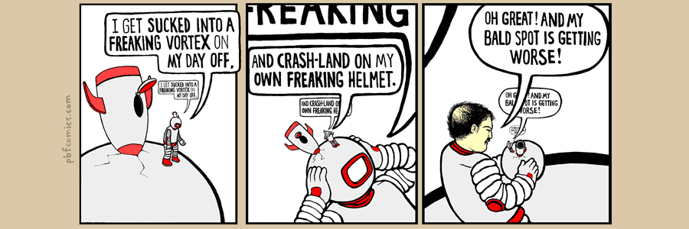

Slide 296
classes

Slide 297
anatomy of a class

Slide 298
anatomy of a class (1/2)
class ClassName {
VariableOneType variableOne;
...
FunctionOneReturnType functionOneName(...) { ... }
...
}
a class is (a blueprint for) a lil chunk of data that you can make elsewhere
a class may have any number of variables (fields)
int foo; // objects of this class have an int called foo
a class may have any number of functions (methods)
int bar() { ... } // objects of class have function bar

Slide 299
anatomy of a class (2/2)
class Thing {
// instance variables
double x;
double y;
Color color;
double radius;
// instance methods
void draw() { ... }
...
}

Slide 300
dot

Slide 301
dot
the dot operator is used to access an object's variables and functions
Thing thing = new Thing();
thing.x = 3.0;
thing.y = 4.0;
thing.draw();

Slide 302
terminology

Slide 303
class vs. object (instance of a class)
a class is NOT the same thing as an object
a class is "a blueprint for making objects"
we can make an instance of a class (an object) using the new keyword
this is called "instantiating the class"
Thing thing = new Thing();

Slide 304
[off the record note on OOP (Object Oriented Programming) terminology]

Slide 305
new and constructors

Slide 306
new
the new keyword create a new instance of a class and calls its appropriate constructor
int[] array = new int[5]; // { 0, 0, 0, 0, 0 }
Color color = new Color(1.0, 0.0, 0.0); // (1.0, 0.0, 0.0)
☠️ you don't need new to create a new string
String string = "strings are their own thing";
☠️ you don't need new to create a new array when using {} syntax
int[] array = { 1, 2, 3 };
☠️ new doesn't actually return the object it created; it returns a reference to the object

Slide 307
constructors (1/2)
a constructor is called when an object is created
if the class does not have a constructor, then the default constructor must be called, which takes no arguments and sets all variables to zero
Color color = new Color(); // (0.0, 0.0, 0.0)

Slide 308
constructors (2/2)
a (non-default) constructor is never necessary, but is often convenient
Color color = new Color(1.0, 1.0, 1.0); // (r=1.0, g=1.0, b=1.0)
Color color = new Color(); // (0.0, 0.0, 0.0)
color.r = 1.0; // (1.0, 0.0, 0.0)
color.g = 1.0; // (1.0, 1.0, 0.0)
color.b = 1.0; // (1.0, 1.0, 1.0)

Slide 309
this 🐍 in Python, this is self

Slide 310
this (1/2)
this is a reference to the instance of the class whose function we're inside of
✨ especially useful inside a constructor
class Color {
...
void shade() {
this.r /= 2;
this.g /= 2;
this.b /= 2;
}
Color(double r, double g, double b) { // constructor
this.r = r;
this.g = g;
this.b = b;
}
}

Slide 311

ANNOUNCEMENTS today is Laptop Wednesday!
✨ would you like Your Homework-02 Code to be prominently featured in our tutorial today?! first come first served WARMUP what is memory?
what is a memory?
can you trust your memory?
TODAY class tutorial

Slide 312
HW-00 has been graded

Slide 313
HW-01 is being graded...

Slide 314
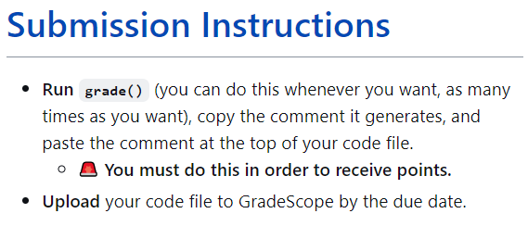

Slide 317
most of you did not do this

Slide 318


Slide 319
you have 24 hours to do this

Slide 320
record LEC 01

Slide 321
Java memory model (references to objects)

Slide 322
references and null

Slide 323
references (1/2)
in Java, we deal with references to objects
int[] foo; // foo is a reference to an int array
String bar; // bar is a reference to a String object
Vector2 a; // a is a reference to a Vector2 object

Slide 324
references (2/2)
☠️ you can (unintentionally) make multiple reference to one object
Vector2 a = new Vector2(3.0, 4.0);
Vector2 b = a;
// a and b are references to the same Vector2 object!
a
x
y
3.0
4.0
b

Slide 325
null
a null reference doesn't refer to any object
Vector2[] array = new Vector2[3]; // { null, null, null }
Vector2 a = null;

Slide 326
the heap a reference is a memory address a memory address is an integer

Slide 327

the heap
objects made using new are stored "on the heap"
the heap is a huuuuuge chunk of memory
objects have an address in that memory (that says where they live)
0x00110022
0x00a20038
0x0ff0a147

Slide 329
Vector2 a = new Vector2(3.0, 4.0);
a
0x00000008
3.0
4.0
0x00000000
0x00000003
0x00000013
0x00000001
0x00000002
0x00000010
0x00000011
0x00000004
0x00000007
0x0000000b
0x00000012
0x00000005
0x00000006
0x00000008
0x00000009
0x0000000a
0x00000014
0x0000000c
0x0000000f
0x00000015
0x0000000d
0x00000008
0x0000000e

Slide 330
references (1/2)
= assigns the value on the right-hand side to the variable on the left-hand side
int a = 3;
int b = a;
a
b
3
3

Slide 331
references (1/2)
= assigns the value on the right-hand side to the variable on the left-hand side
int a = 3;
int b = a;
a = 7;
a
b
7
3

Slide 332
references (2/2)
int a = 3;
int b = a;
a
b
☠️ new doesn't actually return the object it created; it returns a reference to the object it created
a reference is an object's location in memory
this reference is a number (it acts like an int)!
3
3
Foo a = new Foo();
Foo b = a;
a
b
0x7aae6227
0x7aae6227
0x7aae6227

Slide 333
references (2/2)
int a = 3;
int b = a;
a
b
☠️ new doesn't actually return the object it created; it returns a reference to the object it created
a reference is an object's location in memory
this reference is a number (it acts like an int)!
3
3
Foo a = new Foo();
Foo b = a;
a = null;
a
b
0x7aae6227
null
0x7aae6227

Slide 334
references (3/2)
i told a small lie last time we talked
System.out.println(array); does NOT actually print array's memory address
rather, it prints a number called array's "hash code"
(the hash code is typically calculated using the memory address)
🤷
the important point is that a reference is a memory address
and a memory address is an integer (often written in hex) 🙂👍

Slide 335
static

Slide 336
static variables and static methods

Slide 337
instance variables vs. static variables
an instance variable is part of an instance of a class
a static variable (class variable) is part of the class itself
there is only one, period. (it's a global variable that lives "on the class")
class Vector3 {
double x;
double y;
double z;
static Vector3 red = new Vector3(1.0, 0.0, 0.0);
...
}
// drawLine(a, b, Vector3.red);

Slide 338
instance methods vs. static methods
an instance method must be called on an instance (object) of a class
a static method (class method) can be called on the class itself
✅ there is no this in a static method
class Vector2 {
double length() { ... }; // (non-static method)
static double distanceBetween(Vector2 a, Vector2 b) { ... }
...
}
// a.length();
// Vector2.distanceBetween(a, b);

Slide 339
example

Slide 340
class Dog {
static int numTimesAllDogsBarked;
String bark;
Dog(String bark) {
this.bark = bark;
}
void makeBark() {
System.out.println(this.bark);
Dog.numTimesAllDogsBarked++;
}
> public static void main(String[] args) {
Dog rex = new Dog("woof!");
> Dog fido = new Dog("yip!");
rex.makeBark();
fido.makeBark();
System.out.println(Dog.numTimesAllDogsBarked);
}
}
Dog
(the class)
int numTimesAllDogsBarked;
args
(an instance/object of String[])
rex
(an instance of Dog)
rex.bark
(an instance of String)
String bark;
"woof!"
String[] args;
Dog rex;
Dog fido;
fido
(an instance of Dog)
fido.bark
(an instance of String)
main()
(stack frame)
String bark;
"yip!"
(these are references!)
----Stack----
(local variables)
-------Heap-------
(instances aka objects)
-----Static-----
(static data)

Slide 341
💻Class Tutorial

Slide 342
ANNOUNCEMENTS today is Jim Codes At You For 50 Minutes Friday 🎉🎉
WARMUP explain!
TODAY Homework-03
65 turrets = new Turret[100];
66 for (int i = 0; i < turrets.length; i++) {
67 Turret turret = turrets[i];
68 turret = new Turret();
69 }
70 turrets[0].position = new Vector2(40.0, 0.0);
java.lang.NullPointerException
at HW03.setup(HW03.java:70)

Slide 343
record LEC 01

Slide 344
example

Slide 345
turrets = new Turret[100]; for (int i = 0; i < turrets.length; i++) { // consider iteration i <- 0 Turret turret = turrets[i]; turret = new Turret(); } turrets[0].position = new Vector2(40.0, 0.0);
turret
turrets
0x00000010
0x00000010
null
null
null
null
0x00000000
0x00000003
0x00000013
0x00000001
0x00000002
0x00000010
0x00000011
0x00000004
0x00000007
0x0000000b
0x00000012
0x00000005
0x00000006
0x00000008
0x00000009
0x0000000a
0x00000014
0x0000000c
0x0000000f
0x00000015
0x0000000d
0x0000000e

Slide 346
turrets = new Turret[100]; for (int i = 0; i < turrets.length; i++) { // consider iteration i <- 0 Turret turret = turrets[i]; turret = new Turret(); } turrets[0].position = new Vector2(40.0, 0.0);
turret
turrets
0x00000002
0x00000010
null
null
0.0, 0.0
0
0.0, 0.0
null
null
0x00000000
0x00000003
0x00000013
0x00000001
0x00000002
0x00000010
0x00000011
0x00000004
0x00000007
0x0000000b
0x00000012
0x00000005
0x00000006
0x00000008
0x00000009
0x0000000a
0x00000014
0x0000000c
0x0000000f
0x00000015
0x0000000d
0x0000000e

Slide 347
ANNOUNCEMENTS today is Jim Codes At You For 50 Minutes Friday 🎉🎉
Help Hours
WARMUP explain!
TODAY Homework-03
65 turrets = new Turret[100];
66 for (int i = 0; i < turrets.length; i++) {
67 turrets[i] = new Turret();
68 // Turret turret = turrets[i]; OK here
69 }
70 turrets[0].position = new Vector2(40.0, 0.0);

Slide 348
stack trace
a stack trace is the state of the call stack (all the functions that got called and haven't returned yet), usually printed when your program crashes
java.lang.NullPointerException
at HW03.setup(HW03.java:70)
at App.paintComponent(Cow.java:397)
at javax.swing.JComponent.paint(JComponent.java:1056)
at javax.swing.JComponent.paintChildren(JComponent.java:889)
at javax.swing.JComponent.paint(JComponent.java:1065)
at javax.swing.JComponent.paintChildren(JComponent.java:889)
at javax.swing.JComponent.paint(JComponent.java:1065)
at javax.swing.JLayeredPane.paint(JLayeredPane.java:586)
at javax.swing.JComponent.paintChildren(JComponent.java:889)
at javax.swing.JComponent.paintToOffscreen(JComponent.java:5217)
at javax.swing.RepaintManager$PaintManager.paintDoubleBuffered(RepaintManager.java:1579)
at javax.swing.RepaintManager$PaintManager.paint(RepaintManager.java:1502)
at javax.swing.RepaintManager.paint(RepaintManager.java:1272)
at javax.swing.JComponent.paint(JComponent.java:1042)
at java.awt.GraphicsCallback$PaintCallback.run(GraphicsCallback.java:39)
at sun.awt.SunGraphicsCallback.runOneComponent(SunGraphicsCallback.java:79)
at sun.awt.SunGraphicsCallback.runComponents(SunGraphicsCallback.java:116)
at java.awt.Container.paint(Container.java:1978)
at java.awt.Window.paint(Window.java:3906)
at javax.swing.RepaintManager$4.run(RepaintManager.java:842)
at javax.swing.RepaintManager$4.run(RepaintManager.java:814)
at java.security.AccessController.doPrivileged(Native Method)
at java.security.ProtectionDomain$JavaSecurityAccessImpl.doIntersectionPrivilege(ProtectionDomain.java:74)
at javax.swing.RepaintManager.paintDirtyRegions(RepaintManager.java:814)
at javax.swing.RepaintManager.paintDirtyRegions(RepaintManager.java:789)
at javax.swing.RepaintManager.prePaintDirtyRegions(RepaintManager.java:738)
at javax.swing.RepaintManager.access$1200(RepaintManager.java:64)
at javax.swing.RepaintManager$ProcessingRunnable.run(RepaintManager.java:1732)
at java.awt.event.InvocationEvent.dispatch(InvocationEvent.java:311)
at java.awt.EventQueue.dispatchEventImpl(EventQueue.java:758)
at java.awt.EventQueue.access$500(EventQueue.java:97)
at java.awt.EventQueue$3.run(EventQueue.java:709)
at java.awt.EventQueue$3.run(EventQueue.java:703)
at java.security.AccessController.doPrivileged(Native Method)
at java.security.ProtectionDomain$JavaSecurityAccessImpl.doIntersectionPrivilege(ProtectionDomain.java:74)
at java.awt.EventQueue.dispatchEvent(EventQueue.java:728)
at java.awt.EventDispatchThread.pumpOneEventForFilters(EventDispatchThread.java:205)
at java.awt.EventDispatchThread.pumpEventsForFilter(EventDispatchThread.java:116)
at java.awt.EventDispatchThread.pumpEventsForHierarchy(EventDispatchThread.java:105)
at java.awt.EventDispatchThread.pumpEvents(EventDispatchThread.java:101)
at java.awt.EventDispatchThread.pumpEvents(EventDispatchThread.java:93)
at java.awt.EventDispatchThread.run(EventDispatchThread.java:82)

Slide 349
stack trace
a stack trace is the state of the call stack (all the functions that got called and haven't returned yet), usually printed when your program crashes
java.lang.NullPointerException
at HW03.setup(HW03.java:70)

Slide 350
how did the starter code come to be?

Slide 351
run the starter code

Slide 352
delete the starter code

Slide 353
get familiar with App setup() runs once at the beginning loop() runs over and over, once per frame during a frame (like a frame of a movie) we update and draw the world

Slide 354
loop(); // update and draw
loop(); // update and draw
loop(); // update and draw
loop(); // update and draw
loop(); // update and draw
loop(); // update and draw
loop(); // update and draw
loop(); // update and draw
loop(); // update and draw

Slide 355
draw a circle for the player get something (anything) on the screen ☺

Slide 356
move the player around the player's position must "persist across frames" the simplest approach is to make playerPosition an instance variable of the HW03 class we will initialize it in setup() and update it in loop() keyboard input is explained in the ✨Documentation✨

Slide 357
DOCUMENTATION

Slide 358
make Player a class optional, but seems reasonable in Java (would have been okay to skip straight to this step; i tend not to)

Slide 359
make a Turret class keep it simple!--make it similar to Player

Slide 360
write usage code for how we'll create and update the bullets since it's Week-03, we'll store a bunch of "slots" for bullets in a huuuge array i'll call currently unused slots "not alive" ("dead") to fire a bullet, find the first empty slot in the bullets array and make that bullet alive 🧟

Slide 361
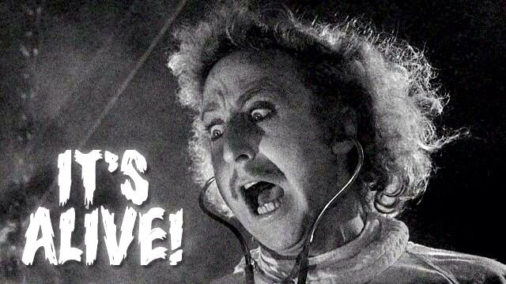

Slide 362
starting the homework

Slide 363
multiple turrets

Slide 364
fire function

Slide 365
extensions

Slide 366
turrets flashing upon hit i like having an instance variable called int framesSinceHitByBullet;

Slide 368
🎥 time

Slide 369
object-oriented programming

Slide 370
in Java, everything is a class

Slide 371
object-orientation != my-code-has-objects

Slide 372
compression-oriented programming

Slide 373
neo in the matrix (int) int a; int b

Slide 374
int[] nums; nums = new int[4]; int[] nums = new int[4];

Slide 375
details

Slide 376
garbage collection

Slide 377
garbage collector
the garbage collector is like a trash truck that drives around in memory; when it notices an object that your program no longer has any references to, it frees up that memory for future use
🌊 C does NOT have a garbage collector; in C you free heap-allocated memory yourself by calling free(...)

Slide 382
☕️ the art of coding things in the right order compile and run early compile and run often

Slide 383
why implement Rule 22 first? why not just skip straight to the general case?

Slide 384

well, let us imagine...

Slide 385
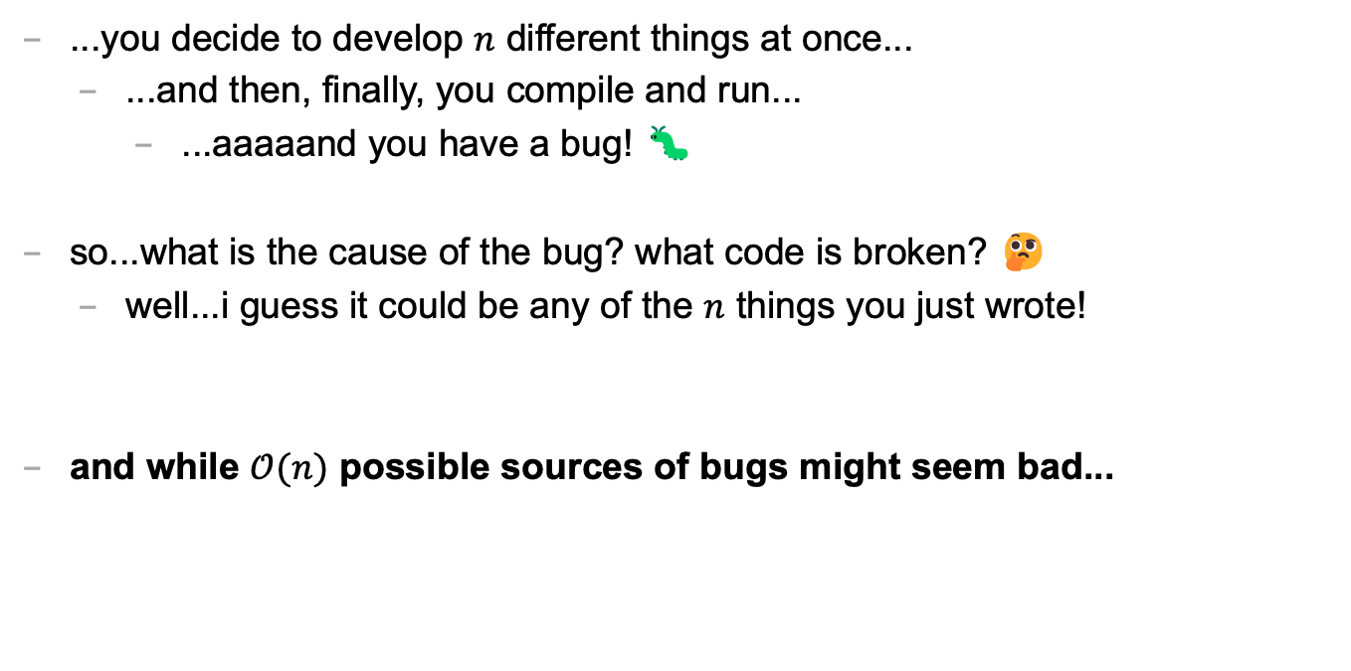
let's imagine...
...you decide to develop $n$ different things at once...
...and then, finally, you compile and run...
...aaaaand you have a bug! 🐛
so...what is the cause of the bug? what code is broken? 🤔
well...i guess it could be any of the $n$ things you just wrote!
and while $𝒪(n)$ possible sources of bugs might seem bad...

Slide 386
...the reality is ✨so much worse✨!

Slide 387

because broken code likes to interact with other broken code, to make✨super bugs✨!

Slide 389
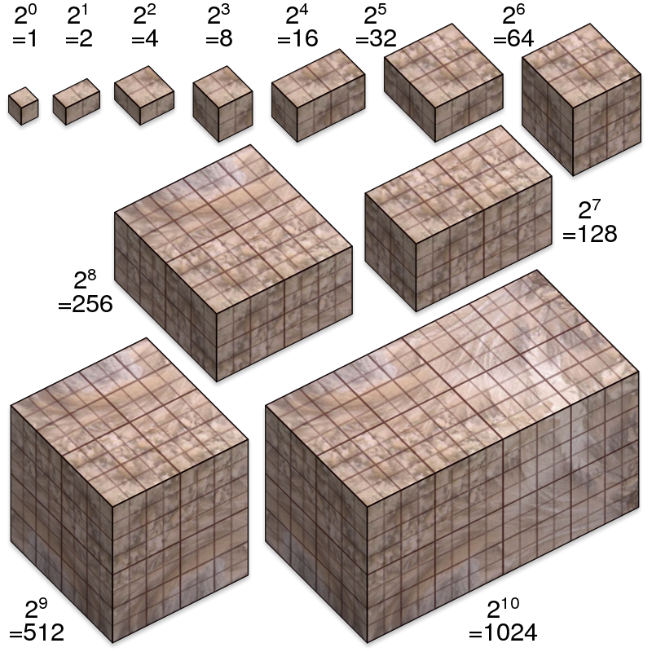
not broken
broken
developing one thing at a time

Slide 390
not broken
A is broken
B is broken
A and B are both broken
developing two things at a time

Slide 391

asymptotic bug-finding time

Slide 392
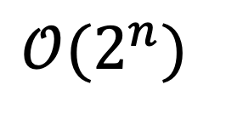
$$𝒪(2^{n})$$
gl;hf 🙂👍

Slide 393
big lesson
implement code one thing at a time
compile and run and test after implementing every single thing
this is a learned skill!
how i would actually implement the automata homework
make the array
print the array as an array
print the array as a string
update the array once using Rule 22 and print the result
wrap the printing and update in a for loop
implement code to handle all rules and test it on Rule 22
test it on the other rules

Slide 394
this is a learned skill!

Slide 395

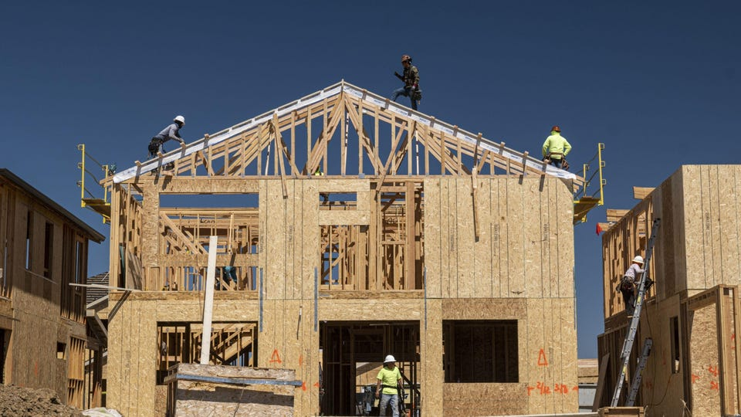
in summary

Slide 396
CHATGPT TODO: help hours start monday
🙅🙆🙅‍♂️🙆‍♂️🙅‍♀️🙆‍♀️

Slide 397
expectations
🙅🙆🙅‍♂️🙆‍♂️🙅‍♀️🙆‍♀️

Slide 398
ANNOUNCEMENTS today is No Laptop Monday! 🙅‍♂️💻🎉 WARMUP (discuss with people you don't know) what does 2 + 2 like...mean? 🧠 🌞 TODAY Fundamentals of Java Part 1

Slide 399
thank you to those who emailed DrJava questions! note: my email responses tend to be really short; it doesn't mean i'm annoyed; i just have to write emails really fast because there are ~64 students in this class 🙂👍 ps screenshots are really helpful if you email me!

Slide 400
is there anyone here who is not yet enrolled in CS 136 and would like to be?

Slide 401
questions before we begin?

Slide 402
record lecture?

Slide 403
type

Slide 404
variables in Java have a specified type
# okay in Python
foo = 7 # foo is an int
foo = False # now, foo is a boolean
// NOT okay in Java
int foo = 7; // foo is an int
foo = false; // Error: incompatible types:
// boolean cannot be converted to int

Slide 405
in Java, declaring and initializing variables are separate things
// Option A: one line int foo = 7; // declare int foo and initialize it to 7
// Option B: two lines int foo; // declare a variable foo of type int foo = 7; // initialize foo to 7

Slide 406
built-in data types

Slide 407
primitive data types

Slide 408
boolean, char, double, int
a boolean stores a truth value
true, false
a char stores a character
'\0', 'a', 'Z', '!', '\n'
a double stores a floating point number
0.0, -0.5, 3.1415926, Double.NEGATIVE_INFINITY
an int stores an integer number
0, -1, 4

Slide 409
primitive data type Venn diagram
integers
numbers
char
double
boolean
int

Slide 410
char is an integer type
a char is an integer type
each char has a corresponding integer, for example ('a' == 97)
the letters are in order ('a' == 97), ('b' == 98), ('c' == 99)...
the numbers are also in order ('0' == 48), ('1' == 49)...
you can do math with char's
char foo = 'a' + 2; // foo is 'c'
char bar = '0' + 7; // bar is '7'
int baz = '6' - '0'; // baz is 6

Slide 411
zero
each primitive data type has its own notion of what it means to "be zero"
int zero = 0;
double zero = 0.0;
boolean zero = false;
char zero = '\0'; // the "null character"

Slide 412
String

Slide 413
String (1/2)
a String is a sequence of characters
"Hello World", "Foo123"

Slide 414
String (2/2)
String's have several useful functions/methods (which are described in our Documentation)
String string = "Hello"; // makes a new String
System.out.println(string.length()); // 5
System.out.println(string.charAt(1)); // 'e'
System.out.println(string.substring(0, 3)); // "Hel"

Slide 415
operators (except for bitwise operators, which we'll do later maybe)

Slide 416
assignment operator

Slide 417
assignment operator
= assigns the value on the right-hand side to the variable on the left-hand side
int i = 0; // 0 ("int i now has the value 0")
double foo = coolFunction();
☠ the assignment operator returns the value it assigned this is usually pretty confusing
boolean b = false;
boolean c = (b = foo());

Slide 418
arithmetic operators

Slide 419
basic arithmetic (number) operators
+ adds two numbers
- subtracts two numbers
* multiplies two numbers
/ divides two numbers
☠ an int divided by an int is an int
int foo = 8 / 2; // 4
int bar = 7 / 2; // 3
Java "throws away the remainder"
- returns the negative of a number
int bar = -7; // -7 ("negative 7" or "minus 7")
int baz = -bar; // 7

Slide 420
modulo
x % y returns the remainder of (x / y) and is read "x modulo y"
int foo = 17 % 5; // 2 ("17 divided by 5 is 3 remainder 2")
☠ % probably doesn't do what you expect for negative numbers; if x can be negative, use Math.floorMod(x, y) instead
5 % 3 // 2
4 % 3 // 1
3 % 3 // 0
2 % 3 // 2
1 % 3 // 1
0 % 3 // 0
-1 % 3 // -1 🤔
Math.floorMod(-1, 3) // 2 🙂👍

Slide 421
logical operators

Slide 422
logical operators (1/2)
|| returns whether the left-hand side or the right-hand side is true
(true || true) // true
(true || false) // true
(false || true) // true
(false || false) // false
&& returns whether the left-hand side and the right-hand side are true
(true && true) // true
(true && false) // false
(false && true) // false
(false && false) // false
! returns the opposite of a boolean, and is read as "not"
(!true) // false ("not true")
(!false) // true

Slide 423
logical operators (2/2)
// example, step by step
boolean a = (2 + 2 == 5); // false
boolean b = true; // true
boolean c = (a || b); // true
boolean d = !c; // false
// same thing all on one line
boolean d = !((2 + 2 == 5) || true); // false
// equivalent code
boolean d = false;

Slide 424
☠ logical operator short-circuiting
(false && foo()) "lazily" evaluates to false without evaluating foo()
(true || foo()) "lazily" evaluates to true without evaluating foo()

Slide 425
comparison operators

Slide 426
☠ equality (is equal to)
== returns whether the left-hand side is equal to the right-hand side
boolean b = (foo == bar);
if (foo == bar) { ... }
☠ this does NOT work for String's
instead, use (stringA.equals(stringB) )
☠ this (usually) does NOT work for double's
instead, use (Math.abs(double1 - double2) < 0.00001)

Slide 427
is greater than, is less than
> returns whether the left-hand side is greater than the right-hand side
< returns whether the left-hand side is less than the right-hand side

Slide 428
convenient operators (feel free to ignore these for now)

Slide 429
inequality
!= returns whether the left-hand side is not equal to the right-hand side
(left != right) is exactly the same as (!(left == right))

Slide 430
greater than or equal to, less than or equal to
>= returns whether the left-hand side is greater than or equal to the right-hand side
(left >= right) is basically the same as ((left > right) || (left == right)) greater-than or equal
<= returns whether the left-hand side is less than or equal to the right-hand side

Slide 431
arithmetic assignment operators
a += b; // a = a + b;
a -= b; // a = a - b;
a *= b; // a = a * b;
a /= b; // a = a / b;

Slide 432
String concatenation
+ concatenates two String's
// String foo = "Hello".concat("World"); String foo = "Hello" + "World"; // "HelloWorld"
it also does some conversions for you (very convenient, kind of consuming)
// String foo = "Hello".concat(Integer.toString(2)); String foo = "Hello" + 2; // "Hello2"

Slide 433
increment operator
to "increment" means to increase the value of a number by one
i = i + 1;
i += 1;
the pre-increment ++i increments i and returns the new value of i
j = ++i; // i = i + 1;
// j = i;
the post-increment i++ increments i and returns the old value of i
j = i++; // j = i;
// i = i + 1;

Slide 434
decrement operator
to "decrement" means to decrease the value of a number by one
i = i - 1;
i -= 1;
the pre-decrement --i decrements i and returns the new value of i
j = --i; // i = i - 1;
// j = i;
the post-decrement i-- decrements i and returns the old value of i
j = i--; // j = i;
// i = i - 1;

Slide 435
ANNOUNCEMENTS today is No Laptop Wednesday! 🙅‍♂️💻🎉🔥 WARMUP is it bad when programs crash? 🌞🌞 TODAY Fundamentals of Java Part 2

Slide 436
Homework-00 was due in Gradescope two nights ago; if you didn't submit it yet, probably do that ASAP 🙂👍

Slide 437
Homework-01 will be harder than Homework-00; Homework-02 will be harder than Homework-01; and then hopefully we more or less plateau (feel free to reach out with any questions about course difficulty 🙂👍)

Slide 438
record LEC 01

Slide 439
flow control

Slide 440
the execution of a Java program starts at the top of main(...) and flows down down down

Slide 441
let's step through this program in our minds, and then in a debugger
class Main {
public static void main(String[] arguments) {
double a = 3.0;
double b = 4.0;
double result = Math.sqrt(a * a + b * b);
System.out.println(result);
}
}

Slide 442
functions (preview)

Slide 443
functions (preview)
when a function is called, control flow jumps to the top of the function, flows down through it, and then jumps back to right after the function call
class Main {
static double pythagoreanTheorem(double a, double b) {
return Math.sqrt(a * a + b * b);
}
public static void main(String[] arguments) {
double hypotenuse = pythagoreanTheorem(3.0, 4.0);
System.out.println(hypotenuse);
}
}

Slide 444
assert

Slide 445
assert condition; (1/2)
an assert statement crashes the program if its condition is false
assert false; crashes the program no matter what
class Main {
static double pythagoreanTheorem(double a, double b) {
assert a > 0.0;
assert b > 0.0;
return Math.sqrt(a * a + b * b);
}
public static void main(String[] arguments) {
double hypotenuse = pythagoreanTheorem(3.0, 4.0);
System.out.println(hypotenuse);
}
}

Slide 446
assert condition; (2/2)
☠ asserts are actually disabled by default in Java, and are ignored
DrJava enables them by default 🙂👍

Slide 447
if and else

Slide 448
if (condition) { body }
an if statement lets a program make a decision (instead of just stepping down down down forever down)
int choice = getIntFromUser();
if (choice == 0) {
System.out.println("The user chose 0. What a fine choice");
}

Slide 449
if (...) { if-body } else { else-body }
the body of an else statement is executed if its corresponding if statement's condition is false
int choice = getIntFromUser();
if (choice == 0) {
System.out.println("The user chose 0. What a fine choice");
} else {
System.out.println("The user did not choose 0.");
System.out.println("How avant-garde!");
}

Slide 450
if (...) { ... } else if (...) { ... } ... else { ... }
if and else statements can be chained together
this is great for decisions with many options
int choice = getIntFromUser();
if (choice == 0) {
...
} else if (choice == 1) {
...
} else if (choice == 2) {
...
} else {
assert false;
}

Slide 451
while and do...while

Slide 452
while (condition) { body }
a while loop repeats a block of code as long as the condition holds (if the condition is false the first time we see it, we never execute the body)
while (true) { ... } is an infinite loop
while (!gameOver) {
...
if (player.health <= 0) {
gameOver = true;
}
}

Slide 453
do { ... } while (...);
a do...while loop is (sometimes) useful when you know you need to do something at least once (and then potentially a bunch more times)
int choice;
do {
choice = getIntFromUser();
} while (!(0 <= choice && choice <= 2));
int choice = getIntFromUser();
while (!(0 <= choice && choice <= 2)) {
choice = getIntFromUser();
}

Slide 454
for

Slide 455
for (...; condition; ...) { ... } (1/2)
a for loop can be a convenient alternative to a while loop
for (int i = 0; i < n; ++i) {
...
}
{
int i = 0;
while (i < n) {
...
++i;
}
}

Slide 456
for (...; condition; ...) { ... } (2/2)
for loops can be kind of wild (probably stick with simple ones for now)
for (double a = 10.0; (a > 1.01); a = Math.sqrt(a)) {
...
}
for (int j = n - 1, i = 0; (i < n); j = i++) {
...
}
for (;;) {
...
}

Slide 457
break and continue

Slide 458
break
break breaks out of a loop
while (true) {
...
if (player.health <= 0) {
break;
}
}

Slide 459
continue
continue continues to the next iteration of a loop
for (int i = 0; i < numberOfSlots; ++i) {
if (!slots[i].isOccupied) {
continue;
}
... // do something with whatever is in the i-th slot
}

Slide 460
scope

Slide 461
{ ... }

Slide 462
scope
a scope is a region of code in which variables live
in Java, a scope is (usually) defined by a pair of curly braces
OUTER_SCOPE { INNER_SCOPE } OUTER_SCOPE
{
int i;
{
int j;
// you CAN use i here 🙆‍♂️
// you CAN use j here 🙆‍♂️
}
// you CAN use i here 🙆‍♂️
// you CANNOT use j here 🙅
}

Slide 463
common scope-related errors

Slide 464
cannot find symbol (1/2)
Error: cannot find symbol
symbol: variable foo
location: class Main
class Main {
public static void main(String[] arguments) {
if (...) {
int foo = 0;
} else {
int foo = 1;
}
System.out.println(foo);
}
}

Slide 465
cannot find symbol (2/2)
Compilation completed.
class Main {
public static void main(String[] arguments) {
int foo;
if (...) {
foo = 0;
} else {
foo = 1;
}
System.out.println(foo);
}
}

Slide 466
variable already defined (1/2)
Error: variable foo is already defined in method main(java.lang.String[])
class Main {
public static void main(String[] arguments) {
int foo;
if (...) {
int foo = 0;
} else {
foo = 1;
}
System.out.println(foo);
}
}

Slide 467
variable already defined (2/2)
Compilation completed.
class Main {
public static void main(String[] arguments) {
int foo;
if (...) {
foo = 0;
} else {
foo = 1;
}
System.out.println(foo);
}
}

Slide 468
whitespace

Slide 469
whitespace
whitespace includes spaces and newlines
🐍 Python does care about whitespace (indentation changes what code does)
Java does NOT care about whitespace
🗣️ do you care about whitespace?
some guidelines:
be consistent!
carefully indent your scopes (and make sure your curly braces line up)
✨ DrJava can do this for you! no excuses!
sparks joy | NOT equivalent -- doesn’t spark joy
for (int i = 0; i < 10; ++i) { if (i % 3 == 0) { System.out.println("fizz"); } } | for (int i = 0; i < 10; ++i) { if (i % 3 == 0) { } System.out.println("fizz"); }

Slide 470
exceptions to scope being the same as curly braces

Slide 471
for (...; ...; ...) { ... }
variables declared inside the parentheses of a for loop are not available outside of the for loop (this is probably the behavior you already expected)
Error: cannot find symbol
symbol: variable i
location: class Main
class Main {
public static void main(String[] arguments) {
for (int i = 0; i < 10; ++i) {
...
}
System.out.println(i);
}
}

Slide 472
☠ if, else, for, while without braces (1/2)
☠ if you (intentionally or unintentionally) forget your curly braces, then Java will assume you wanted them go around the first statement after the if (...), else, for (...), or while (...)
in this class, i highly recommend always using curly braces
if (choice == 0)
System.out.println("The user chose 0. What a fine choice");
if (choice == 0) {
System.out.println("The user chose 0. What a fine choice");
}

Slide 473
☠ if, for, while without braces (2/2)
if (choice == 0)
System.out.println("The user chose 0. What a fine choice");
else
System.out.println("The user did not choose 0.");
System.out.println("How avant-garde!");
if (choice == 0) {
System.out.println("The user chose 0. What a fine choice");
} else {
System.out.println("The user did not choose 0.");
} // whoops!
System.out.println("How avant-garde!");

Slide 474
let's do the homework (including infinite loop example)

Slide 475
ANNOUNCEMENTS hexDigitSum CORRECTION -- don't print error message and return; instead, just crash using an assert false; 🙂👍 today is Fun Friday! 🎉🎉🎉🔥🚨🚨 WARMUP compress this code! 🙆‍♂️ TODAY goto and big O notation
boolean isEven;
if (i % 2 == 0) {
isEven = true;
} else if (i % 2 != 0) {
isEven = false;
}
if (isEven) {
...
}

Slide 476
homework hints

Slide 477
homework hints (1/2)
char is an integer type!
// char c
48 <= c
'0' <= c
we have ✨Documentation✨ linked on the website! (it's really good!)
for (char c : string.toCharArray()) {
for (int i = 0; i < string.length(); ++i) {
char c = string.charAt(i);
// i know it's more typing but you'll thank me (much) later
the starter code has ✨Examples✨ (they're relevant!)

Slide 478
homework hints (2/2)
if you get a weird "illegal start of expression" compiler error...
highlight your code and press Tab!
you're probably missing a curly brace somewhere above the error
import java.util.*;
class Main {
// returns the length of the hypotenuse of right triangle with legs of lengths a and b
static double pythagoreanTheorem(double a, double b) {
return Math.sqrt(a * a + b * b);
// returns whether n is prime
static boolean isPrime(int n) {
if (n < 2) { return false; }
for (int i = 2; i < n / 2; ++i) {
if (n % i == 0) {
return false;
}
}
return true;
}
}

Slide 479
Java doesn't have a goto

Slide 480
goto label;
a goto "goes to" some label
it turns out loops are just convenient alternatives to goto's
goto's are considered *spooky*👻
while (condition) {
...
}
label BEGINNING_OF_WHILE:
if (!condition) {
goto END_OF_WHILE;
}
...
goto BEGINNING_OF_WHILE;
label END_OF_WHILE:

Slide 485
story time ☕️

Slide 489
{
}
goto fail;

Slide 490
did the bug really happen because they left out the curly braces?

Slide 493
did the bug really happen because they left out the curly braces?

Slide 494
no, the bug happened because they didn't code in DrJava!

Slide 495
highlight your code and press Tab!

Slide 496
big O

Slide 497
big O (1/2)
big O describes a function’s “limiting behavior”
to find a mathematical function’s big O notation...
1. throw away the coefficients
2. find the fastest growing term
3. the function is $𝒪($FASTEST_GROWING_TERM$)$
e.g., $f\left(n\right)=7n^{2}+100n+4732$
1. throw away coefficients to get $n^{2}+n+1$
2. fastest growing term is $n^{2}$
3. $f\left(n\right)$ is $𝒪(n^{2})$

Slide 498
big O (2/2)
what is $f\left(n\right)=77n^{7}+2^{n}$ in big O notation?
$n^{7}+2^{n}$
$2^{n}$ 🧪 is this true?
$𝒪(2^{n})$
what is $f\left(n\right)=100$ in big O notation?
$1$
$1$ 🧠 what does this mean?
$𝒪(1)$
what is $f\left(n\right)=n+log⁡(n)$ in big O notation?
$n+log⁡(n)$
$n$ 🧪 is this true?
$𝒪(n)$

Slide 499
🗣 what is the big O of your isPrime(int n)? can you do better?

Slide 500
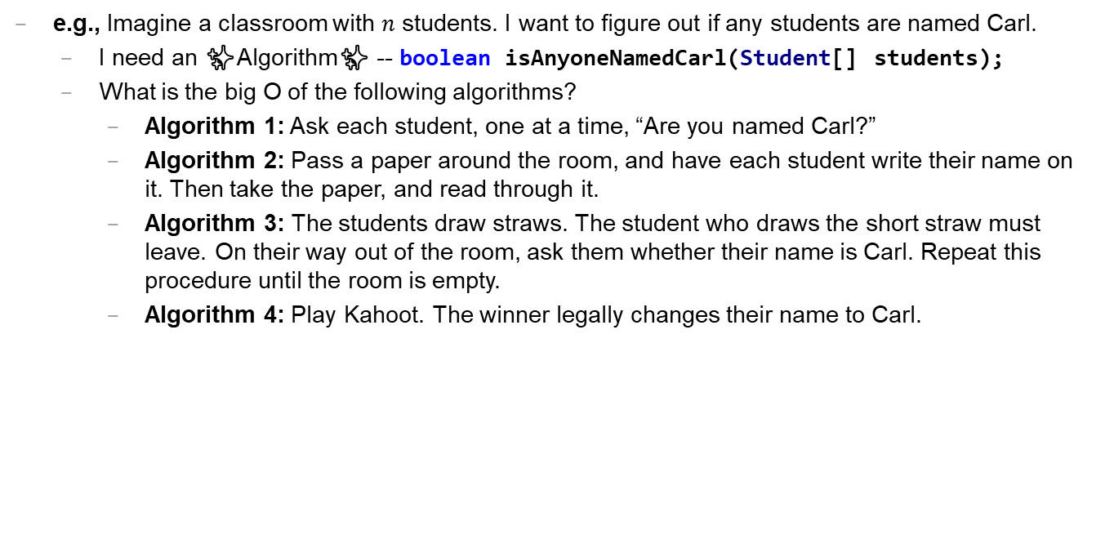
Caaaaaaaaaaaarl
e.g., Imagine a classroom with $n$ students. I want to figure out if any students are named Carl.
I need an ✨Algorithm✨ -- boolean isAnyoneNamedCarl(Student[] students);
What is the big O of the following algorithms?
Algorithm 1: Ask each student, one at a time, “Are you named Carl?”
Algorithm 2: Pass a paper around the room, and have each student write their name on it. Then take the paper, and read through it.
Algorithm 3: The students draw straws. The student who draws the short straw must leave. On their way out of the room, ask them whether their name is Carl. Repeat this procedure until the room is empty.
Algorithm 4: Play Kahoot. The winner legally changes their name to Carl.

Slide 501
extra time: practice exam questions 🤷‍♂️

Slide 502

ANNOUNCEMENTS today is No Laptop Monday WARMUP how many arrays does this app use? (answer on Friday) TODAY arrays, aka, The Best Data Structure Ever
arrays

Slide 503
record LEC 02

Slide 504
mental model of an array

Slide 505
mental model of an array
elements live in equally-sized boxes all right next to each other
🟩🟩🟩🟩🟩🟩🟩🟩
the array itself lives "in memory"

Slide 506
mental model of an array
elements live in equally-sized boxes all right next to each other
🟩🟩🟩🟩🟩🟩🟩🟩
the array itself lives "in memory"

Slide 507
arrays

Slide 508
arrays (1/2)
an array is a fixed-size sequence of elements, all of the same type
"an array of 4372 double's"
"an array of 1 int's"
"an array of 64 Student's"

Slide 509
arrays (2/2)
we will often write an array using curly braces
{ 7, 7, 9 } is an array containing 7, 7, and 9
optionally, you can include a comma after the last element
{ 7, 7, 9, }
☠ even though sets from math also use curly braces, Java arrays have nothing to do with sets; in a set, all elements must be unique

Slide 510
array operations

Slide 511
creating an array (1/2)
you can create an array by specifying its length (the number of elements); if you do, the array is zero-initialized (all elements are initially set to zero)
int[] array = new int[8]; // { 0, 0, 0, 0, 0, 0, 0, 0 }
boolean[] array = new boolean[2]; // { false, false }
String[] array = new String[3]; // { null, null, null }

Slide 512
creating an array (2/2)
you can also create an array by specifying its elements; if you do, the array's length is the number of elements you specified
int[] array = { 7, 7, 9 };
boolean[] array = { true };
String[] array = { "hello", "world" };

Slide 513
getting an array's length
after creating an array, you can get (but not set) its length
int[] array = { 7, 7, 9 };
System.out.println(array.length); // 3
int[] array = new int[8];
System.out.println(array.length); // 8
Error: cannot assign a value to final variable length
array.length = 42;

Slide 514
getting the value of an element of an array
you can get the value of an element of an array using the square brackets and the index of the element
this is also called "accessing the array"
int[] array = { 3, 4, 5 };
int foo = array[0]; // 3
int[] array = { 3, 4, 5 };
int foo = array[42];
java.lang.ArrayIndexOutOfBoundsException: 42

Slide 515
setting the value of an element of an array
you can set the value of an element of an array using the square brackets and the index of the element
int[] array = { 7, 7, 9 };
array[1] = 8;
// { 7, 8, 9 }
int[] array = { 7, 7, 9 };
array[-1] = 1000;
java.lang.ArrayIndexOutOfBoundsException: -1

Slide 516
☠ printing the elements of an array
☠ in Java, you don't simply call System.out.println(array)
instead, you call System.out.println(Arrays.toString(array));
note: this prints with square brackets instead of curly brackets
🤷‍♂️

Slide 517
runtime of array operations

Slide 518
runtime of array operations
arrays are fast!
⏱️ creating an array takes $𝒪(n)$ time, where $n$ is the length of the array
⏱️ getting the value of the i-th element of an array takes $𝒪(1)$ time
⏱️ setting the value of the i-th element of an array takes $𝒪(1)$ time

Slide 519
accessing an array "under the hood"
how Java does array[4], step-by-step:
start at the head (0-th element) of the array 🟦⬛⬛⬛⬛⬛⬛⬛
move over 4 slots (using an $𝒪(1)$ "add") ⬛⬛⬛⬛🟦⬛⬛⬛
return the value of the element in that slot ⬛⬛⬛⬛🟨⬛⬛⬛
we can't actually see Java do this (it's too "low level")
but we *can* see C do it! (stay tuned 🙂)

Slide 520
iterating over an array

Slide 521
iterating over an array
a for loop can be used to iterate over an array
for (int i = 0; i < array.length; ++i) {
array[i] = ...;
}

Slide 522
array examples

Slide 523
example: creating an array of the first 100 non-negative integers

Slide 524
example: creating an array of the first 100 non-negative integers
import java.util.*;
class Main {
public static void main(String[] arguments) {
int[] array = new int[100];
for (int i = 0; i < array.length; ++i) {
array[i] = i;
}
System.out.println(Arrays.toString(array));
}
}

Slide 525
example: array copy

Slide 526
example: array copy
import java.util.*;
class Main {
public static void main(String[] arguments) {
int[] source = { 3, 4, 5 };
int[] destination = new int[source.length];
for (int i = 0; i < source.length; ++i) {
destination[i] = source[i];
}
System.out.println(Arrays.toString(source));
System.out.println(Arrays.toString(destination));
}
}

Slide 527
☠ example: bad very bad broken array copy

Slide 528
☠ example: bad very bad broken array copy
import java.util.*;
class Main {
public static void main(String[] arguments) {
int[] source = { 3, 4, 5 };
int[] destination = source;
source[0] = 7;
System.out.println(Arrays.toString(source));
System.out.println(Arrays.toString(destination));
}
}

Slide 529
ANNOUNCEMENTS today is Laptop Wednesday 💻 🎉 WARMUP internally, a String is an array of characters what must stringA + stringB *do*? why might this be scary? 👻
TODAY more arrays; arrays of arrays; arrays arrays arrays

Slide 530
Homework-02 (refresh the page!) 📚

Slide 531
Pre-Lab Post-Lab

Slide 532
record LEC 02

Slide 533
example: circular array
3, 4, 5, 6, 7, 8, 9, 10, 11,

Slide 534
example: circular array
import java.util.*;
class Main {
public static void main(String[] arguments) {
int[] array = new int[5];
int indexToWriteIntoNext = 0;
while (true) {
array[indexToWriteIntoNext] = getIntFromUser();
indexToWriteIntoNext = (indexToWriteIntoNext + 1) % array.length;
System.out.println(Arrays.toString(array));
}
}
static int getIntFromUser() {
Scanner scanner = new Scanner(System.in);
while (!scanner.hasNextInt()) { scanner.nextLine(); }
return scanner.nextInt();
}
}

Slide 535
example: finding the index (and value) of an array's maximum element

Slide 536
example: finding the index (and value) of an array's maximum element
import java.util.*;
class Main {
public static void main(String[] arguments) {
double[] array = { 1.0, 3.0, -42.0, 1000.0, 99.0 };
int indexOfMaximumElement = -1;
double valueOfMaximumElement = Double.NEGATIVE_INFINITY;
for (int i = 0; i < array.length; ++i) {
if (array[i] > valueOfMaximumElement) {
indexOfMaximumElement = i;
valueOfMaximumElement = array[i];
}
}
System.out.println("array[" + indexOfMaximumElement + "] = " + valueOfMaximumElement);
}
}

Slide 537
multi-dimensional arrays

Slide 538
multi-dimensional arrays

Slide 539
multi-dimensional arrays (arrays of arrays of ...)
multi-dimensional arrays are sometimes really handy
int[][] array = { { 3, 4 }, { 5, 6 }, { 7, 8 } };
System.out.println(Arrays.deepToString(array));
// [[3, 4], [5, 6], [7, 8]]
System.out.println(array[0][1]); // 4
int[][][] array = new int[2][3][4];
array[0][0][0] = 42;
System.out.println(Arrays.deepToString(array));
// [[[42, 0, 0, 0], [0, 0, 0, 0], [0, 0, 0, 0]], [[0, 0, 0, 0], [0, 0, 0, 0], [0, 0, 0, 0]]]

Slide 540
swap

Slide 541
🐍 Python swap

Slide 542
🐍 Python swap
a = 0
b = 1
a, b = b, a # Python swap
# a is now 1
# b is now 0

Slide 543
☠️ BAD VERY BAD BROKEN swap

Slide 544
☠️ BAD VERY BAD BROKEN swap
int a = 0;
int b = 1;
{ // BAD VERY BAD BROKEN swap
a = b; // a <- 1
b = a; // b <- 1
}

Slide 545
swap

Slide 546
swap
int a = 0;
int b = 1;
{ // swap
int tmp = a; // tmp <- 0
a = b; // a <- 1
b = tmp; // b <- 0
}

Slide 547
array algorithms that use swaps

Slide 548
reversing an array

Slide 549
out-of-place reverse
we can reverse an array out-of-place using an additional array
static int[] outOfPlaceReverse(int[] array) {
int[] result = new int[array.length];
for (int i = 0; i < array.length; ++i) {
int j = (array.length - 1) - i;
result[i] = array[j];
}
return result;
}

Slide 550
in-place reverse
we can reverse an array in-place using "swaps" (no additional array)
static void inPlaceReverse(int[] array) {
for (int i = 0; i < array.length / 2; ++i) {
int j = (array.length - 1) - i;
int tmp = array[i];
array[i] = array[j];
array[j] = tmp;
}
}

Slide 551
bubble sort

Slide 552
bubble sort
bubble sort is a simple in-place sorting algorithm that uses swaps
import java.util.*;
class Main {
public static void main(String[] arguments) {
int[] array = { 2, 4, 1, 6, 0, 3, 5 };
boolean arrayIsSorted;
do {
arrayIsSorted = true;
for (int i = 0; i < array.length - 1; ++i) {
if (array[i] > array[i + 1]) {
arrayIsSorted = false;
// swap
int tmp = array[i];
array[i] = array[i + 1];
array[i + 1] = tmp;
}
}
} while (!arrayIsSorted);
System.out.println(Arrays.toString(array));
}
}

Slide 553
ANNOUNCEMENTS today is Fun Laptop Friday 💻 🎉
Post-Lab @ 1:00 – 2:00
colloquium @ 2:35; juggling club @ 4:00 WARMUP i finished my paper video (ish)!
let's count the arrays! 🐉
TODAY retry of the array tutorial; live-code; super bugs

Slide 554
how many arrays?
ARRAYS (not counting tiny arrays of 3 double's, which i use to represent points)
NOTE: Counts are very approximate
==========
strings for loading files >5
huge arrays for drawing random stuff (the floor, etc) 2
random stuff in my cow.cpp library (keyboard state, OpenGL objects, etc.) >20
random global variables 1
building the simulation >6
simulation state 3
simulation itself >20
dragon head mesh 7
dragon body mesh 7
dragon mesh 7
sphere mesh 3
cylinder mesh 3
motor configuration 3
arrays that just move data back and forth between C++ <-> unity 8
inverse kinematics >15
physics >10
----------
definitely at least 100; probably less than 1000

Slide 555
💻 array tutorial

Slide 556
💻 array tutorial (this time with a wiki page)

Slide 557
💻 array tutorial
// 🟢 ([5, 4, 7, 0, 0, 7], 7) -> 2
// 🟢 ([5, 4, 7, 0, 0, 7], 3) -> -1
static int findFirstIndexOf(int[] array, int value);
// 🟦 ([1, 3, 3, 2, 3, 4], 3) -> [1, 2, 4]
static int[] removeAllOccurences(int[] array, int value);
// ♦️ [[1, 3], [2, 4, 5], [0, 5]] -> [0, 1, 2, 3, 4, 5, 5]
static int[] mergeArrayOfSortedArrays(int[][] arrays);

Slide 558
record LEC 02

Slide 559
attempt to live-code the solutions while half-asleep 🙂👍

Slide 560
☕️ the art of coding things in the right order compile and run early compile and run often

Slide 561
why implement Rule 22 first? why not just skip straight to the general case?

Slide 562
well, let us imagine...

Slide 563
let's imagine...
...you decide to develop $n$ different things at once...
...and then, finally, you compile and run...
...aaaaand you have a bug! 🐛
so...what is the cause of the bug? what code is broken? 🤔
well...i guess it could be any of the $n$ things you just wrote!
and while $𝒪(n)$ possible sources of bugs might seem bad...

Slide 564
...the reality is ✨so much worse✨!

Slide 565
because broken code likes to interact with other broken code, to make✨super bugs✨!

Slide 567
not broken
broken
developing one thing at a time

Slide 568
not broken
A is broken
B is broken
A and B are both broken
developing two things at a time

Slide 569
asymptotic bug-finding time

Slide 570
$$𝒪(2^{n})$$
gl;hf 🙂👍

Slide 571
big lesson
implement code one thing at a time
compile and run and test after implementing every single thing
this is a learned skill!
how i would actually implement the automata homework
make the array
print the array as an array
print the array as a string
update the array once using Rule 22 and print the result
wrap the printing and update in a for loop
implement code to handle all rules and test it on Rule 22
test it on the other rules

Slide 572
this is a learned skill!

Slide 573
in summary

Slide 574
ANNOUNCEMENTS today is No Laptop Monday! WARMUP what is a 3, 4, 5 right triangle (from geometry)?
what are points and vectors (from geometry)?
why would you write a function?
why would you write a class?
TODAY a very class-y lecture lol

Slide 575
draw some points and lines on the board

Slide 576
monday memes

Slide 577
code up the entire program without compiling it
compile early; compile often

Slide 578
compilers

Slide 579
record LEC 01

Slide 580
functions

Slide 581
anatomy of a function

Slide 582
anatomy of a function (1/2)
a function is a lil chunk of code you can call from elsewhere
a function takes any number of arguments
... foo(int arg) { ... } // function foo takes an int
a function with a non-void return type must return a value of that type
int bar(...) { ... } // bar returns an int
void baz(...) { ... } // baz doesn't return anything
ReturnType functionName(ArgumentOneType argumentOne, ...) {
...
}

Slide 583
anatomy of a function (2/2)
void drawLine(Vector2 pointA, Vector2 pointB, Vector3 color) {
...
}

Slide 584
function arguments

Slide 585
arguments
a function can take arguments

Slide 586
return

Slide 587
return (1/2)
a return statement stops execution of a function and returns the program to where the function was called
some return statements return a value
return 123;
others do not
return;

Slide 588
return (2/2)
a function with a non-void return type must return a value of that type, regardless of the path taken through the function
Error: missing return statement
static boolean isPrime(int n) {
if (n <= 1) { return false; }
for (int i = 2; i <= Math.sqrt(n); ++i) {
if (n % i == 0) { return false; }
}
}

Slide 589
return (2/2)
a function with a non-void return type must return a value of that type, regardless of the path taken through the function
static boolean isPrime(int n) {
if (n <= 1) { return false; }
for (int i = 2; i <= Math.sqrt(n); ++i) {
if (n % i == 0) { return false; }
}
return true;
}

Slide 590
void

Slide 591
void
void is a special return type meaning a function does not return a value
void functions often modify (the objects referenced by) their arguments
static void reverseArrayInPlace(int[] array) { ... }
// no need to return a reference to array // (user of the function already has one)
in Java, the main method is a void function
public static void main(String[] arguments) { ... }

Slide 592
the call stack

Slide 593
the call stack
functions can call other functions
the resulting "stack" of function calls is called the call stack
class Main {
static void snap() {
crackle();
}
static void crackle() {
pop();
}
static void pop() {
return;
}
public static void main(String[] arguments) {
snap();
}
}

Slide 594
🤔

Slide 595
recursion

Slide 596
recursion (1/2)
a recursive function is a function that calls itself
each call must make progress towards a base case (when the function finally returns without calling itself)
✨ when in doubt, try something like zero for your base case
class Main {
static int digitSum(int n) {
if (n == 0) {
return 0;
}
return digitSum(n / 10) + (n % 10);
}
public static void main(String[] arguments) {
System.out.println(digitSum(256)); // 13
}
}

Slide 597
static int digitSum(int n) {
if (n == 0) {
return 0;
}
return digitSum(n / 10) + (n % 10);
}
return 0;
return digitSum(0) + 2;
return digitSum(2) + 5;
return digitSum(25) + 6;
int a = digitSum(256);

Slide 598
static int digitSum(int n) {
if (n == 0) {
return 0;
}
return digitSum(n / 10) + (n % 10);
}
return 0;
return digitSum(0) + 2;
return digitSum(2) + 5;
return digitSum(25) + 6;
int a = digitSum(256);

Slide 599
static int digitSum(int n) {
if (n == 0) {
return 0;
}
return digitSum(n / 10) + (n % 10);
}
return 0 + 2;
return digitSum(2) + 5;
return digitSum(25) + 6;
int a = digitSum(256);

Slide 600
static int digitSum(int n) {
if (n == 0) {
return 0;
}
return digitSum(n / 10) + (n % 10);
}
return 2;
return digitSum(2) + 5;
return digitSum(25) + 6;
int a = digitSum(256);

Slide 601
static int digitSum(int n) {
if (n == 0) {
return 0;
}
return digitSum(n / 10) + (n % 10);
}
return 2;
return digitSum(2) + 5;
return digitSum(25) + 6;
int a = digitSum(256);

Slide 602
static int digitSum(int n) {
if (n == 0) {
return 0;
}
return digitSum(n / 10) + (n % 10);
}
return 2 + 5;
return digitSum(25) + 6;
int a = digitSum(256);

Slide 603
static int digitSum(int n) {
if (n == 0) {
return 0;
}
return digitSum(n / 10) + (n % 10);
}
return 7;
return digitSum(25) + 6;
int a = digitSum(256);

Slide 604
static int digitSum(int n) {
if (n == 0) {
return 0;
}
return digitSum(n / 10) + (n % 10);
}
return 7;
return digitSum(25) + 6;
int a = digitSum(256);

Slide 605
static int digitSum(int n) {
if (n == 0) {
return 0;
}
return digitSum(n / 10) + (n % 10);
}
return 7 + 6;
int a = digitSum(256);

Slide 606
static int digitSum(int n) {
if (n == 0) {
return 0;
}
return digitSum(n / 10) + (n % 10);
}
return 13;
int a = digitSum(256);

Slide 607
static int digitSum(int n) {
if (n == 0) {
return 0;
}
return digitSum(n / 10) + (n % 10);
}
return 13;
int a = digitSum(256);

Slide 608
static int digitSum(int n) {
if (n == 0) {
return 0;
}
return digitSum(n / 10) + (n % 10);
}
int a = 13;

Slide 609
fin.

Slide 610
recursion (2/2)
a stack overflow error happens when functions call too many functions without returning; these errors are usually caused by broken recursive code
class Main {
static void stackOverflow() {
stackOverflow();
}
public static void main(String[] arguments) {
stackOverflow();
}
}
java.lang.StackOverflowError
at Main.stackOverflow(Tmp.java:3)
at Main.stackOverflow(Tmp.java:3)
at Main.stackOverflow(Tmp.java:3)
at Main.stackOverflow(Tmp.java:3)
at Main.stackOverflow(Tmp.java:3)
at Main.stackOverflow(Tmp.java:3)
at Main.stackOverflow(Tmp.java:3)
at Main.stackOverflow(Tmp.java:3)
at Main.stackOverflow(Tmp.java:3)
at Main.stackOverflow(Tmp.java:3)
at Main.stackOverflow(Tmp.java:3)
at Main.stackOverflow(Tmp.java:3)
at Main.stackOverflow(Tmp.java:3)
at Main.stackOverflow(Tmp.java:3)
at Main.stackOverflow(Tmp.java:3)
at Main.stackOverflow(Tmp.java:3)
at Main.stackOverflow(Tmp.java:3)
at Main.stackOverflow(Tmp.java:3)
at Main.stackOverflow(Tmp.java:3)
at Main.stackOverflow(Tmp.java:3)
at Main.stackOverflow(Tmp.java:3)
at Main.stackOverflow(Tmp.java:3)
at Main.stackOverflow(Tmp.java:3)
at Main.stackOverflow(Tmp.java:3)
at Main.stackOverflow(Tmp.java:3)
at Main.stackOverflow(Tmp.java:3)
at Main.stackOverflow(Tmp.java:3)
at Main.stackOverflow(Tmp.java:3)
at Main.stackOverflow(Tmp.java:3)
at Main.stackOverflow(Tmp.java:3)
at Main.stackOverflow(Tmp.java:3)
at Main.stackOverflow(Tmp.java:3)
at Main.stackOverflow(Tmp.java:3)
at Main.stackOverflow(Tmp.java:3)
at Main.stackOverflow(Tmp.java:3)
at Main.stackOverflow(Tmp.java:3)
at Main.stackOverflow(Tmp.java:3)
at Main.stackOverflow(Tmp.java:3)
at Main.stackOverflow(Tmp.java:3)
at Main.stackOverflow(Tmp.java:3)
at Main.stackOverflow(Tmp.java:3)
at Main.stackOverflow(Tmp.java:3)
at Main.stackOverflow(Tmp.java:3)
at Main.stackOverflow(Tmp.java:3)
at Main.stackOverflow(Tmp.java:3)
at Main.stackOverflow(Tmp.java:3)
at Main.stackOverflow(Tmp.java:3)
at Main.stackOverflow(Tmp.java:3)
at Main.stackOverflow(Tmp.java:3)
at Main.stackOverflow(Tmp.java:3)
at Main.stackOverflow(Tmp.java:3)
at Main.stackOverflow(Tmp.java:3)
at Main.stackOverflow(Tmp.java:3)
at Main.stackOverflow(Tmp.java:3)
at Main.stackOverflow(Tmp.java:3)
at Main.stackOverflow(Tmp.java:3)
at Main.stackOverflow(Tmp.java:3)
at Main.stackOverflow(Tmp.java:3)
at Main.stackOverflow(Tmp.java:3)
at Main.stackOverflow(Tmp.java:3)
at Main.stackOverflow(Tmp.java:3)
at Main.stackOverflow(Tmp.java:3)
at Main.stackOverflow(Tmp.java:3)
at Main.stackOverflow(Tmp.java:3)
at Main.stackOverflow(Tmp.java:3)
at Main.stackOverflow(Tmp.java:3)

Slide 612
classes

Slide 613
anatomy of a class

Slide 614
anatomy of a class (1/2)
class ClassName {
VariableOneType variableOne;
...
FunctionOneReturnType functionOneName(...) { ... }
...
}
a class is (a blueprint for) a lil chunk of data that you can make elsewhere
a class may have any number of variables (fields)
int foo; // objects of this class have an int called foo
a class may have any number of functions (methods)
int bar() { ... } // objects of class have function bar

Slide 615
anatomy of a class (2/2)
class Vector2 {
// instance variables
double x;
double y;
// constructor
Vector2(double x, double y) { ... }
// instance methods
double length() { ... }
...
}

Slide 616
dot

Slide 617
dot
the dot operator is used to access an object's variables and functions
Vector2 a = new Vector2();
a.x = 3.0;
a.y = 4.0;
System.out.println(a.length()); // 5.0

Slide 618
terminology

Slide 619
class vs. object (instance of a class)
a class is NOT the same thing as an object
a class is "a blueprint for making objects"
we can make an instance of a class (an object) using the new keyword
this is called "instantiating the class"

Slide 620
new and constructors

Slide 621
new
the new keyword create a new instance of a class and calls its appropriate constructor
int[] array = new int[5]; // { 0, 0, 0, 0, 0 }
Vector2 a = new Vector2(3.0, 4.0); // (3.0, 4.0)
☠️ you don't need new to create a new string
String string = "strings are their own thing";
☠️ you don't need new to create a new array when using {} syntax
int[] array = { 1, 2, 3 };
☠️ new doesn't actually return the object it created; it returns a reference to the object it created

Slide 622
constructors (1/2)
a constructor is called when an object is created
if the class does not have a constructor, then the default constructor must be called, which takes no arguments and sets all variables to zero
Vector2 a = new Vector2(3.0, 4.0); // (3.0, 4.0)
Vector2 b = new Vector2(); // (0.0, 0.0)

Slide 623
constructors (2/2)
a (non-default) constructor is never necessary, but is often convenient
Vector2 a = new Vector2(3.0, 4.0); // a: (3.0, 4.0)
Vector2 a = new Vector2(); // a: (0.0, 0.0)
a.x = 3.0; // a: (3.0, 0.0)
a.y = 4.0; // a: (3.0, 4.0)

Slide 624
this 🐍 in Python, this is self

Slide 625
this (1/2)
this is a reference to the instance of the class whose function we're inside of
class Vector2 {
double x;
double y;
Vector2(double x, double y) {
this.x = x;
this.y = y;
}
Vector2 plus(Vector2 other) {
return new Vector2(this.x + other.x, this.y + other.y);
}
...
}

Slide 626
this (2/2)
this is especially useful inside a constructor (elsewhere it's usually optional)
class Vector2 {
double x;
double y;
Vector2(double x, double y) {
this.x = x;
this.y = y;
}
Vector2 plus(Vector2 other) {
return new Vector2(x + other.x, y + other.y);
}
...
}

Slide 627
ANNOUNCEMENTS today is Laptop Wednesday!
✨ would you like Your Homework-02 Code to be prominently featured in our tutorial today?! first come first served WARMUP what is memory?
what is a memory?
can you trust your memory?
TODAY class tutorial

Slide 628
HW-00 has been graded

Slide 629
HW-01 is being graded...

Slide 633
most of you did not do this

Slide 635
you have 24 hours to do this

Slide 636
record LEC 01

Slide 637
Java memory model (references to objects)

Slide 638
references and null

Slide 639
references (1/2)
in Java, we deal with references to objects
int[] foo; // foo is a reference to an int array
String bar; // bar is a reference to a String object
Vector2 a; // a is a reference to a Vector2 object

Slide 640
references (2/2)
☠️ you can (unintentionally) make multiple reference to one object
Vector2 a = new Vector2(3.0, 4.0);
Vector2 b = a;
// a and b are references to the same Vector2 object!
a
x
y
3.0
4.0
b

Slide 641
null
a null reference doesn't refer to any object
Vector2[] array = new Vector2[3]; // { null, null, null }
Vector2 a = null;

Slide 642
the heap a reference is a memory address a memory address is an integer

Slide 643
the heap
objects made using new are stored "on the heap"
the heap is a huuuuuge chunk of memory
objects have an address in that memory (that says where they live)
0x00110022
0x00a20038
0x0ff0a147

Slide 645
Vector2 a = new Vector2(3.0, 4.0);
a
0x00000008
3.0
4.0
0x00000000
0x00000003
0x00000013
0x00000001
0x00000002
0x00000010
0x00000011
0x00000004
0x00000007
0x0000000b
0x00000012
0x00000005
0x00000006
0x00000008
0x00000009
0x0000000a
0x00000014
0x0000000c
0x0000000f
0x00000015
0x0000000d
0x00000008
0x0000000e

Slide 646
references (1/2)
= assigns the value on the right-hand side to the variable on the left-hand side
int a = 3;
int b = a;
a
b
3
3

Slide 647
references (1/2)
= assigns the value on the right-hand side to the variable on the left-hand side
int a = 3;
int b = a;
a = 7;
a
b
7
3

Slide 648
references (2/2)
int a = 3;
int b = a;
a
b
☠️ new doesn't actually return the object it created; it returns a reference to the object it created
a reference is an object's location in memory
this reference is a number (it acts like an int)!
3
3
Foo a = new Foo();
Foo b = a;
a
b
0x7aae6227
0x7aae6227
0x7aae6227

Slide 649
references (2/2)
int a = 3;
int b = a;
a
b
☠️ new doesn't actually return the object it created; it returns a reference to the object it created
a reference is an object's location in memory
this reference is a number (it acts like an int)!
3
3
Foo a = new Foo();
Foo b = a;
a = null;
a
b
0x7aae6227
null
0x7aae6227

Slide 650
references (3/2)
i told a small lie last time we talked
System.out.println(array); does NOT actually print array's memory address
rather, it prints a number called array's "hash code"
(the hash code is typically calculated using the memory address)
🤷
the important point is that a reference is a memory address
and a memory address is an integer (often written in hex) 🙂👍

Slide 651
static

Slide 652
static variables and static methods

Slide 653
instance variables vs. static variables
an instance variable is part of an instance of a class
a static variable (class variable) is part of the class itself
there is only one, period. (it's a global variable that lives "on the class")
class Vector3 {
double x;
double y;
double z;
static Vector3 red = new Vector3(1.0, 0.0, 0.0);
...
}
// drawLine(a, b, Vector3.red);

Slide 654
instance methods vs. static methods
an instance method must be called on an instance (object) of a class
a static method (class method) can be called on the class itself
✅ there is no this in a static method
class Vector2 {
double length() { ... }; // (non-static method)
static double distanceBetween(Vector2 a, Vector2 b) { ... }
...
}
// a.length();
// Vector2.distanceBetween(a, b);

Slide 655
example

Slide 656
class Dog {
static int numTimesAllDogsBarked;
String bark;
Dog(String bark) {
this.bark = bark;
}
void makeBark() {
System.out.println(this.bark);
Dog.numTimesAllDogsBarked++;
}
> public static void main(String[] args) {
Dog rex = new Dog("woof!");
> Dog fido = new Dog("yip!");
rex.makeBark();
fido.makeBark();
System.out.println(Dog.numTimesAllDogsBarked);
}
}
Dog
(the class)
int numTimesAllDogsBarked;
args
(an instance/object of String[])
rex
(an instance of Dog)
rex.bark
(an instance of String)
String bark;
"woof!"
String[] args;
Dog rex;
Dog fido;
fido
(an instance of Dog)
fido.bark
(an instance of String)
main()
(stack frame)
String bark;
"yip!"
(these are references!)
----Stack----
(local variables)
-------Heap-------
(instances aka objects)
-----Static-----
(static data)

Slide 657
💻Class Tutorial

Slide 658
ANNOUNCEMENTS today is Jim Codes At You For 50 Minutes Friday 🎉🎉
WARMUP explain!
TODAY Homework-03
65 turrets = new Turret[100];
66 for (int i = 0; i < turrets.length; i++) {
67 Turret turret = turrets[i];
68 turret = new Turret();
69 }
70 turrets[0].position = new Vector2(40.0, 0.0);
java.lang.NullPointerException
at HW03.setup(HW03.java:70)

Slide 659
record LEC 01

Slide 660
example

Slide 661
turrets = new Turret[100]; for (int i = 0; i < turrets.length; i++) { // consider iteration i <- 0 Turret turret = turrets[i]; turret = new Turret(); } turrets[0].position = new Vector2(40.0, 0.0);
turret
turrets
0x00000010
0x00000010
null
null
null
null
0x00000000
0x00000003
0x00000013
0x00000001
0x00000002
0x00000010
0x00000011
0x00000004
0x00000007
0x0000000b
0x00000012
0x00000005
0x00000006
0x00000008
0x00000009
0x0000000a
0x00000014
0x0000000c
0x0000000f
0x00000015
0x0000000d
0x0000000e

Slide 662
turrets = new Turret[100]; for (int i = 0; i < turrets.length; i++) { // consider iteration i <- 0 Turret turret = turrets[i]; turret = new Turret(); } turrets[0].position = new Vector2(40.0, 0.0);
turret
turrets
0x00000002
0x00000010
null
null
0.0, 0.0
0
0.0, 0.0
null
null
0x00000000
0x00000003
0x00000013
0x00000001
0x00000002
0x00000010
0x00000011
0x00000004
0x00000007
0x0000000b
0x00000012
0x00000005
0x00000006
0x00000008
0x00000009
0x0000000a
0x00000014
0x0000000c
0x0000000f
0x00000015
0x0000000d
0x0000000e

Slide 663
ANNOUNCEMENTS today is Jim Codes At You For 50 Minutes Friday 🎉🎉
Help Hours
WARMUP explain!
TODAY Homework-03
65 turrets = new Turret[100];
66 for (int i = 0; i < turrets.length; i++) {
67 turrets[i] = new Turret();
68 // Turret turret = turrets[i]; OK here
69 }
70 turrets[0].position = new Vector2(40.0, 0.0);

Slide 664
stack trace
a stack trace is the state of the call stack (all the functions that got called and haven't returned yet), usually printed when your program crashes
java.lang.NullPointerException
at HW03.setup(HW03.java:70)
at App.paintComponent(Cow.java:397)
at javax.swing.JComponent.paint(JComponent.java:1056)
at javax.swing.JComponent.paintChildren(JComponent.java:889)
at javax.swing.JComponent.paint(JComponent.java:1065)
at javax.swing.JComponent.paintChildren(JComponent.java:889)
at javax.swing.JComponent.paint(JComponent.java:1065)
at javax.swing.JLayeredPane.paint(JLayeredPane.java:586)
at javax.swing.JComponent.paintChildren(JComponent.java:889)
at javax.swing.JComponent.paintToOffscreen(JComponent.java:5217)
at javax.swing.RepaintManager$PaintManager.paintDoubleBuffered(RepaintManager.java:1579)
at javax.swing.RepaintManager$PaintManager.paint(RepaintManager.java:1502)
at javax.swing.RepaintManager.paint(RepaintManager.java:1272)
at javax.swing.JComponent.paint(JComponent.java:1042)
at java.awt.GraphicsCallback$PaintCallback.run(GraphicsCallback.java:39)
at sun.awt.SunGraphicsCallback.runOneComponent(SunGraphicsCallback.java:79)
at sun.awt.SunGraphicsCallback.runComponents(SunGraphicsCallback.java:116)
at java.awt.Container.paint(Container.java:1978)
at java.awt.Window.paint(Window.java:3906)
at javax.swing.RepaintManager$4.run(RepaintManager.java:842)
at javax.swing.RepaintManager$4.run(RepaintManager.java:814)
at java.security.AccessController.doPrivileged(Native Method)
at java.security.ProtectionDomain$JavaSecurityAccessImpl.doIntersectionPrivilege(ProtectionDomain.java:74)
at javax.swing.RepaintManager.paintDirtyRegions(RepaintManager.java:814)
at javax.swing.RepaintManager.paintDirtyRegions(RepaintManager.java:789)
at javax.swing.RepaintManager.prePaintDirtyRegions(RepaintManager.java:738)
at javax.swing.RepaintManager.access$1200(RepaintManager.java:64)
at javax.swing.RepaintManager$ProcessingRunnable.run(RepaintManager.java:1732)
at java.awt.event.InvocationEvent.dispatch(InvocationEvent.java:311)
at java.awt.EventQueue.dispatchEventImpl(EventQueue.java:758)
at java.awt.EventQueue.access$500(EventQueue.java:97)
at java.awt.EventQueue$3.run(EventQueue.java:709)
at java.awt.EventQueue$3.run(EventQueue.java:703)
at java.security.AccessController.doPrivileged(Native Method)
at java.security.ProtectionDomain$JavaSecurityAccessImpl.doIntersectionPrivilege(ProtectionDomain.java:74)
at java.awt.EventQueue.dispatchEvent(EventQueue.java:728)
at java.awt.EventDispatchThread.pumpOneEventForFilters(EventDispatchThread.java:205)
at java.awt.EventDispatchThread.pumpEventsForFilter(EventDispatchThread.java:116)
at java.awt.EventDispatchThread.pumpEventsForHierarchy(EventDispatchThread.java:105)
at java.awt.EventDispatchThread.pumpEvents(EventDispatchThread.java:101)
at java.awt.EventDispatchThread.pumpEvents(EventDispatchThread.java:93)
at java.awt.EventDispatchThread.run(EventDispatchThread.java:82)

Slide 665
stack trace
a stack trace is the state of the call stack (all the functions that got called and haven't returned yet), usually printed when your program crashes
java.lang.NullPointerException
at HW03.setup(HW03.java:70)

Slide 666
how did the starter code come to be?

Slide 667
run the starter code

Slide 668
delete the starter code

Slide 669
get familiar with App setup() runs once at the beginning loop() runs over and over, once per frame during a frame (like a frame of a movie) we update and draw the world

Slide 670
loop(); // update and draw
loop(); // update and draw
loop(); // update and draw
loop(); // update and draw
loop(); // update and draw
loop(); // update and draw
loop(); // update and draw
loop(); // update and draw
loop(); // update and draw

Slide 671
draw a circle for the player get something (anything) on the screen ☺

Slide 672
move the player around the player's position must "persist across frames" the simplest approach is to make playerPosition an instance variable of the HW03 class we will initialize it in setup() and update it in loop() keyboard input is explained in the ✨Documentation✨

Slide 673
DOCUMENTATION

Slide 674
make Player a class optional, but seems reasonable in Java (would have been okay to skip straight to this step; i tend not to)

Slide 675
make a Turret class keep it simple!--make it similar to Player

Slide 676
write usage code for how we'll create and update the bullets since it's Week-03, we'll store a bunch of "slots" for bullets in a huuuge array i'll call currently unused slots "not alive" ("dead") to fire a bullet, find the first empty slot in the bullets array and make that bullet alive 🧟

Slide 678
starting the homework

Slide 679
multiple turrets

Slide 680
fire function

Slide 681
extensions

Slide 682
turrets flashing upon hit i like having an instance variable called int framesSinceHitByBullet;

Slide 684
🎥 time

Slide 685
object-oriented programming

Slide 686
in Java, everything is a class

Slide 687
object-orientation != my-code-has-objects

Slide 688
compression-oriented programming

Slide 689
neo in the matrix (int) int a; int b

Slide 690
int[] nums; nums = new int[4]; int[] nums = new int[4];

Slide 691
details

Slide 692
garbage collection

Slide 693
garbage collector
the garbage collector is like a trash truck that drives around in memory; when it notices an object that your program no longer has any references to, it frees up that memory for future use
🌊 C does NOT have a garbage collector; in C you free heap-allocated memory yourself by calling free(...)

Slide 694
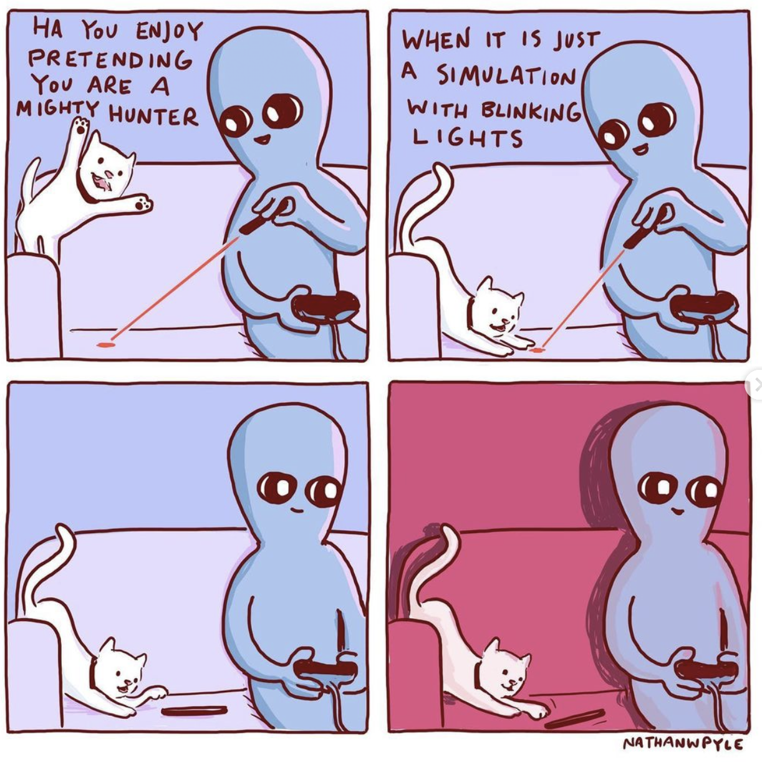
ANNOUNCEMENTS this week, the role of Jim will be played by Jeannie & Mark
WARMUP what is a (real-world) TODO list?
why are lists useful?
TODAY array lists

Slide 695
warmup: using lists
When are some real-life list examples?
What actions do you perform on lists?
What properties of lists do you care about?
Keep these in mind!

Slide 696
array list

Slide 697
motivation

Slide 698
limitations of arrays
think back to your days of using lists in Python
how do they compare to arrays in Java?
what are the pros/cons of arrays?

Slide 699
arrays are fixed-length
🔄 an array is a fixed-length sequence of elements all of the same type
🙂 simple, fast ($𝒪(1)$ access)
☹️ fixed-length (what if we don't know how many elements we'll have?)
solution A: make an array that's longer than you'll ever need
🔄 bullets = new Bullet[256]; // from HW-03
🙂 simple
☹️ wastes space, might end up not actually be long enough
solution B: make an array that grows as needed (an array list)

Slide 700
array list

Slide 701
array list
an array list (dynamic array, stretchy buffer, vector) acts like an array that can grow as needed
like an array, the user can access the $i$-th element in an array list
get the value of an element that is already there
set the value of an element that is already there
unlike an array, the user can always add a new element to an array list, no matter how many elements it already has
append (push back) a new element to the back or end
insert a new element at any index
the user can also remove elements from an array list

Slide 702
implementing array list
what properties of lists do we care about?
The items
Total number of items
what actions do we perform on lists?
adding item to end
removing item(s)
inserting item in middle
maybe sorting items? we’ll discuss this later…
these features will guide our implementation
properties: instance variables
actions: instance methods

Slide 703
the internal (private) array
an array list stores its elements inside of an array
an array list's capacity is the length of this array
an array list's size (length) is the number of (non-null) elements currently actually stored in this array
class ArrayList<ElementType> {
private ElementType[] privateArray;
private int numberOfElementsActuallyStoredInPrivateArray;
// int capacity() { return privateArray.length; }
int size() {
return numberOfElementsActuallyStoredInPrivateArray;
};
}

Slide 704
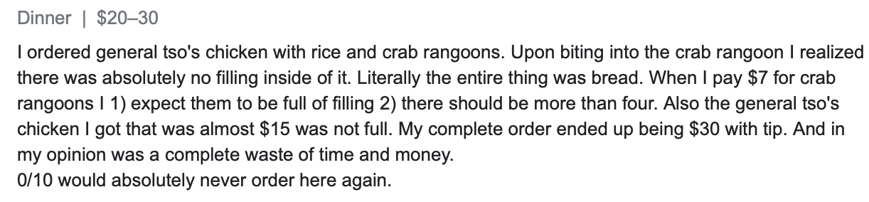
array list
☠️ an array list's capacity is NOT the same thing as its size
imagine ArrayList<String> bestaurants; with capacity 5 and size 3 // if we could print bestaurants.privateArray... ["Blango", "Sproot", "Sparket", null, null] ...we would see 5 – 3 = 2 "empty slots."

Slide 705
array list
☠️ even though another name for an array list is a "vector," the array list is NOT related to Vector2 (vector from math/physics)

Slide 706
Java's ArrayList<ElementType>

Slide 707
generic
Replace ElementType with the type of object being stored in your array list
Java's ArrayList<ElementType> is generic
// make a list of Foo's ArrayList<Foo> list = new ArrayList<>(); ArrayList<Foo> list = new ArrayList<Foo>();
// make a list of int's // NOTE: you must use Integer instead of int inside the <> ArrayList<Integer> list = new ArrayList<>();
ArrayList<Boolean> list = new ArrayList<>();
ArrayList<Double> list = new ArrayList<>();

Slide 708
generic
Java's ArrayList<ElementType> is generic
// make a list of lists of Vector2's ArrayList<ArrayList<Vector2>> list = new ArrayList<>();

Slide 709
internal array is private
Java's ArrayList<ElementType> uses access modifiers
specifically, its internal array is private (so is the int storing its size)
private means you can't access a variable/function directly
instead, you will need to use the functions (instance methods) given in our Documentation
class ArrayList<ElementType> {
int size(); // number of elements in the list
void add(ElementType element); // add element to the end of the list
void add(int index, ElementType element); // insert element into the list at index
ElementType get(int index); // get element at index
void removeElementAt(int index); // remove element by index
boolean removeElement(ElementType element); // remove element by value
}

Slide 710
the user doesn't think about the "empty slots"
ArrayList<String> list = new ArrayList<>();
System.out.println(list); // []
list.add("Hello");
list.add("World");
System.out.println(list); // [Hello, World]
list.add(1, "Cruel");
System.out.println(list); // [Hello, Cruel, World]
System.out.println(list.size()); // 3
System.out.println(list.get(1)); // Cruel
list.removeElementAt(0);
System.out.println(list); // [Cruel, World]

Slide 711
array list functions (under the hood)

Slide 712
ArrayList() { ... } // constructor
a new array list should have...
this.privateArray = new ElementType[STARTING_CAPACITY];
this.numberOfElementsActuallyStoredInPrivateArray = 0;
there isn't one right answer to what the STARTING_CAPACITY should be
perhaps...8?
8 sounds good.
🙂👍
note: in the tutorial, we'll use 1 🤷

Slide 713
ElementType get(int index) { ... }
to get an element with a given index...
return privateArray[index];
this is a "getter"
we need it because privateArray is private
users never access privateArray directly

Slide 714
void add(ElementType element) { ... }
to append (push back) a new element to the back (end) of an array list...
write the new element to the first available empty slot in privateArray
increment numberOfElementsActuallyStoredInPrivateArray
potential problems?
what if privateArray is full?
need to make room, but how?

Slide 715
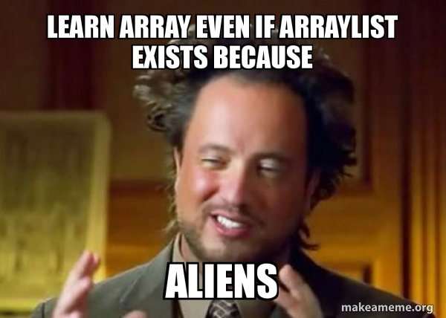
TODAY array lists (continued!)

Slide 716
array list
an array list (dynamic array, stretchy buffer, vector) acts like an array that can grow as needed
like an array, the user can access the $i$-th element in an array list
get the value of an element that is already there
set the value of an element that is already there
unlike an array, the user can always add a new element to an array list, no matter how many elements it already has
append (push back) a new element to the back or end
insert a new element at any index
the user can also remove elements from an array list

Slide 717
generic
Replace ElementType with the type of object being stored in your array list
Java's ArrayList<ElementType> is generic
// make a list of Foo's ArrayList<Foo> list = new ArrayList<>(); ArrayList<Foo> list = new ArrayList<Foo>();
// make a list of int's // NOTE: you must use Integer instead of int inside the <> ArrayList<Integer> list = new ArrayList<>();
ArrayList<Boolean> list = new ArrayList<>();
ArrayList<Double> list = new ArrayList<>();

Slide 718
internal array is private
Java's ArrayList<ElementType> uses access modifiers
specifically, its internal array is private (so is the int storing its size)
private means you can't access a variable/function directly
instead, you will need to use the functions (instance methods) given in our Documentation
class ArrayList<ElementType> {
int size(); // number of elements in the list
void add(ElementType element); // add element to the end of the list
void add(int index, ElementType element); // insert element into the list at index
ElementType get(int index); // get element at index
void removeElementAt(int index); // remove element by index
boolean removeElement(ElementType element); // remove element by value
}

Slide 719
ArrayList() { ... } // constructor
a new array list should have...
this.privateArray = new ElementType[STARTING_CAPACITY];
this.numberOfElementsActuallyStoredInPrivateArray = 0;
there isn't one right answer to what the STARTING_CAPACITY should be
perhaps...8?
8 sounds good.
🙂👍
note: in the tutorial, we'll use 1 🤷

Slide 720
ElementType get(int index) { ... }
to get an element with a given index...
return privateArray[index];
this is a "getter"
we need it because privateArray is private
users never access privateArray directly

Slide 721
void add(ElementType element) { ... }
to append (push back) a new element to the back (end) of an array list...
write the new element to the first available empty slot in privateArray
increment numberOfElementsActuallyStoredInPrivateArray
potential problems?
what if privateArray is full?
need to make room, but how?

Slide 722
void add(ElementType element) { ... }
to append (push back) a new element to the back (end) of an array list...
if privateArray is full...
make a new array two times the length of the current private array
copy the elements of the current private array into this new array (using a for loop)
update the privateArray reference to refer to this new array
write the new element to the first available empty slot in privateArray
increment numberOfElementsActuallyStoredInPrivateArray
food for thought: why is new array 2x size of old array? why not just add 1 extra spot? should we ever shrink the array?
this is an example of the time-space tradeoff!

Slide 723
void add(int index, ElementType element)
to insert a new element so it has a given index...
assert that the given index is valid!
0 OK ("prepend")
numberOfElementsActuallyStoredInPrivateArray OK (append)
-1 BAD VERY BAD (out of bounds)
if privateArray is full...
double its length (see previous slide)
make room for the new element!
move elements with index greater than or equal to the given index one slot to the right
how?

Slide 724
b c d e f g h .
a b c d e f g h

Slide 725

for (int i = index; i < numberOfElements-2, ++i) {
privateArray[i+1] = privateArray[i];
}
...
b c d e f g h .
a b b b b b b b

Slide 726

for (int i = numberOfElements-1; i >= index, --i) {
//copy from right to left
privateArray[i+1] = privateArray[i];
}
...
b c d e f g h .
a b c d e f g h

Slide 727
void add(int index, ElementType element)
to insert a new element so it has a given index...
assert that the given index is valid!
0 OK ("prepend")
numberOfElementsActuallyStoredInPrivateArray OK (append)
-1 BAD VERY BAD (out of bounds)
if privateArray is full...
double its length (see previous slide)
make room for the new element!
move elements with index greater than or equal to the given index one slot to the right (starting at the back!)
✨ for (int i = ...; i >= index, --i) { ... }
write the new element to the given index in privateArray
increment numberOfElementsActuallyStoredInPrivateArray

Slide 728
✨ functions can call other functions
the less general add (append) can be implemented using the more general add (insert)
void add(ElementType element) { add(numberOfElementsActuallyStoredInPrivateArray, element); }
☠️ however, if i were implementing an array list from scratch, i would implement the less general version first because it is simpler

Slide 729
void remove(int index) { ... }
to remove an element with a given index...
move elements with index greater than or equal to the given index one slot to the left
decrement numberOfElementsActuallyStoredInPrivateArray

Slide 730
💻 Array List Tutorial (linked on website)

Slide 731
Tut04() {
// TODO: construct new array list with starting capacity of 1
this.privateArray = new String[1];
this.numberOfElementsActuallyStoredInPrivateArray = 0;
}
String get(int index) {
// TODO: get element at given index
assert index >= 0 && index < numberOfElementsActuallyStoredInPrivateArray;
return privateArray[index];
}

Slide 732
void add(String element) {
// TODO: append element to the back of the list
add(numberOfElementsActuallyStoredInPrivateArray, element);
}
void add(int index, String element) {
// TODO: insert element so it has given index in the list
assert index >= 0 && index <= numberOfElementsActuallyStoredInPrivateArray;
if (numberOfElementsActuallyStoredInPrivateArray == privateArray.length) {
//must make array bigger
String tempArray[] = new String[privateArray.length * 2];
for (int i=0; i<privateArray.length; i++){
tempArray[i]=privateArray[i];
}
privateArray = tempArray; // update the reference
}
//room in the array
//copy from right to left down to index
for (int i=numberOfElementsActuallyStoredInPrivateArray-1; i>=index; --i){
privateArray[i+1]=privateArray[i];
}
privateArray[index] = element;
numberOfElementsActuallyStoredInPrivateArray++;
}

Slide 733
void remove(int index) {
// TODO: remove element at given index
assert index >= 0 && index < numberOfElementsActuallyStoredInPrivateArray;
for (int i=index; i<privateArray.length-1; ++i){
privateArray[i]=privateArray[i+1];
}
privateArray[numberOfElementsActuallyStoredInPrivateArray-1] = null;
numberOfElementsActuallyStoredInPrivateArray--;
}
void repeatElements(int numRepeats) {
int saveValue = size();
for (int i=0; i<saveValue; ++i){
for (int j=0; j<numRepeats-1; j++) {
add(i*numRepeats, get(i*numRepeats));
}
}
}

Slide 734
runtime of array list functions

Slide 735
runtime of array list operations
get() – a single operation that retrieves a value from privateArray
O(1)
set() - a single operation that sets a value in privateArray
O(1)
add() – insert element, shift other elements down to make room in for loop
O(1) – if adding to back (and no need to make room)
O(n) – if adding to middle
O(n) – if adding to any location and we have to grow privateArray (ideally this won’t happen often)
remove() – remove element, shift other elements down to eliminate gap
O(n)

Slide 736
ANNOUNCEMENTS Jim is back; Jim got sick
Midterm info on website
Midterm review session info on website
WARMUP is this code good?
were array lists helpful?
TODAY array list wrap-up
abstraction 🙂 and ☹️
void repeatElements(int numRepeats) {
int numBefore = size();
for (int i = 0; i < numBefore; ++i) {
int index = i * numRepeats;
for (int rep = 0; rep < (numRepeats - 1); ++rep) {
add(index, get(index));
}
}
}

Slide 737
big-O runtime of void add(...);

Slide 738
big-O runtime
big-O runtime (running time, time complexity) gives us a big-picture idea of how long a function will take to run (execute, finish)
a function that operates on $n$ things, could be...
$𝒪(1)$ (constant time) 😀 FAST
$𝒪(\log_{2}{n})$ (logarithmic time, log time) 🙂 fast
$𝒪(n)$ (linear time) 😐 meh
$𝒪(n^{2})$ (quadratic time) ☹️ slow
$𝒪(2^{n})$ (exponential time) 😦 SLOW

Slide 739
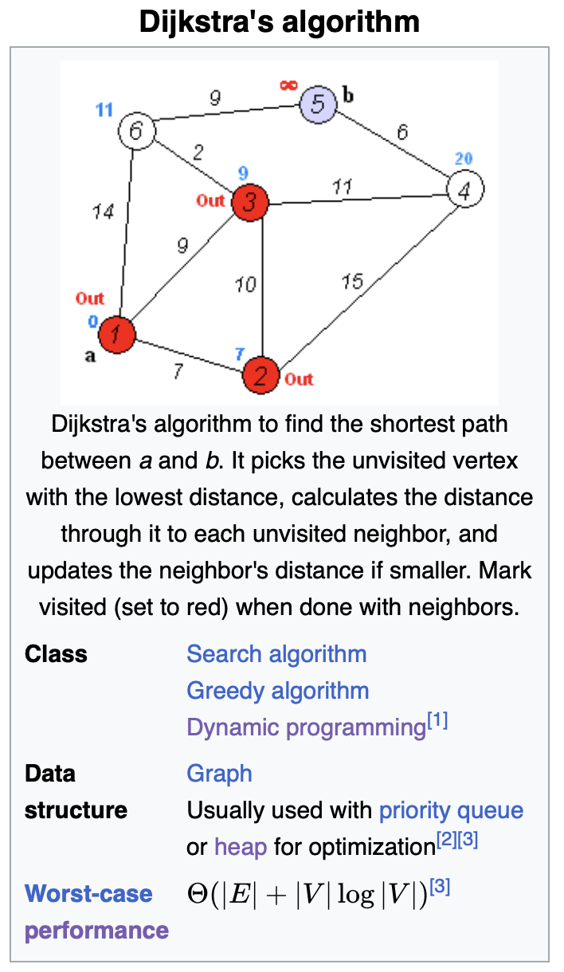
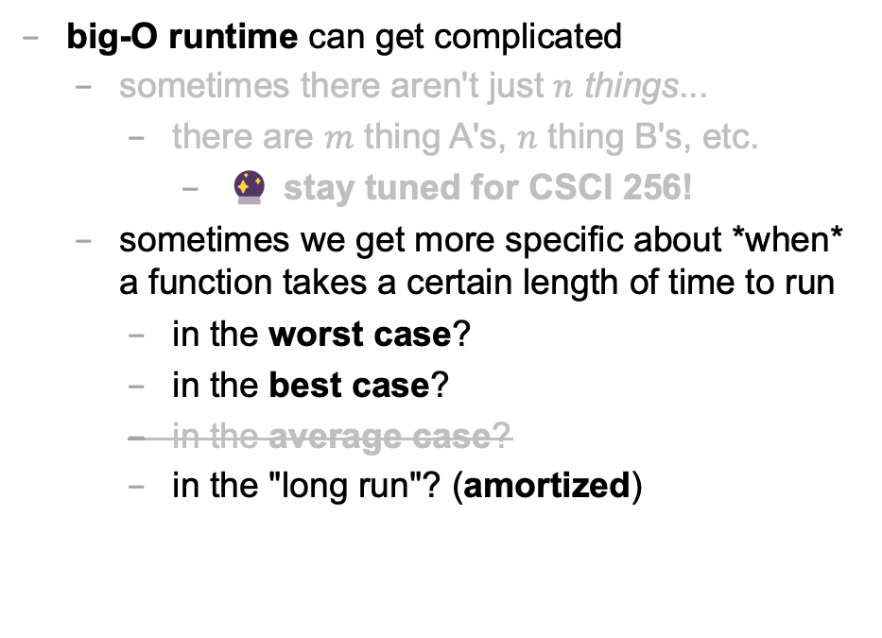
big-O runtime
big-O runtime can get complicated
sometimes there aren't just $n$ things...
there are $m$ thing A's, $n$ thing B's, etc.
🔮 stay tuned for CSCI 256!
sometimes we get more specific about *when* a function takes a certain length of time to run
in the worst case?
in the best case?
in the average case?
in the "long run"? (amortized)

Slide 740
best case and worst case runtime of adding to the back of an array list

Slide 741
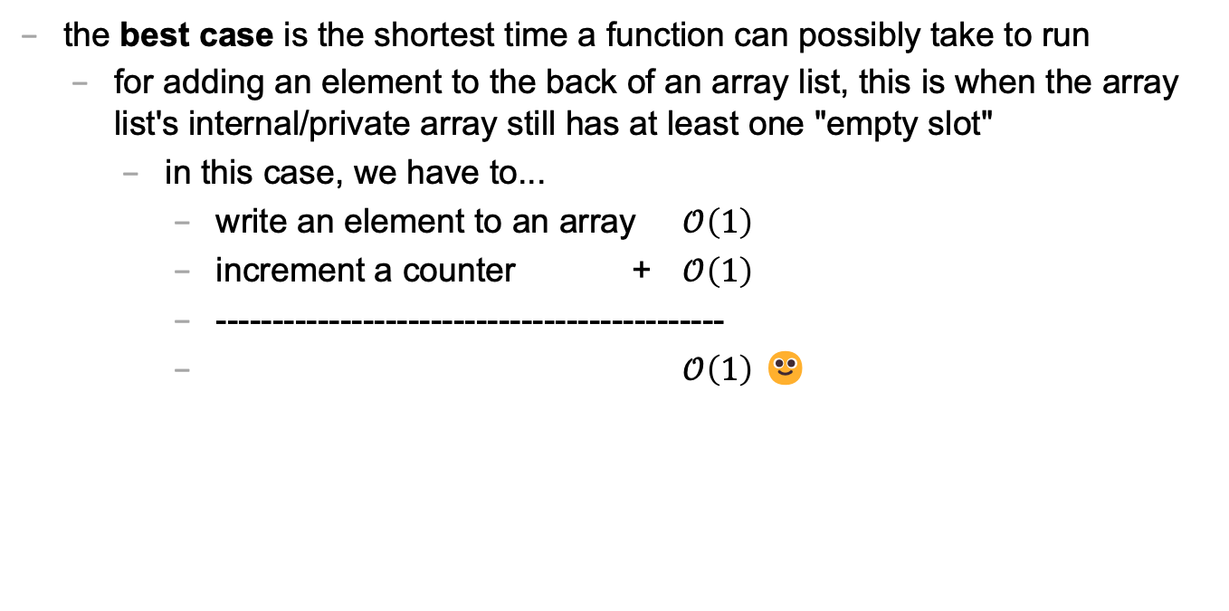
best case
the best case is the shortest time a function can possibly take to run
for adding an element to the back of an array list, this is when the array list's internal/private array still has at least one "empty slot"
in this case, we have to...
write an element to an array $𝒪\left(1\right)$
increment a counter + $𝒪\left(1\right)$
---------------------------------------------
$𝒪\left(1\right)$ 🙂

Slide 742
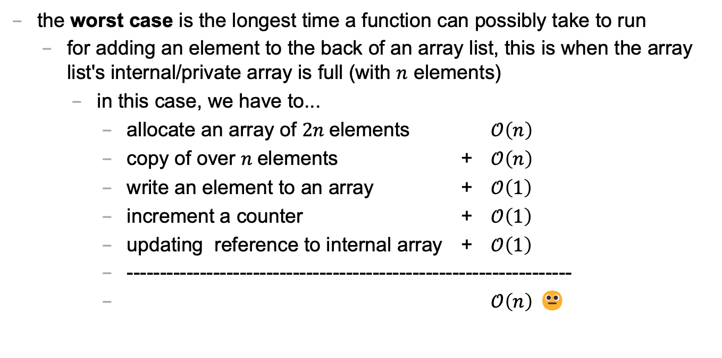
worst case
the worst case is the longest time a function can possibly take to run
for adding an element to the back of an array list, this is when the array list's internal/private array is full (with $n$ elements)
in this case, we have to...
allocate an array of $2n$elements $𝒪\left(n\right)$
copy of over $n$elements + $𝒪\left(n\right)$
write an element to an array + $𝒪\left(1\right)$
increment a counter + $𝒪\left(1\right)$
updating reference to internal array + $𝒪\left(1\right)$
-------------------------------------------------------------------
$𝒪\left(n\right)$ 😐

Slide 743
sometimes the best case and worst case are very different

Slide 744
amortized runtime of adding to the back of an array list

Slide 745
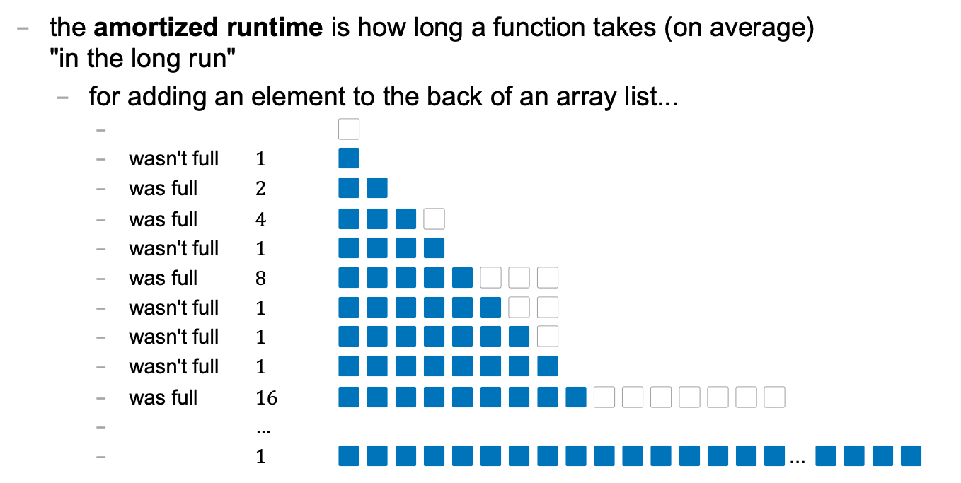
amortized
the amortized runtime is how long a function takes (on average) "in the long run"
for adding an element to the back of an array list...
⬜️
wasn't full $1$ 🟦
was full $2$ 🟦🟦
was full $4$ 🟦🟦🟦⬜️
wasn't full $1$ 🟦🟦🟦🟦
was full $8$ 🟦🟦🟦🟦🟦⬜️⬜️⬜️
wasn't full $1$ 🟦🟦🟦🟦🟦🟦⬜️⬜️
wasn't full $1$ 🟦🟦🟦🟦🟦🟦🟦⬜️
wasn't full $1$ 🟦🟦🟦🟦🟦🟦🟦🟦
was full $16$ 🟦🟦🟦🟦🟦🟦🟦🟦🟦⬜️⬜️⬜️⬜️⬜️⬜️⬜️
$…$
$1$ 🟦🟦🟦🟦🟦🟦🟦🟦🟦🟦🟦🟦🟦🟦🟦🟦... 🟦🟦🟦🟦

Slide 746
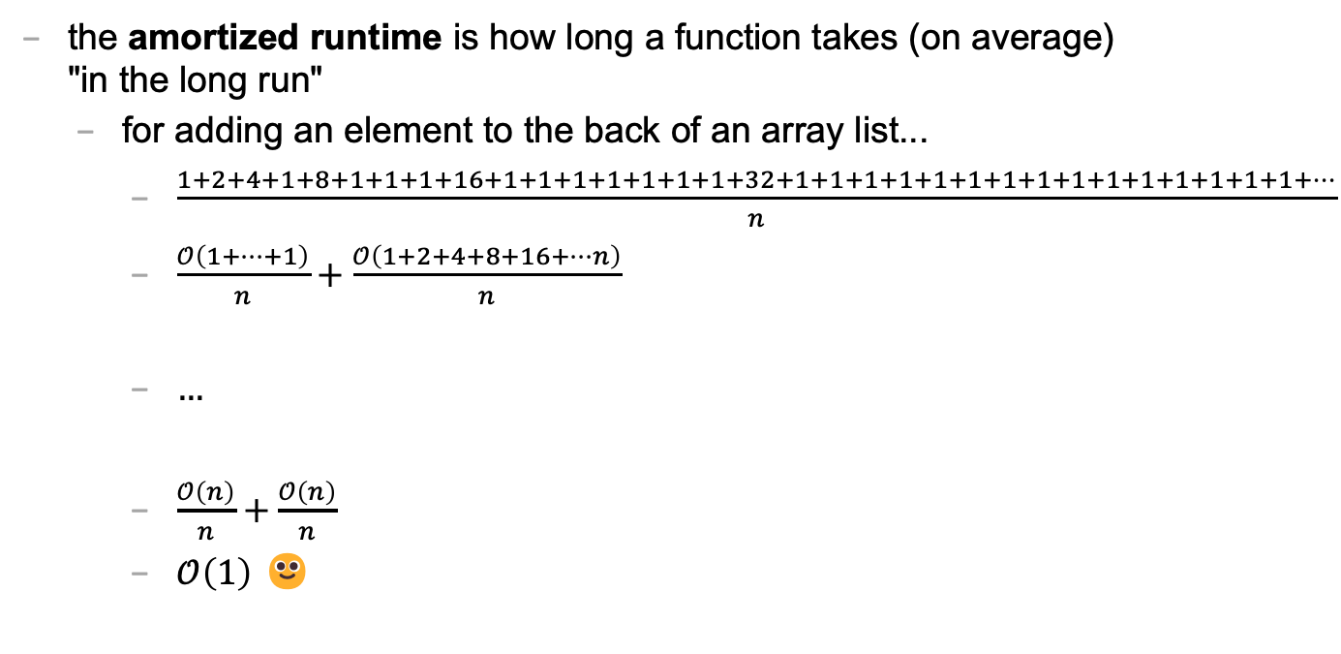
amortized
the amortized runtime is how long a function takes (on average) "in the long run"
for adding an element to the back of an array list...
$\frac{1+2+4+1+8+1+1+1+16+1+1+1+1+1+1+1+32+1+1+1+1+1+1+1+1+1+1+1+1+1+1+1+…}{n}$
$\frac{𝒪\left(1+…+1\right)}{n}+\frac{𝒪\left(1+2+4+8+16+…n\right)}{n}$
$…$
$\frac{𝒪\left(n\right)}{n}+\frac{𝒪\left(n\right)}{n}$
$𝒪\left(1\right)$ 🙂

Slide 747
the amortized run time is less "pessimistic" than worst case

Slide 748
the most relevant runtime depends on context 💭 when might worst case be more relevant? 💭 when might amortized be more relevant?

Slide 749
best case and worst case runtime of inserting into the front of an array list

Slide 750
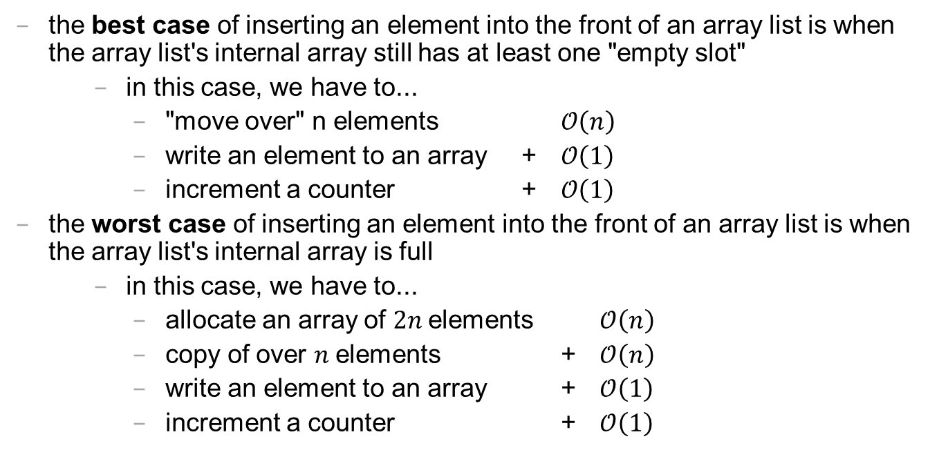
best case and worst cast
the best case of inserting an element into the front of an array list is when the array list's internal array still has at least one "empty slot"
in this case, we have to...
"move over" n elements $𝒪\left(n\right)$
write an element to an array + $𝒪\left(1\right)$
increment a counter + $𝒪\left(1\right)$
the worst case of inserting an element into the front of an array list is when the array list's internal array is full
in this case, we have to...
allocate an array of $2n$elements $𝒪\left(n\right)$
copy of over $n$elements + $𝒪\left(n\right)$
write an element to an array + $𝒪\left(1\right)$
increment a counter + $𝒪\left(1\right)$

Slide 751
lesson?: sometimes best case and worst case are the same

Slide 752
abstraction

Slide 753
repeatElements two ways

Slide 754
naive array solution
void repeatElementsArrayVersion(int numRepeats) {
int numBefore = size();
// allocate a new array O(n) String[] newPrivateArray = new String[numRepeats * numBefore];
// fill it + O(n)
int k = 0; for (int i = 0; i < numBefore; ++i) { for (int rep = 0; rep < numRepeats; ++rep) { newPrivateArray[k++] = privateArray[i]; } }
// "swap" references + O(1)
privateArray = newPrivateArray; }

Slide 755
the naive array solution is linear

Slide 756
naive array list solution
void repeatElements(int numRepeats) { int numBefore = size(); for (int i = 0; i < numBefore; ++i) { // n * int index = i * numRepeats; for (int rep = 0; rep < (numRepeats - 1); ++rep) { add(index, get(index)); // insert an element } // O(n) because we have to } // "move stuff over" }

Slide 757
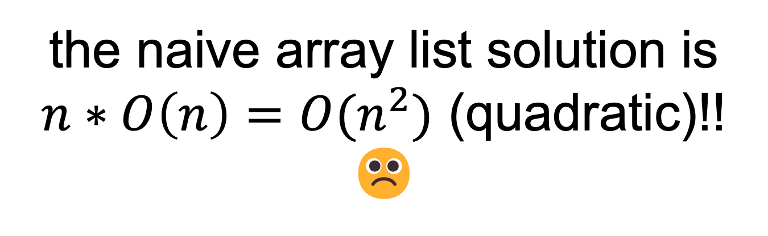
the naive array list solution is $n∗O\left(n\right)={O(n}^{2})$ (quadratic)!! ☹️

Slide 758
🧪

Slide 759
lesson: ignoring what's actually happening under the hood is dangerous!

Slide 760
int a = 5; int b=8;

Slide 761

ANNOUNCEMENTS welcome back i hope you had a nice mountain day :)
WARMUP what is this robot for? →
TODAY stacks and queues

Slide 762
record LEC-02

Slide 763
where are we?

Slide 764
recap of first half

Slide 765
we built a foundation
Java!
types, operators, & compiler errors
when should we compile?
early and often!
avoid repetition!
functions!
for when we have the same chunk of logic repeated in multiple places
classes!
for when we repeatedly pass around the same chunk of data

Slide 766
we started thinking about code more deeply
the array!
how *fast* is an array?
what are pros and cons of the array?
how might we address the cons of an array?
the array list!
how *fast* is an array list? best case? worst case? ...
what are pros and cons of the array list?
how might we address the cons of an array list?
...

Slide 767


Slide 768
preview of second half

Slide 769
we will look at how to structure data
we will meet a whole menagerie of data structures
stacks
queues
hash tables
linked lists
trees
graphs
heaps
we will analyze speed and space

Slide 770
we will learn to choose the right data structure for the job
fun homeworks (at least in my opinion) 🙂👍
Flip Book
array list of array lists of array lists of Vector2's
PostScript Interpreter
stack and hash table
Text Generator
hash table of hash tables
...

Slide 771
data structures

Slide 772
what is a data structure? why is a data structure?

Slide 773
data structures
In computer science, a data structure is a data organization, management, and storage format that is usually chosen for efficient access to data.^{[1][2][3]} More precisely, a data structure is a collection of data values, the relationships among them, and the functions or operations that can be applied to the data,^{[4]} i.e., it is an algebraic structure about data. --Wikipedia

Slide 774
data structures
In computer science, a data structure is the organization and implementation of values and information. In simple words, it is the way of organizing information in a computer so that it can be more easily understood and worked with. --Simple Wikipedia

Slide 775
data structures
A data structure is...a system for organizing and using information... It...make[s] information easier to understand and work with.. --Simple Wikipedia, further simplified by ChatGPT

Slide 776
data structures
data means numbers (and letters)
a data structure organizes your data
for a particular task...
...a good data structure is...
easy to work with (programmer time)
runs fast (runtime / user's time)

Slide 777
were array lists a good choice for implementing a Flip Book? 💭 (how) could you have done it with just arrays?

Slide 778
we didn't know how many...
frames in each animation
strokes in each frame
points (Vector2's) in each stroke

Slide 779
"Alternative" 1: just use arrays, but resize them yourself when needed (essentially, implement the functionality of an array list without actually having a class)

Slide 780
"Alternative" 2: // ~30,000,000 elements Vector2[][][] animation = new Vector2[64][512][1024]; // need all these counter variables // can't just call .size() like before! int numFrames = 0; int[] numStrokes = ...; int[][] numPoints = ...;

Slide 781
interface

Slide 782
interface
add, get, set, remove, ...
ArrayList<ElementType>'s
state
your state

Slide 783


Slide 784


Slide 785
interface
a data structure's interface (API) or abstract data type is a set of functions a data structure must have
a list has...
get
set
add
remove
etc.
a data structure is a specific implementation (code that does the thing) of that interface
an array list implements the list interface using an array
🔮 a linked list implements a list using nodes that refer to nodes

Slide 786
you can get (very) formal about this
The abstract list type L with elements of some type E (a monomorphic list) is defined by the following functions:
nil: () → L
cons: E × L → L
first: L → E
rest: L → L
with the axioms
first (cons (e, l)) = e
rest (cons (e, l)) = l
for any element e and any list l. It is implicit that
cons (e, l) ≠ l
cons (e, l) ≠ e
cons (e₁, l₁) = cons (e₂, l₂) if e₁ = e₂ and l₁ = l₂
Note that first (nil ()) and rest (nil ()) are not defined.
These axioms are equivalent to those of the abstract stack data type.

Slide 787
i typically won't. just know there is a difference between interface ("list") and implementation (ArrayList<Element>)

Slide 788
Tungsten break 😀 did you know the density of Tungsten is 19.25 g/cm³? Gold is 19.32 g/cm³ did you know Tungsten is really hard? Tungsten alloys can be as hard as Sapphire! that's really hard! Tungsten is expensive (that cube is $60) but not like...that expensive what could YOU do with Tungsten?

Slide 789
stacks

Slide 790
stack

Slide 791


Slide 792


Slide 793

pushing
popping

Slide 794


Slide 795
stack interface
// Push (add) a new element to the top of the stack. void push(ElementType element);
// Pop (remove) the top element of the stack. // and returns it. ElementType pop();
// Peek (look) at the top element of the stack // (without removing it) and return it. ElementType peek();
// Returns the number of elements currently in the stack. int size();

Slide 796
queues

Slide 797
queue

Slide 798


Slide 799

Back

Slide 800

Back
add
remove

Slide 801
queue interface
// Add (enqueue) a new element to the back of the queue. void add(ElementType element);
// Remove (dequeue) the front element of the queue // and return it. ElementType remove();
// Peek (look) at the front element of the queue // (without removing it) and return it. ElementType peek();
// Returns the number of elements currently in the queue. int size();

Slide 802
why stacks and queues in the same lecture?

Slide 803
stack interface
// Push (add) a new element to the top of the stack. void push(ElementType element);
// Remove (pop) the top element of the stack. // and returns it. ElementType pop();
// Peek (look) at the top element of the stack // (without removing it) and return it. ElementType peek();
// Returns the number of elements currently in the stack. int size();

Slide 804
queue interface
// Add (enqueue) a new element to the back of the queue. void add(ElementType element);
// Remove (dequeue) the front element of the queue // and return it. ElementType remove();
// Peek (look) at the front element of the queue // (without removing it) and return it. ElementType peek();
// Returns the number of elements currently in the queue. int size();

Slide 805
💭 what are some example uses of stacks and queues in computer science?

Slide 806



Slide 807

ANNOUNCEMENTS today is Laptop Wednesday!
replace interpret(...tokens) with version from the Writeup
WARMUP a couple (slightly silly) interview questions
- implement a stack using a (basic) queue
- just implement push and pop (and peek?)
- (don't worry about efficiency)
- pseudocode is fine
- what is the runtime (big O)?
- implement a queue using 2 stacks TODAY stacks and queue tutorial

Slide 808
record LEC-02

Slide 809
Stack and Queue tutorial 💻

Slide 810
the midterm 😱

Slide 811
i graded the midterm over the weekend

Slide 812
i had so much fun

Slide 813
not really

Slide 814


Slide 816
the midterm
overall, i think it went well!
MEAN ~ 87
STANDARD DEVIATION ~ 11
if you have any questions (how to prep for final, why did you lose points), let's chat in Lab (we can also schedule a chat)
notes on grading
some feedback just for your benefit (no lost points) – variable names, etc.
feedback is very sparse! (please ask questions if unsure what i mean)

Slide 817


some common pain points
i have removed them from the HW-03;
let's take a look
let's also redo this problem together on the board
"convenience variables" created lots of problems
this is an example of modifying an array while you're iterating over it (see HW-02 README)
let's redo it together on the board

Slide 818
ANNOUNCEMENTS today is Friday! (fun Colloquium today at 2:35 in TCL 123)
apply to TA next semester! also next next (next?) semester!
WARMUP implement a queue using two stacks
- just implement add and remove (and peek?)
- (don't worry about efficiency)
- pseudocode is fine
- what is the runtime (big O)?
TODAY odds and ends

Slide 819
record LEC-02

Slide 820
tricky midterm questions

Slide 821
Player -> Player[]

Slide 822
question
class HW03 extends App { // BEFORE
Player player;
void setup() {
player = new Player();
player.color = Vector3.cyan;
player.radius = 4.0;
player.position = new Vector2(0.0, 0.0)
}
}

Slide 823
answer
class HW03 extends App { // AFTER
Player[] players;
void setup() {
players = new Player[4];
for (int i = 0; i < players.length; i++) {
players[i] = new Player();
players[i].radius = 4.0;
players[i].position = new Vector2(0.0, 0.0);
}
players[0].color = Vector3.red;
players[1].color = Vector3.orange;
players[2].color = Vector3.yellow;
players[3].color = Vector3.green;
}
}

Slide 824
alternate answer
class HW03 extends App { // AFTER
Player[] players;
Vector3[] colors =
{ Vector3.red, Vector3.orange, Vector3.yellow, Vector3.green };
void setup() {
players = new Player[4];
for (int i = 0; i < players.length; i++) {
players[i] = new Player();
players[i].radius = 4.0;
players[i].position = new Vector2(0.0, 0.0);
players[i].color = colors[i];
}
}
}

Slide 825
what will this code print? (arrays and array lists)

Slide 826
question
int[] array = { 2, 3, 4 };
ArrayList<Integer> list = new ArrayList<>();
for (int i = 0; i < array.length; ++i) {
for(int rep = 0; rep < 3; ++rep) {list.add(array[i]);}
}

Slide 827
question
int[] array = { 2, 3, 4 };
ArrayList<Integer> list = new ArrayList<>();
int i = 0;
for (int rep = 0; rep < 3; ++rep) { list.add(array[i]); }
i = 1;
for (int rep = 0; rep < 3; ++rep) { list.add(array[i]); }
i = 2;
for (int rep = 0; rep < 3; ++rep) { list.add(array[i]); }

Slide 828
question
int[] array = { 2, 3, 4 };
ArrayList<Integer> list = new ArrayList<>();
for (int rep = 0; rep < 3; ++rep) { list.add(array[0]); }
for (int rep = 0; rep < 3; ++rep) { list.add(array[1]); }
for (int rep = 0; rep < 3; ++rep) { list.add(array[2]); }

Slide 829
question
int[] array = { 2, 3, 4 };
ArrayList<Integer> list = new ArrayList<>();
list.add(array[0]);
list.add(array[0]);
list.add(array[0]);
list.add(array[1]);
list.add(array[1]);
list.add(array[1]);
list.add(array[2]);
list.add(array[2]);
list.add(array[2]);

Slide 830
question
int[] array = { 2, 3, 4 };
ArrayList<Integer> list = new ArrayList<>();
list.add(2);
list.add(2);
list.add(2);
list.add(3);
list.add(3);
list.add(3);
list.add(4);
list.add(4);
list.add(4);

Slide 831
question
int[] array = { 2, 3, 4 };
ArrayList<Integer> list = new ArrayList<>();
list.add(2);
list.add(2);
list.add(2);
list.add(3);
list.add(3);
list.add(3);
list.add(4);
list.add(4);
list.add(4);
// { 2, 2, 2, 3, 3, 3, 4, 4, 4 }

Slide 832
question
// { 2, 2, 2, 3, 3, 3, 4, 4, 4 }
for (int i = 0; i < list.size() / 2; ++i) {
int j = (list.size() - 1) - i;
int tmp = list.get(i);
list.set(i, list.get(j));
list.set(j, tmp);
}

Slide 833
question
// { 2, 2, 2, 3, 3, 3, 4, 4, 4 }
for (int i = 0; i < list.size() / 2; ++i) {
int j = (list.size() - 1) - i;
int tmp = list.get(i);
list.set(i, list.get(j));
list.set(j, tmp);
} // { 4, 4, 4, 3, 3, 3, 2, 2, 2 }

Slide 834
question
// { 4, 4, 4, 3, 3, 3, 2, 2, 2 }
for (int i = 0; i < list.size(); ++i) {
list.set(i, list.get(list.get(i)));
}

Slide 835
question
// { 4, 4, 4, 3, 3, 3, 2, 2, 2 }
for (int i = 0; i < list.size(); ++i) {
int j = list.get(i);
list.set(i, list.get(j));
}

Slide 836
question
// { 4, 4, 4, 3, 3, 3, 2, 2, 2 }
for (int i = 0; i < list.size(); ++i) {
int j = list.get(i);
list.set(i, list.get(j));
}
// 0 1 2 3 4 5 6 7 8
// { 4, 4, 4, 3, 3, 3, 2, 2, 2 }
// ^ ^
// | |
// | j
// |
// i

Slide 837
question
// { 4, 4, 4, 3, 3, 3, 2, 2, 2 }
for (int i = 0; i < list.size(); ++i) {
int j = list.get(i);
list.set(i, list.get(j));
}
// 0 1 2 3 4 5 6 7 8
// { 3, 4, 4, 3, 3, 3, 2, 2, 2 }
// ^ ^
// | |
// | j
// |
// i

Slide 838
question
// { 4, 4, 4, 3, 3, 3, 2, 2, 2 }
for (int i = 0; i < list.size(); ++i) {
int j = list.get(i);
list.set(i, list.get(j));
}
// 0 1 2 3 4 5 6 7 8
// { 3, 4, 4, 3, 3, 3, 2, 2, 2 }
// ^ ^
// | |
// | j
// |
// i

Slide 839
question
// { 4, 4, 4, 3, 3, 3, 2, 2, 2 }
for (int i = 0; i < list.size(); ++i) {
int j = list.get(i);
list.set(i, list.get(j));
}
// 0 1 2 3 4 5 6 7 8
// { 3, 3, 4, 3, 3, 3, 2, 2, 2 }
// ^ ^
// | |
// | j
// |
// i

Slide 840
question
// { 4, 4, 4, 3, 3, 3, 2, 2, 2 }
for (int i = 0; i < list.size(); ++i) {
int j = list.get(i);
list.set(i, list.get(j));
}
// 0 1 2 3 4 5 6 7 8
// { 3, 3, 4, 3, 3, 3, 2, 2, 2 }
// ^ ^
// | |
// | j
// |
// i

Slide 841
question
// { 4, 4, 4, 3, 3, 3, 2, 2, 2 }
for (int i = 0; i < list.size(); ++i) {
int j = list.get(i);
list.set(i, list.get(j));
}
// 0 1 2 3 4 5 6 7 8
// { 3, 3, 3, 3, 3, 3, 2, 2, 2 }
// ^ ^
// | |
// | j
// |
// i

Slide 842
question
// { 4, 4, 4, 3, 3, 3, 2, 2, 2 }
for (int i = 0; i < list.size(); ++i) {
int j = list.get(i);
list.set(i, list.get(j));
}
// 0 1 2 3 4 5 6 7 8
// { 3, 3, 3, 3, 3, 3, 2, 2, 2 }
// ^
// |
// j
// |
// i

Slide 843
question
// { 4, 4, 4, 3, 3, 3, 2, 2, 2 }
for (int i = 0; i < list.size(); ++i) {
int j = list.get(i);
list.set(i, list.get(j));
}
// 0 1 2 3 4 5 6 7 8
// { 3, 3, 3, 3, 3, 3, 2, 2, 2 }
// ^
// |
// j
// |
// i

Slide 844
question
// { 4, 4, 4, 3, 3, 3, 2, 2, 2 }
for (int i = 0; i < list.size(); ++i) {
int j = list.get(i);
list.set(i, list.get(j));
}
// 0 1 2 3 4 5 6 7 8
// { 3, 3, 3, 3, 3, 3, 2, 2, 2 }
// ^ ^
// | |
// j |
// |
// i

Slide 845
question
// { 4, 4, 4, 3, 3, 3, 2, 2, 2 }
for (int i = 0; i < list.size(); ++i) {
int j = list.get(i);
list.set(i, list.get(j));
}
// 0 1 2 3 4 5 6 7 8
// { 3, 3, 3, 3, 3, 3, 2, 2, 2 }
// ^ ^
// | |
// j |
// |
// i

Slide 846
question
// { 4, 4, 4, 3, 3, 3, 2, 2, 2 }
for (int i = 0; i < list.size(); ++i) {
int j = list.get(i);
list.set(i, list.get(j));
}
// 0 1 2 3 4 5 6 7 8
// { 3, 3, 3, 3, 3, 3, 2, 2, 2 }
// ^ ^
// | |
// j |
// |
// i

Slide 847
question
// { 4, 4, 4, 3, 3, 3, 2, 2, 2 }
for (int i = 0; i < list.size(); ++i) {
int j = list.get(i);
list.set(i, list.get(j));
}
// 0 1 2 3 4 5 6 7 8
// { 3, 3, 3, 3, 3, 3, 2, 2, 2 }
// ^ ^
// | |
// j |
// |
// i

Slide 848
question
// { 4, 4, 4, 3, 3, 3, 2, 2, 2 }
for (int i = 0; i < list.size(); ++i) {
int j = list.get(i);
list.set(i, list.get(j));
}
// 0 1 2 3 4 5 6 7 8
// { 3, 3, 3, 3, 3, 3, 2, 2, 2 }
// ^ ^
// | |
// j |
// |
// i

Slide 849
question
// { 4, 4, 4, 3, 3, 3, 2, 2, 2 }
for (int i = 0; i < list.size(); ++i) {
int j = list.get(i);
list.set(i, list.get(j));
}
// 0 1 2 3 4 5 6 7 8
// { 3, 3, 3, 3, 3, 3, 3, 2, 2 }
// ^ ^
// | |
// j |
// |
// i

Slide 850
question
// { 4, 4, 4, 3, 3, 3, 2, 2, 2 }
for (int i = 0; i < list.size(); ++i) {
int j = list.get(i);
list.set(i, list.get(j));
}
// 0 1 2 3 4 5 6 7 8
// { 3, 3, 3, 3, 3, 3, 3, 2, 2 }
// ^ ^
// | |
// j |
// |
// i

Slide 851
question
// { 4, 4, 4, 3, 3, 3, 2, 2, 2 }
for (int i = 0; i < list.size(); ++i) {
int j = list.get(i);
list.set(i, list.get(j));
}
// 0 1 2 3 4 5 6 7 8
// { 3, 3, 3, 3, 3, 3, 3, 3, 2 }
// ^ ^
// | |
// j |
// |
// i

Slide 852
question
// { 4, 4, 4, 3, 3, 3, 2, 2, 2 }
for (int i = 0; i < list.size(); ++i) {
int j = list.get(i);
list.set(i, list.get(j));
}
// 0 1 2 3 4 5 6 7 8
// { 3, 3, 3, 3, 3, 3, 3, 3, 2 }
// ^ ^
// | |
// j |
// |
// i

Slide 853
question
// { 4, 4, 4, 3, 3, 3, 2, 2, 2 }
for (int i = 0; i < list.size(); ++i) {
int j = list.get(i);
list.set(i, list.get(j));
}
// 0 1 2 3 4 5 6 7 8
// { 3, 3, 3, 3, 3, 3, 3, 3, 3 }
// ^ ^
// | |
// j |
// |
// i

Slide 854
HW06.java HW06.class ~HW06.java

Slide 855

filetypes
HW06.java is source code (input to the compiler)
HW06.class is bytecode (output from the compiler)
~HW06.java is a backup file created by DrJava 🤨

Slide 856
_thisUnderscoreMeansDoNotUse (unless you really know what you're doing)

Slide 857
constants and readability & searchability

Slide 858
if (token.type == 2) {
...
}
if (token.type == Token.TYPE_STRING) {
...
}

Slide 859
where did the Starter Code come from? (forgive me, I know this should have been on Wednesday)

Slide 860
the big decision in the Starter Code is that we're going to chop the program into a list of "tokens" and each token could be a boolean, double, String, or list

Slide 861
in Python, a variable's type is dynamic
token = True
print(type(token)) # <class 'bool'>
token = 5.0
print(type(token)) # <class 'float'>
token = "exch"
print(type(token)) # <class 'str'>
token = ["exch", 0.0, "add"]
print(type(token)) # <class 'list'>

Slide 862
in Java, a variable's type is static
class Token {
int type;
private boolean _valueIfTypeBoolean;
private double _valueIfTypeDouble;
private String _valueIfTypeString;
private ArrayList<Token> _valueIfTypeList;
static final int TYPE_BOOLEAN = 0;
static final int TYPE_DOUBLE = 1;
static final int TYPE_STRING = 2;
static final int TYPE_LIST = 3;
}
0 | false | 0.0 | null | null

Slide 863
examples
new Token(true)
new Token(5.0)
new Token("exch")
0 | true | 0.0 | null | null
1 | false | 5.0 | null | null
2 | false | 0.0 | 0x02343af34... | null
"exch"

Slide 864
in Java, a variable's type is static
// Create a String-type Token.
Token token = new Token();
token.type = Token.TYPE_STRING;
token._valueIfTypeString = "exch";
// Get the value of a String-type token.
assert token.type = Token.TYPE_STRING : "..."; // check type!
String string = token._valueIfTypeString;
this usage code makes me sad ☹️
let's write some ✨functions✨!

Slide 865
in Java, a variable's type is static
// Create a String-type Token.
Token token = new Token("exch");
// Get the value of a String-type token.
String string = token.getString();
all better 🙂

Slide 866
tl;dr

Slide 867

use these functions 🙂👍

Slide 868

and these functions!! 🙂👍

Slide 869
// Pop a double off the stack
assert _stack.size() > 0;
Token token = _stack.pop();
double num = token.getDouble();
// Push a double onto the stack.
_stack.push(new Token(5.0));
☹️

Slide 870
// Pop a double off the stack
double num = stackPopDouble();
// Push a double onto the stack.
stackPush(5.0);
🙂

Slide 871
midsemester feedback

Slide 872
do you want to give midsemester feedback?

Slide 873

help improve cs136
even though
you're never going to
take it again

Slide 874

tinyurl.com/yf725rdk

Slide 875
ANNOUNCEMENTS today is No Laptop For the First Half of Lecture Monday!
today is Prof. Bill Jannen Is Visiting LEC-02 Monday!
WARMUP long, long, ago, many people owned a large, physical book called a ✨Dictionary✨
- what was it used for?
- did you know there were different kinds of dictionaries?
TODAY maps (dictionaries, tables)

Slide 876
record LEC-01

Slide 877



HashMap<String, String> dictionary;
// {Dog=A cute, four-legged mammal, ...}
HashMap<String, String> englishToSpanishDictionary;
// {Gato=Cat, Perro=Dog, ...}
HashMap<String, ArrayList<String>> rhymingDictionary;
// {Dog=[Bog, Cog, Frog], ...}

Slide 878


Slide 879


Slide 880
maps

Slide 881
map interface

Slide 882
map
a pair is two things
a map (dictionary, table) stores key-value pairs
a map is used to lookup a key's value
a map in Java's standard library is HashMap<KeyType, ValueType>
HashMap<String, ArrayList<String>> rhymingDictionary;

Slide 883
let us imagine...

Slide 884
you have a three week long road trip planned to Bennington, but your prized parrot Hans is deathly afraid of driving it's time to put Hans in the bird kennel

Slide 885
🤵
🦜
map.put("Hans", 🦜)

Slide 886
you return invigorated from a lovely trek to Bennington it's time to get Hans from the bird kennel

Slide 887

here is Hans
🤵
Hans
squack
🦜
map.get("Hans")

Slide 888
HashMap<String, Bird>
🤵

Slide 889
map interface
// Put (add, insert) a new key-value pair into the map. // NOTE: Can also be used to update a key's value. void put(KeyType key, ValueType value);
// Get (lookup) a key's value in the map. ValueType get(KeyType key);
// Get the (unordered) set of all keys. // NOTE: Use this to iterate through all keys. // for (KeyType key : map.keySet()) { ... } Set<KeyType> keySet();

Slide 890
motivating example

Slide 891

Pokémon
there are 151 Pokémon
each has its own number
Bulbasaur
Ivysaur
Venusaur
Charmander
...

Slide 892
number → name
1 → "Bulbasaur"
2 → "Ivysaur"
3 → "Venusaur"
4 → "Charmander"
...

Slide 893
number → name (Option I)
String[] names = { "Bulbasaur", "Ivysaur", ... };
int number = ...;
String name = names[number – 1]; // NOTE: Bulbasaur is #1

Slide 894
number → name (Option II)
String[] _names = { "Bulbasaur", "Ivysaur", ... };
String getName(int number) {
return _names[number – 1];
}
int number = ...;
String name = getName(number);

Slide 895
number → name (Option I)
String[] names = { "Bulbasaur", "Ivysaur", ... };
int number = ...;
String name = names[number – 1]; // NOTE: Bulbasaur is #1

Slide 896
number → name (Option III)
String[] names = { "", "Bulbasaur", "Ivysaur", ... };
int number = ...;
String name = names[number];

Slide 897
lesson: if you're mapping from A → B, and A is something like 0, 1, 2, 3, ... ...then you can just use an array 🙂👍

Slide 898
buuut, if you're mapping from A → B, and A is nothing like 0, 1, 2, 3, ... ...then you're going to want a map 🗺️

Slide 899
name → number
🗺️ solve this problem using a
HashMap<KeyType, ValueType>
"Bulbasaur" → 1
"Ivysaur" → 2
"Venusaur" → 3
"Charmander" → 4
...
// Put (add, insert) a new key-value pair into the map. // NOTE: Can also be used to update a given key's value. void put(KeyType key, ValueType value);
// Get (look up) a key's value in the map. ValueType get(KeyType key);
what data structures will you need?
how will you set them up?
how will you use them?

Slide 900
name → number
// data structures
HashMap<String, Integer> numberFromName;
// setup
String[] names = { "Bulbasaur", "Ivysaur", ... };
numberFromName = new HashMap<>();
for (int i = 0; i < names.length; ++i) {
// Bulbasaur = 1
numberFromName.put(names[i], i + 1);
}
// usage
String name = ...;
int number = numberFromName.get(name);

Slide 901
let's implement numberFromName TODO (Jim): use keySet() method in test code

Slide 902
PokemonExample
import java.util.*;
class PokemonExample {
public static void main(String[] arguments) {
// setup
HashMap<String, Integer> numberFromName = new HashMap<>();
String[] names = { "Bulbasaur", "Ivysaur", "Venusaur", ... };
for (int number = 0; number < names.length; number++) {
numberFromName.put(names[number], number + 1);
}
// usage
for (String name : numberFromName.keySet()) {
System.out.println(name + " -> " + numberFromName.get(name));
}
}
}
Mewtwo -> 150
Raichu -> 26
Arbok -> 24
Kabuto -> 140
Charmander -> 4
Charmeleon -> 5
Shellder -> 90
Fearow -> 22
Kangaskhan -> 115
Mankey -> 56
Dodrio -> 85
Vaporeon -> 134
Golem -> 76
Marowak -> 105
Pikachu -> 25
Raticate -> 20
Kadabra -> 64
Primeape -> 57
Venomoth -> 49
Magikarp -> 129
Pidgeotto -> 17
Slowbro -> 80
Gastly -> 92
Magneton -> 82
Jolteon -> 135
Metapod -> 11
Diglett -> 50
Eevee -> 133
Caterpie -> 10
Goldeen -> 118
Abra -> 63
Blastoise -> 9
Magnemite -> 81
Pinsir -> 127
Machoke -> 67
Graveler -> 75
Meowth -> 52
Staryu -> 120
Gengar -> 94
Moltres -> 146
Dragonite -> 149
Golbat -> 42
Persian -> 53
Dugtrio -> 51
Onix -> 95
Hypno -> 97
Machop -> 66
Victreebel -> 71
Krabby -> 98
Jynx -> 124
Seadra -> 117
Rhydon -> 112
Jigglypuff -> 39
Machamp -> 68
Psyduck -> 54
Rapidash -> 78
Pidgey -> 16
Horsea -> 116
Poliwrath -> 62
Omastar -> 139
Clefairy -> 35
Exeggutor -> 103
Farfetch'd -> 83
Clefable -> 36
Oddish -> 43
Weedle -> 13
Gloom -> 44
Vileplume -> 45
Vulpix -> 37
Slowpoke -> 79
Lickitung -> 108
Golduck -> 55
Tentacruel -> 73
Weezing -> 110
Zapdos -> 145
Doduo -> 84
Haunter -> 93
Poliwhirl -> 61
Squirtle -> 7
Omanyte -> 138
Wigglytuff -> 40
Arcanine -> 59
Hitmonlee -> 106
Kabutops -> 141
Sandshrew -> 27
Venusaur -> 3
Kakuna -> 14
Tangela -> 114
Ekans -> 23
Wartortle -> 8
Venonat -> 48
Muk -> 89
Articuno -> 144
Electrode -> 101
Electabuzz -> 125
Cubone -> 104
Nidoran♀ -> 29
Magmar -> 126
Nidoran♂ -> 32
Dewgong -> 87
Tauros -> 128
Mr. Mime -> 122
Koffing -> 109
Starmie -> 121
Bulbasaur -> 1
Gyarados -> 130
Nidoqueen -> 31
Seel -> 86
Mew -> 151
Alakazam -> 65
Nidoking -> 34
Drowzee -> 96
Seaking -> 119
Rattata -> 19
Sandslash -> 28
Tentacool -> 72
Grimer -> 88
Ponyta -> 77
Exeggcute -> 102
Ditto -> 132
Flareon -> 136
Growlithe -> 58
Beedrill -> 15
Nidorina -> 30
Ivysaur -> 2
Cloyster -> 91
Kingler -> 99
Nidorino -> 33
Scyther -> 123
Dratini -> 147
Spearow -> 21
Charizard -> 6
Hitmonchan -> 107
Paras -> 46
Aerodactyl -> 142
Parasect -> 47
Butterfree -> 12
Snorlax -> 143
Weepinbell -> 70
Zubat -> 41
Chansey -> 113
Lapras -> 131
Voltorb -> 100
Dragonair -> 148
Ninetales -> 38
Bellsprout -> 69
Rhyhorn -> 111
Porygon -> 137
Geodude -> 74
Pidgeot -> 18
Poliwag -> 60

Slide 903
maps in other languages

Slide 904
🐍 Python has a built-in map (dictionary)
numbers = {}
numbers['Bulbasaur'] = 1
numbers['Ivysaur'] = 2
print(numbers['Bulbasaur']) # 1
print(numbers) # {'Bulbasaur': 1, 'Ivysaur': 2}
# Map + Dynamic type = hmm...
map = {}
map[True] = False
map['Jim'] = 3
map[-1] = map
print(map) # {True: False, 'Jim': 3, -1: {...}}

Slide 905
🥰 Lua's only data structure is a map (table)
why?
how?
what about like...arrays?
names = {}
names[1] = "Bulbasaur" -- okay fine, Lua has strings too
names[2] = "Ivysaur"
print(names[1]) -- Bulbasaur

Slide 906


Slide 907
ANNOUNCEMENTS
today is Prof. Bill Is Visiting LEC-02 Laptop Wednesday! WARMUP what is 7 % 3 ?
- ✏️do it on paper
- ☕️do it in Java (java means coffee)
- 🐍 do it in Python (a python is a kind of snake)
what is (-7) % 3 ?
- ✏️do it on paper
- ☕️do it in Java
- 🐍 do it in Python TODAY hash maps

Slide 908
record LEC-01

Slide 909
let's learn someting upsetting 🙂👍

Slide 910
7 % 3
2
R1
3
7
-
6
1

Slide 911
🐍 -7 % 3
☕️ Math.floorMod(-7, 3)
☕️ -7 % 3
-2
R-1
3
-7
-7 - (-6)
= -7 + 6
= -1
+ 3 = 2
-
-6
-1
-1

Slide 912
%
x % y returns the remainder of (x / y) and is read "x modulo y"
int foo = 17 % 5; // 2 ("17 divided by 5 is 3 remainder 2")
☠ % probably doesn't do what you expect for negative numbers; if x can be negative, use Math.floorMod(x, y) instead
5 % 3 // 2
4 % 3 // 1
3 % 3 // 0
2 % 3 // 2
1 % 3 // 1
0 % 3 // 0
-1 % 3 // -1 WAIT WHAT 🤔
Math.floorMod(-1, 3) // 2 🙂👍

Slide 913
Math.floorMod(x, y)
Math.floorMod( 5, 3) // 2
Math.floorMod( 4, 3) // 1
Math.floorMod( 3, 3) // 0
Math.floorMod( 2, 3) // 2
Math.floorMod( 1, 3) // 1
Math.floorMod( 0, 3) // 0
Math.floorMod(-1, 3) // 2
Math.floorMod(-2, 3) // 1
Math.floorMod(-3, 3) // 0
Math.floorMod(-4, 3) // 2
Math.floorMod(-5, 3) // 1
Math.floorMod(-6, 3) // 0
Math.floorMod(-7, 3) // 2

Slide 914
hash maps

Slide 915

hash map
a hash map (hash table) is a great way to implement a map
hash map are implemented using an array and a hash function
hash maps are FAST
put(key, value) is $𝒪\left(1\right)$ 😀 FAST
get(key) is $𝒪(1)$ 😀 FAST
there are many different "flavors" of hash maps
separate chaining (today)
linear probing (friday)
and so much more!

Slide 916
hash function

Slide 917
hash function
a hash function takes some data and returns an int called the data's hash code (hash, hash value)
this is called "hashing" the data
🚨 a hash function MUST be deterministic
given the same data, a hash function MUST return the same value
a hash collision (hash clash) happens when two different pieces of data have the hash code
a good hash function has very few collisions

Slide 918


Slide 919
hash function
all Java objects have a (fine) built-in hash function called hashCode()
hashCode() can be negative!
System.out.println( "Hans".hashCode()); // 2241694
System.out.println( "Gary".hashCode()); // 2212033
System.out.println("Kahoot".hashCode()); // -2054990942
System.out.println("Kahoot".hashCode()); // -2054990942

Slide 920
hash function
often, you want to turn a hash code into an index
✨ Math.floorMod(object.hashCode(), array.length)
System.out.println(Math.floorMod( "Hans".hashCode(), 10)); // 4
System.out.println(Math.floorMod( "Gary".hashCode(), 10)); // 3
System.out.println(Math.floorMod("Kahoot".hashCode(), 10)); // 8
System.out.println(Math.floorMod("Kahoot".hashCode(), 10)); // 8

Slide 921
separate chaining

Slide 922
separate chaining
separate chaining is one way of implementing a hash map
key-value pairs are stored in an array of buckets
one good choice of bucket is an array list
ArrayList<KeyValuePair> bucket;
in practice, you don't have to use an array list; you can use linked lists, binary search trees, or some mixture of the two (this is actually what Java does)

Slide 923

previously, on Hans the Parrot

Slide 924
you have a three week long road trip planned to Bennington, but your prized parrot Hans is deathly afraid of driving it's time to put Hans in the bird kennel

Slide 925
🤵
🦜
map.put("Hans", 🦜)

Slide 926
you return invigorated from a lovely trek to Bennington it's time to get Hans from the bird kennel

Slide 927
here is Hans
🤵
Hans
squack
🦜
map.get("Hans")

Slide 928
HashMap<String, Bird>
🤵

Slide 929
now, let us imagine again...

Slide 930
in a thrilling twist, it turns out that the Bennington trip was secretly cover for Agent Hans's corporate espionage of the bird kennel (rumor had it they were keeping the birds in buckets 🤨) it's time to get Hans back to the hideout

Slide 931
🐧🦉
🦜
🐤
🪣
🪣
🐦
🦆🐓🦃
🪣
🪣
🪣
Joe Kahoot Cheep Hans Doug Io Gary Max
0
1
2
3
4
👮

Slide 932
is this Hans?
buckets[bucketIndex].get(i).key.equals("Hans")?
🐧🦉
🦜
🐤
🪣
🪣
🐦
🦆🐓🦃
🪣
🪣
🪣
Joe Kahoot Cheep Hans Doug Io Gary Max
0
1
2
2
3
4
👮
which bucket is Hans in?
Math.floorMod("Hans".hashCode(), buckets.length)
map.get("Hans")

Slide 933
// Bucket[] buckets ArrayList<KeyValuePair>[] buckets;

Slide 934
ArrayList<KeyValuePair>[] buckets;
to construct the hash map
create a new buckets array
iterate through the array and create a new (empty) bucket in each slot

Slide 935
ArrayList<KeyValuePair>[] buckets;
to put a key-value pair into the hash map
// NOTE: hashCode() can be negative bucketIndex = Math.floorMod(key.hashCode(), buckets.length)
// update value if key in the map iterate through that bucket
if you find a key-value pair with matching key...
update its value
return;
if you did NOT find any key-value pair with matching key
add the key-value pair to the bucket

Slide 936
ArrayList<KeyValuePair>[] buckets;
to get a key's value from the hash map
// NOTE: hashCode() can be negative bucketIndex = Math.floorMod(key.hashCode(), buckets.length)
// return value if key in the map iterate through that bucket
if you find a key-value pair with matching key...
return its value
if you did NOT find any key-value pair with matching key
return null;

Slide 937
ANNOUNCEMENTS
today is an important Colloquium! 2:35 in Wege (TCL 123)
also juggling club after colloquium :)
🦉 today is Kahoot Friday! today is also No Blazer Friday :(
WARMUP last class, i said that hash maps have O(1) put and O(1) get
why is this sus? 🤨 list as many reasons as you can
TODAY more hash maps

Slide 938
record LEC-01

Slide 939
what happens when we call get(key)?

Slide 940
is this Hans?
buckets[bucketIndex].get(i).key.equals("Hans")?
🐧🦉
🦜
🐤
🪣
🪣
🐦
🦆🐓🦃
🪣
🪣
🪣
Joe Kahoot Cheep Hans Doug Io Gary Max
0
1
2
2
3
4
👮
which bucket is Hans in?
Math.floorMod("Hans".hashCode(), buckets.length)
map.get("Hans")

Slide 941
step 1: hashing the key (in our specific case, where key is a String and we use key.hashCode())

Slide 942
hashing the key (our specific case, where key is a String and we use key.hashCode())
// hash the key (not including the Math.floorMod) hash = 0 foreach character in string hash *= 31 hash += character return hash
🤨 this is O(numberOfCharactersInString)
but, if we assume all strings are less than, say, 64 characters... (assume a constant time hash function)
O(1) 😀

Slide 943
getting (a reference to) the correct bucket (our specific case, where bucket is an unsorted ArrayList<KeyValuePair>)
// get the bucket int bucketIndex = Math.floorMod(hash, buckets.length); ArrayList<KeyValuePair> bucket = buckets[bucketIndex];
O(1) 😀

Slide 944
searching the bucket for the key (our specific case, where bucket is an unsorted ArrayList<KeyValuePair>)
// find a key-value pair in the bucket with matching key // (or conclude no such pair exists)
foreach pair in bucket if (key matches pair.key): return pair.value return null
🤨 this is actually O(numberOfPairsInBucket)
assume a lot of buckets...
assume a good hash function...
do a lot of math...
O(1) 😀

Slide 945
🤨 also what about resizing the hash map?! that has to be O(n) !

Slide 946
resizing is O(1) amortized runtime 🙂🤨

Slide 947

REVIEW: amortized
the amortized runtime is how long a function takes (on average) "in the long run"
for adding an element to the back of an array list...
$\frac{1+2+4+1+8+1+1+1+16+1+1+1+1+1+1+1+32+1+1+1+1+1+1+1+1+1+1+1+1+1+1+1+…}{n}$
$\frac{𝒪\left(1+…+1\right)}{n}+\frac{𝒪\left(1+2+4+8+16+…n\right)}{n}$
$…$
$\frac{𝒪\left(n\right)}{n}+\frac{𝒪\left(n\right)}{n}$
$𝒪\left(1\right)$ 🙂
we can make a similar argument for a hash map

Slide 948
lesson: there is a lot of subltety hiding in the seemingly simple statement "hash maps are O(1)" buuut, in an interview, still probably just say O(1) 🙂👍

Slide 949
Tutorial: hash map with separate chaining (using array list buckets)

Slide 950


Slide 951
open addressing

Slide 952
a hash map with separate chaining used an array of buckets of key-value pairs put(key,value) hash key to find bucketIndex add (key, value) to buckets[bucketIndex]

Slide 953
a hash map with open addressing just uses an array of key-value pairs (slots) put(key, value) hash key to find slotIndex if slots[slotIndex] is full, try slots[slotIndex + 1] if slots[slotIndex + 1] is full, try slots[slotIndex + 2] if slots[slotIndex + 2] is full, try slots[slotIndex + 3] ... put (key,value) in first empty slot

Slide 954
get(key) is interesting hash key to find slotIndex is key in slots[slotIndex]? if yes, return slot.value; is key in slots[slotIndex + 1]? if yes, return slot.value; is key in slots[slotIndex + 2]? ... give up if you hit a null (empty) slot map does NOT contain key → return null;

Slide 955
open addressing -- deleting an entry
deletion must be handled (very) carefully!
BAD broken approach: delete an entry by making it null
array: [ ..., ???, notNull, notNull, deleteMe, notNull, notNull, ???, ... ]
array: [ ..., ???, notNull, notNull, null, notNull, notNull, ???, ... ]
but later...what if we call get and null is in the middle?
array: [ ..., ???, initialCollision, notNull, null, notNull, notNullKeyValuePairWeAreActuallyLookingFor, ???, ... ]
then we return null instead of notNullKeyValuePairWeAreActuallyLookingFor.value!
lazy solution: mark newly empty slot; slot.usedToBeFull = true;
good solution: swap the rightmost contiguous notNull entry into newly empty slot
array: [ ..., ???, notNull, notNull, deleteMe, notNull, notNull, ???, ... ]
array: [ ..., ???, notNull, notNull, notNull, notNull, null, ???, ... ]

Slide 956
note: these slides described a specific kind of open addressing called linear probing open addressing is a strategy for resolving collisions linear probing is just one way of doing open addressing

Slide 957
🦉 would you fancy a Kahoot?

